Slide 1
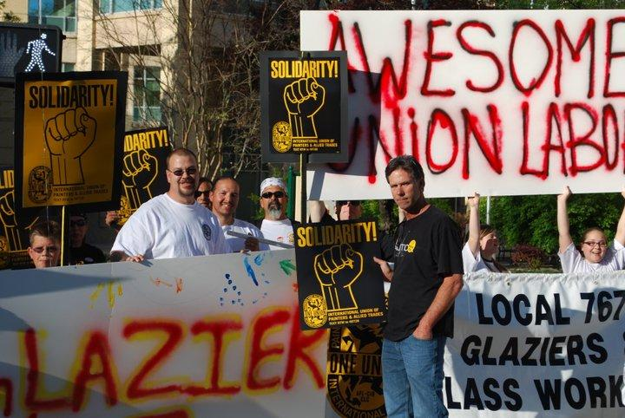
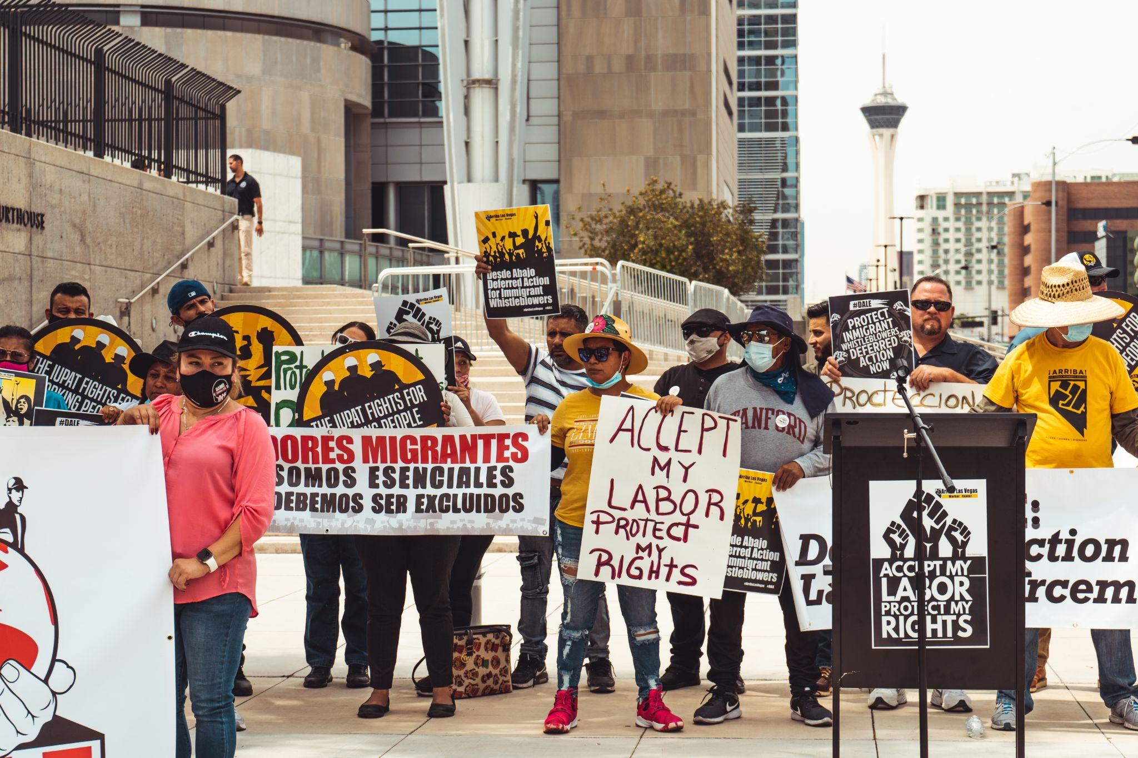
Member Engagement

Slide 2
Why is there apathy and a lack of connection between our union and our membership?
Decrease in participation
Decrease in activism
Decrease in solidarity
Decrease in union pride

Slide 3
One Union, One Family, One Fight
A member engagement campaign comprising 4 phases
Led by the IU and rolled out on a District Council basis with staff training, strategic follow up, and extensive membership tracking
Detailed plan to come
Who is involved?
EVERYONE –
not one person or one department, but a collective effort of our entire union required

Slide 4
THIS IS NON NEGOTIABLE!
This campaign is the sole focus of the IUPAT. We need everyone on board to rebuild our membership from the ground up.

Slide 5
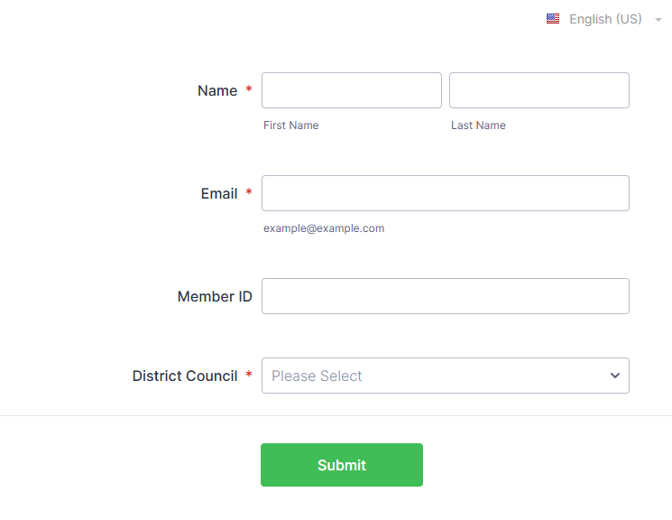
One Union, One Family, One Fight Pledge Sign Up Form

Slide 6
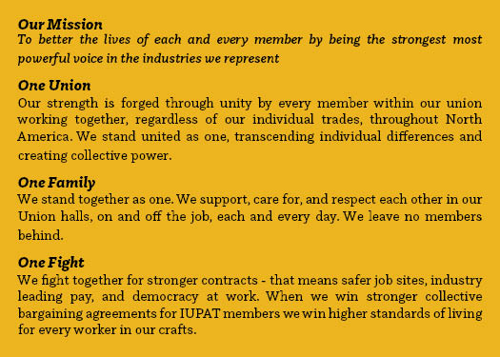
Value Statement Palm Card

Slide 7
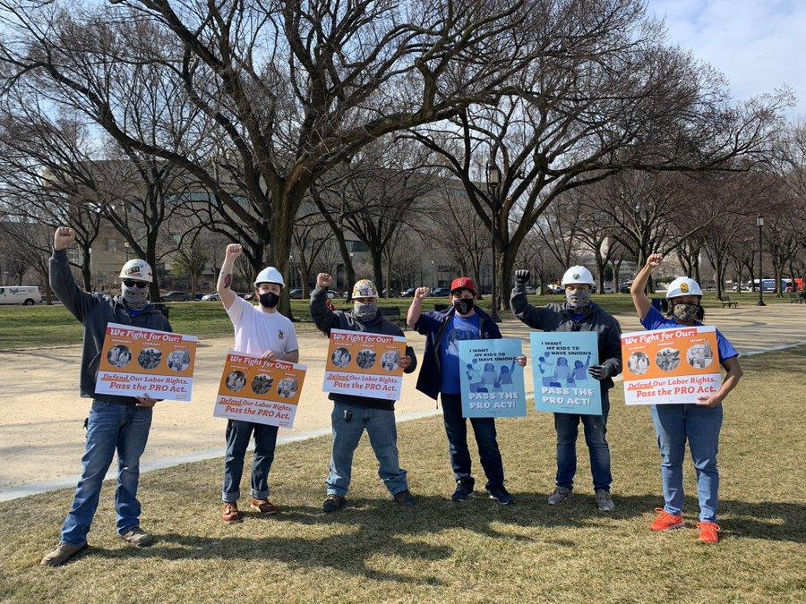
PHASE 1 - BASE BUILDING
Phase 1 is recommitting our base and educating them on the principles of the campaign.
Who is our base?
Elected Officers
Stewards
Apprentices
Activists
Delegates

Slide 8
Membership Tracking
Attendance
Steward activity
Volunteer activism
STAR Events
General Membership Meetings
Community Events
VAC / CORE Committees
Bargaining Committees
Political Action
Member Education

Slide 9
PHASE 2 - ENGAGEMENT
Phase 2 involves reaching out to the entire membership
Re-introducing yourself to the members and using the opportunity to update member records (collecting updated addresses, phone numbers, emails, etc.)
Our members must play a role!
This shouldn’t only be staff to member conversations, but also member to member

Slide 10
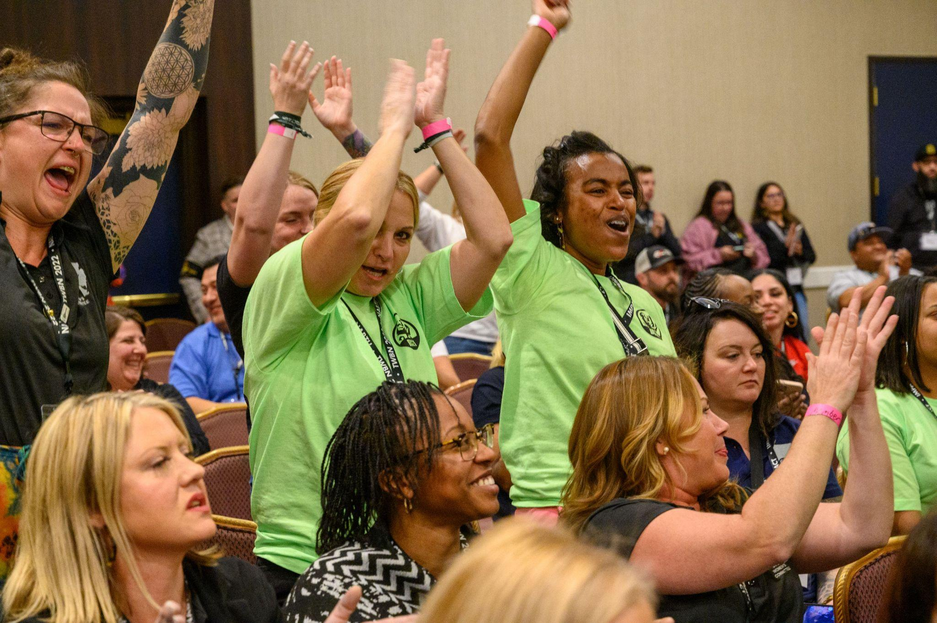
PHASE 2 - ENGAGEMENT
The strategic follow up is critical!
The strategic follow up is critical!
Push our rank and file to also sign the pledge.
These should be organizing conversations.
The IU will assist with resources and a communication plan.

Slide 11
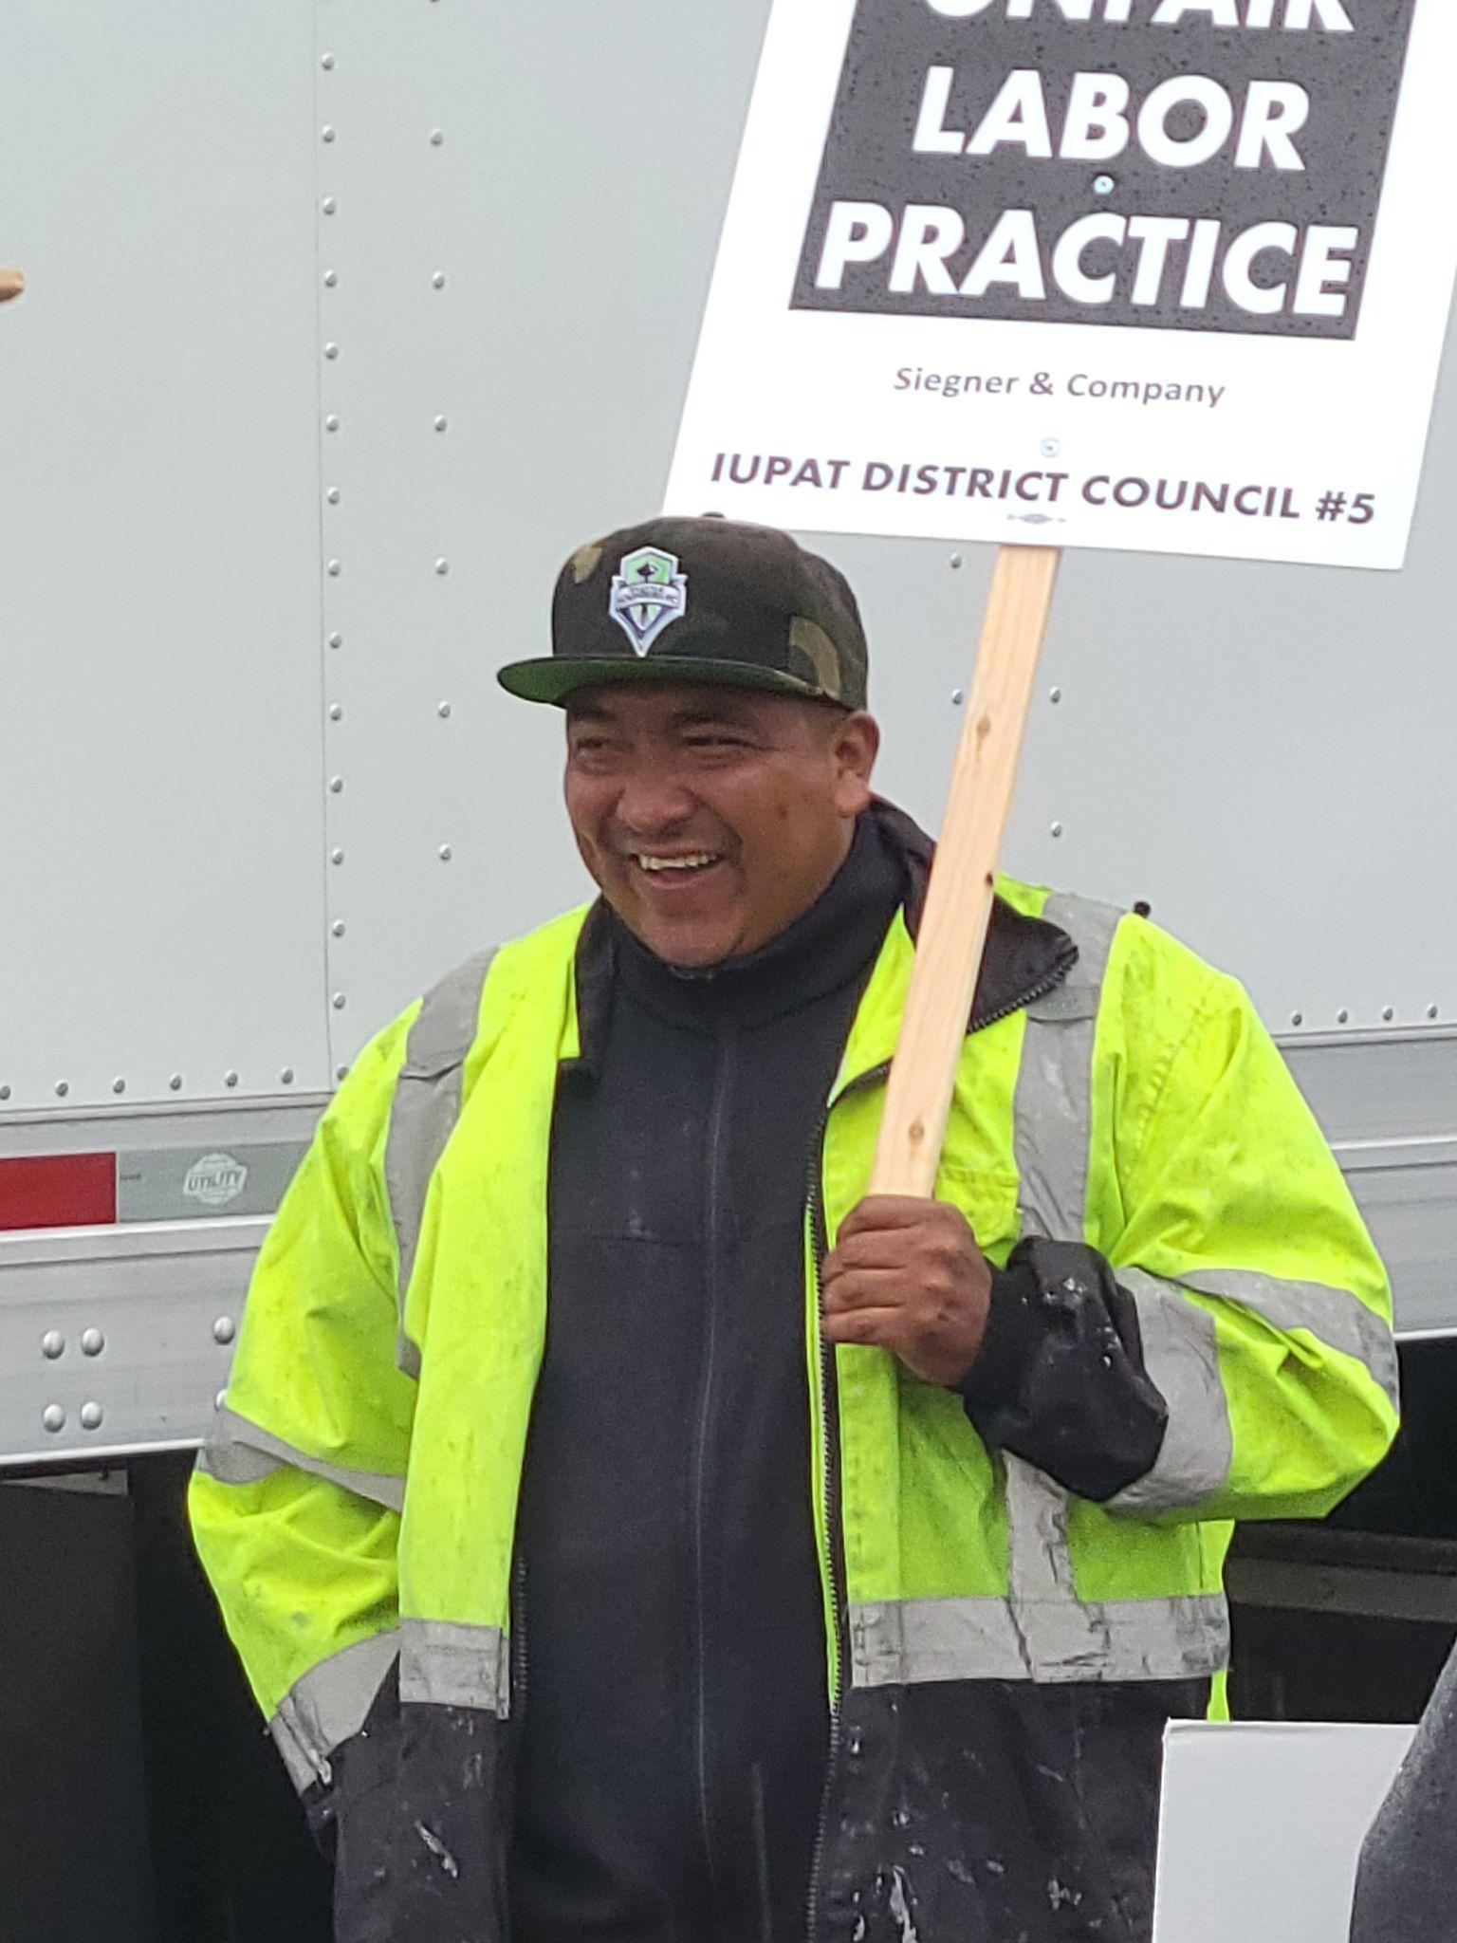
PHASE 3 - EDUCATION
Phase 3 involves organizing our newly activated members around issues that are important to them.
This means…
Active committees (organizing, political, CORE, etc)
Participatory bargaining committees (with rank and file!)
Active stewards programs
Active INVOLVEMENT!

Slide 12
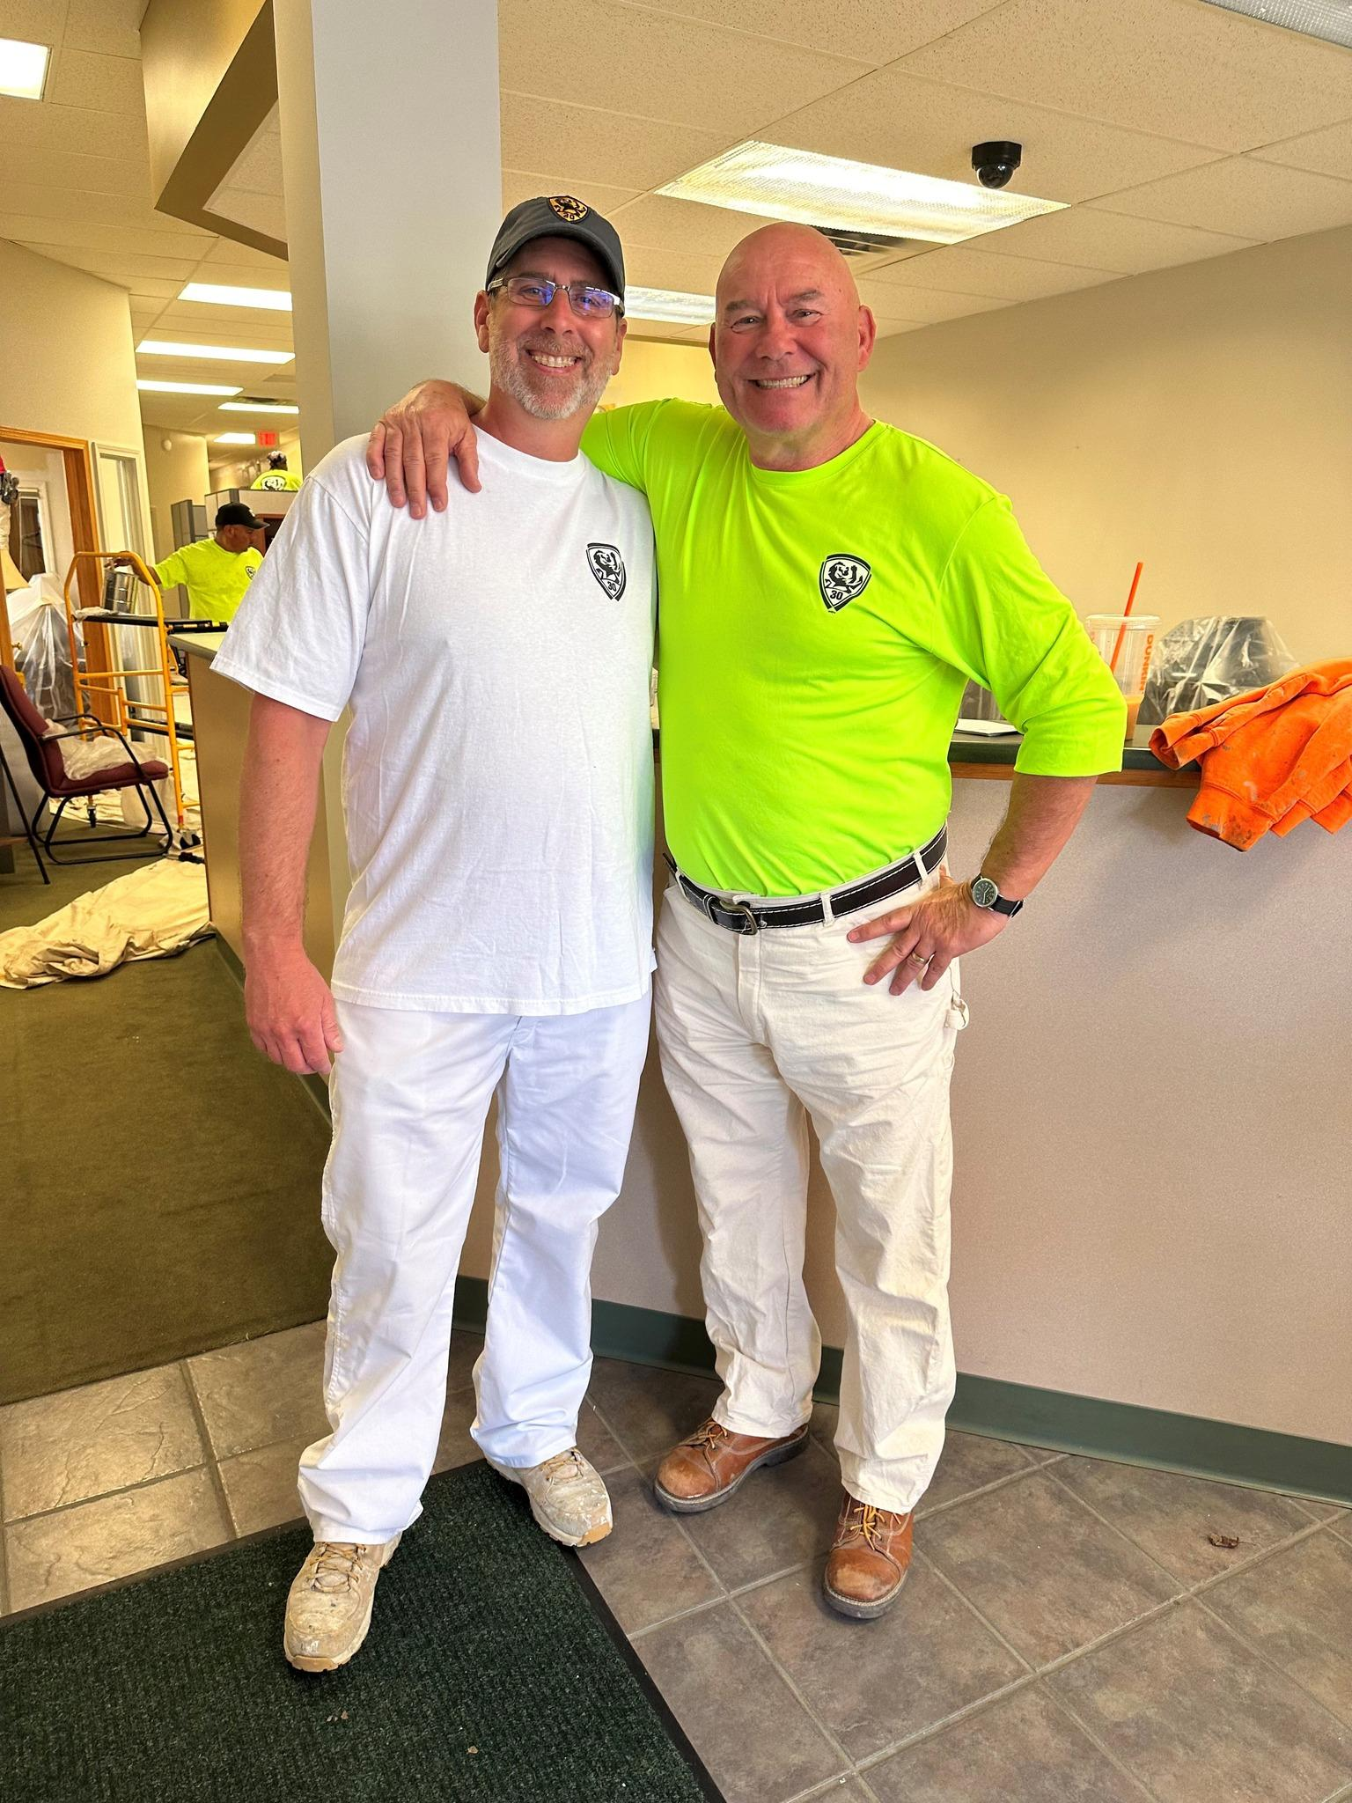
PHASE 4 - BUILDING POWER
What does building power look like?
Stronger Collective Bargaining Agreements!
Organizing Wins!
Policy & Legislative Wins!
& UNION PRIDE!

Slide 13
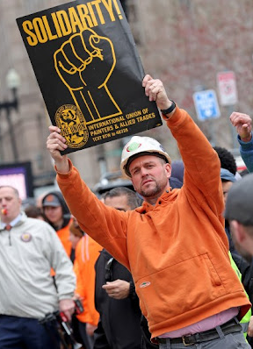
IN SOLIDARITY,

