Slide 1
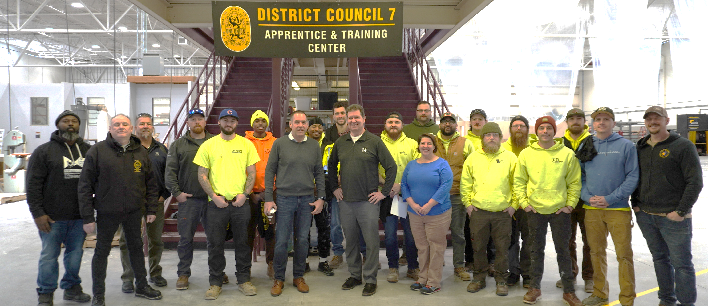
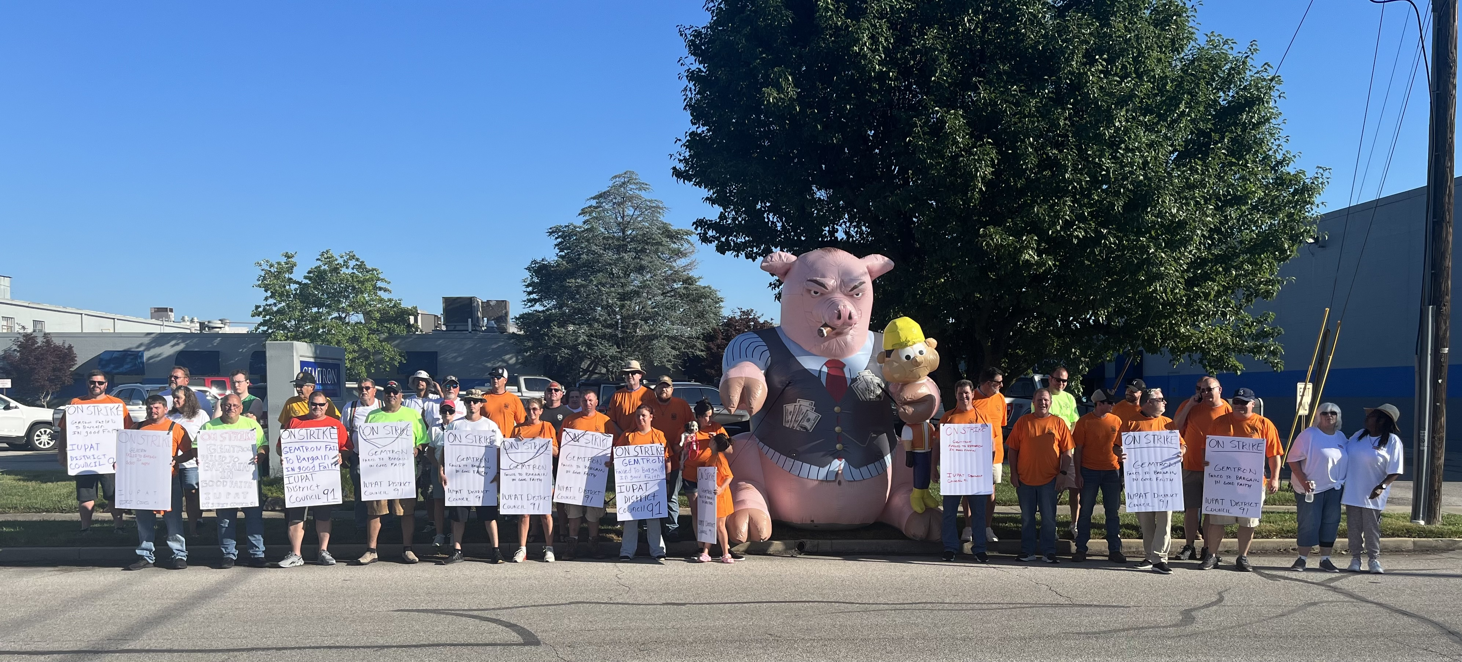
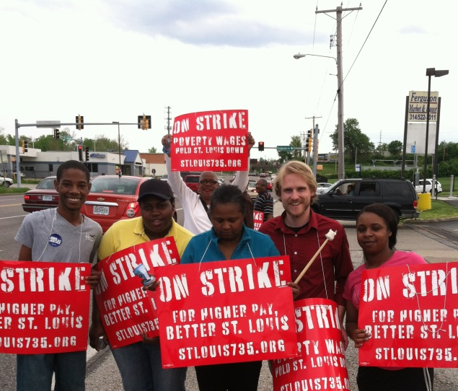
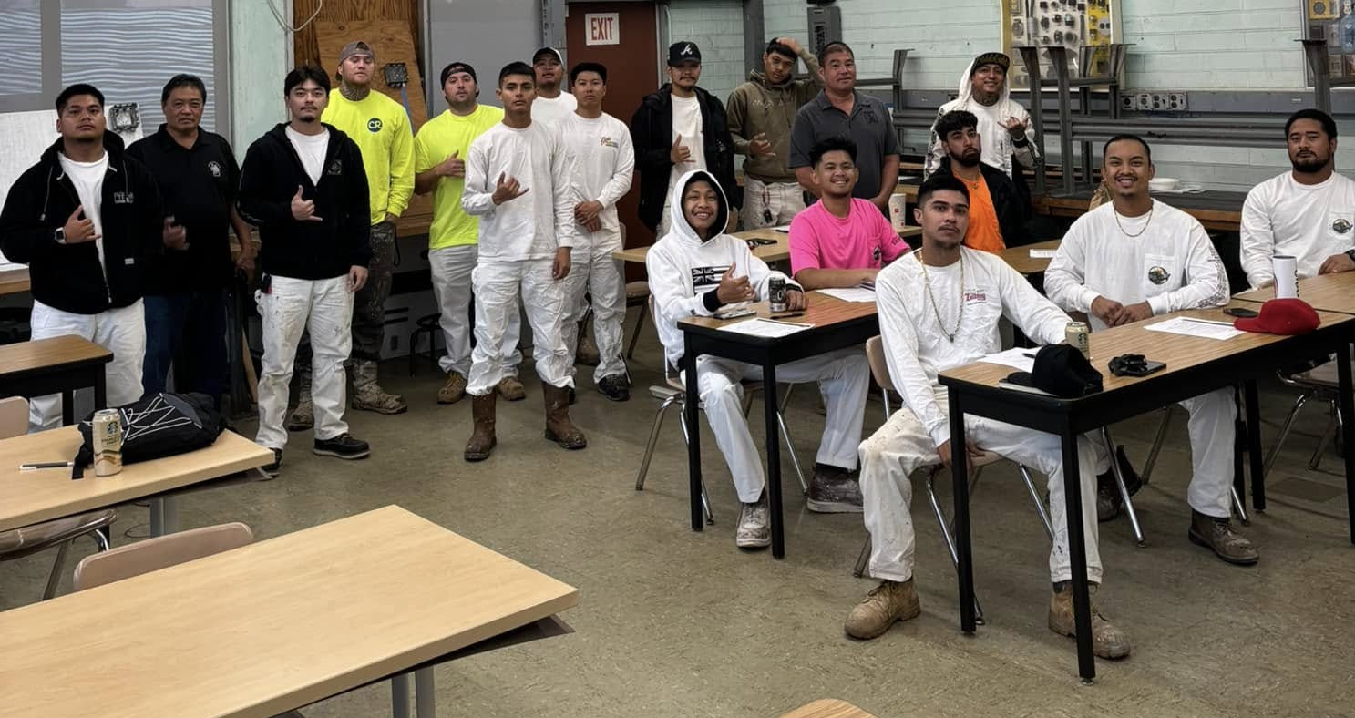
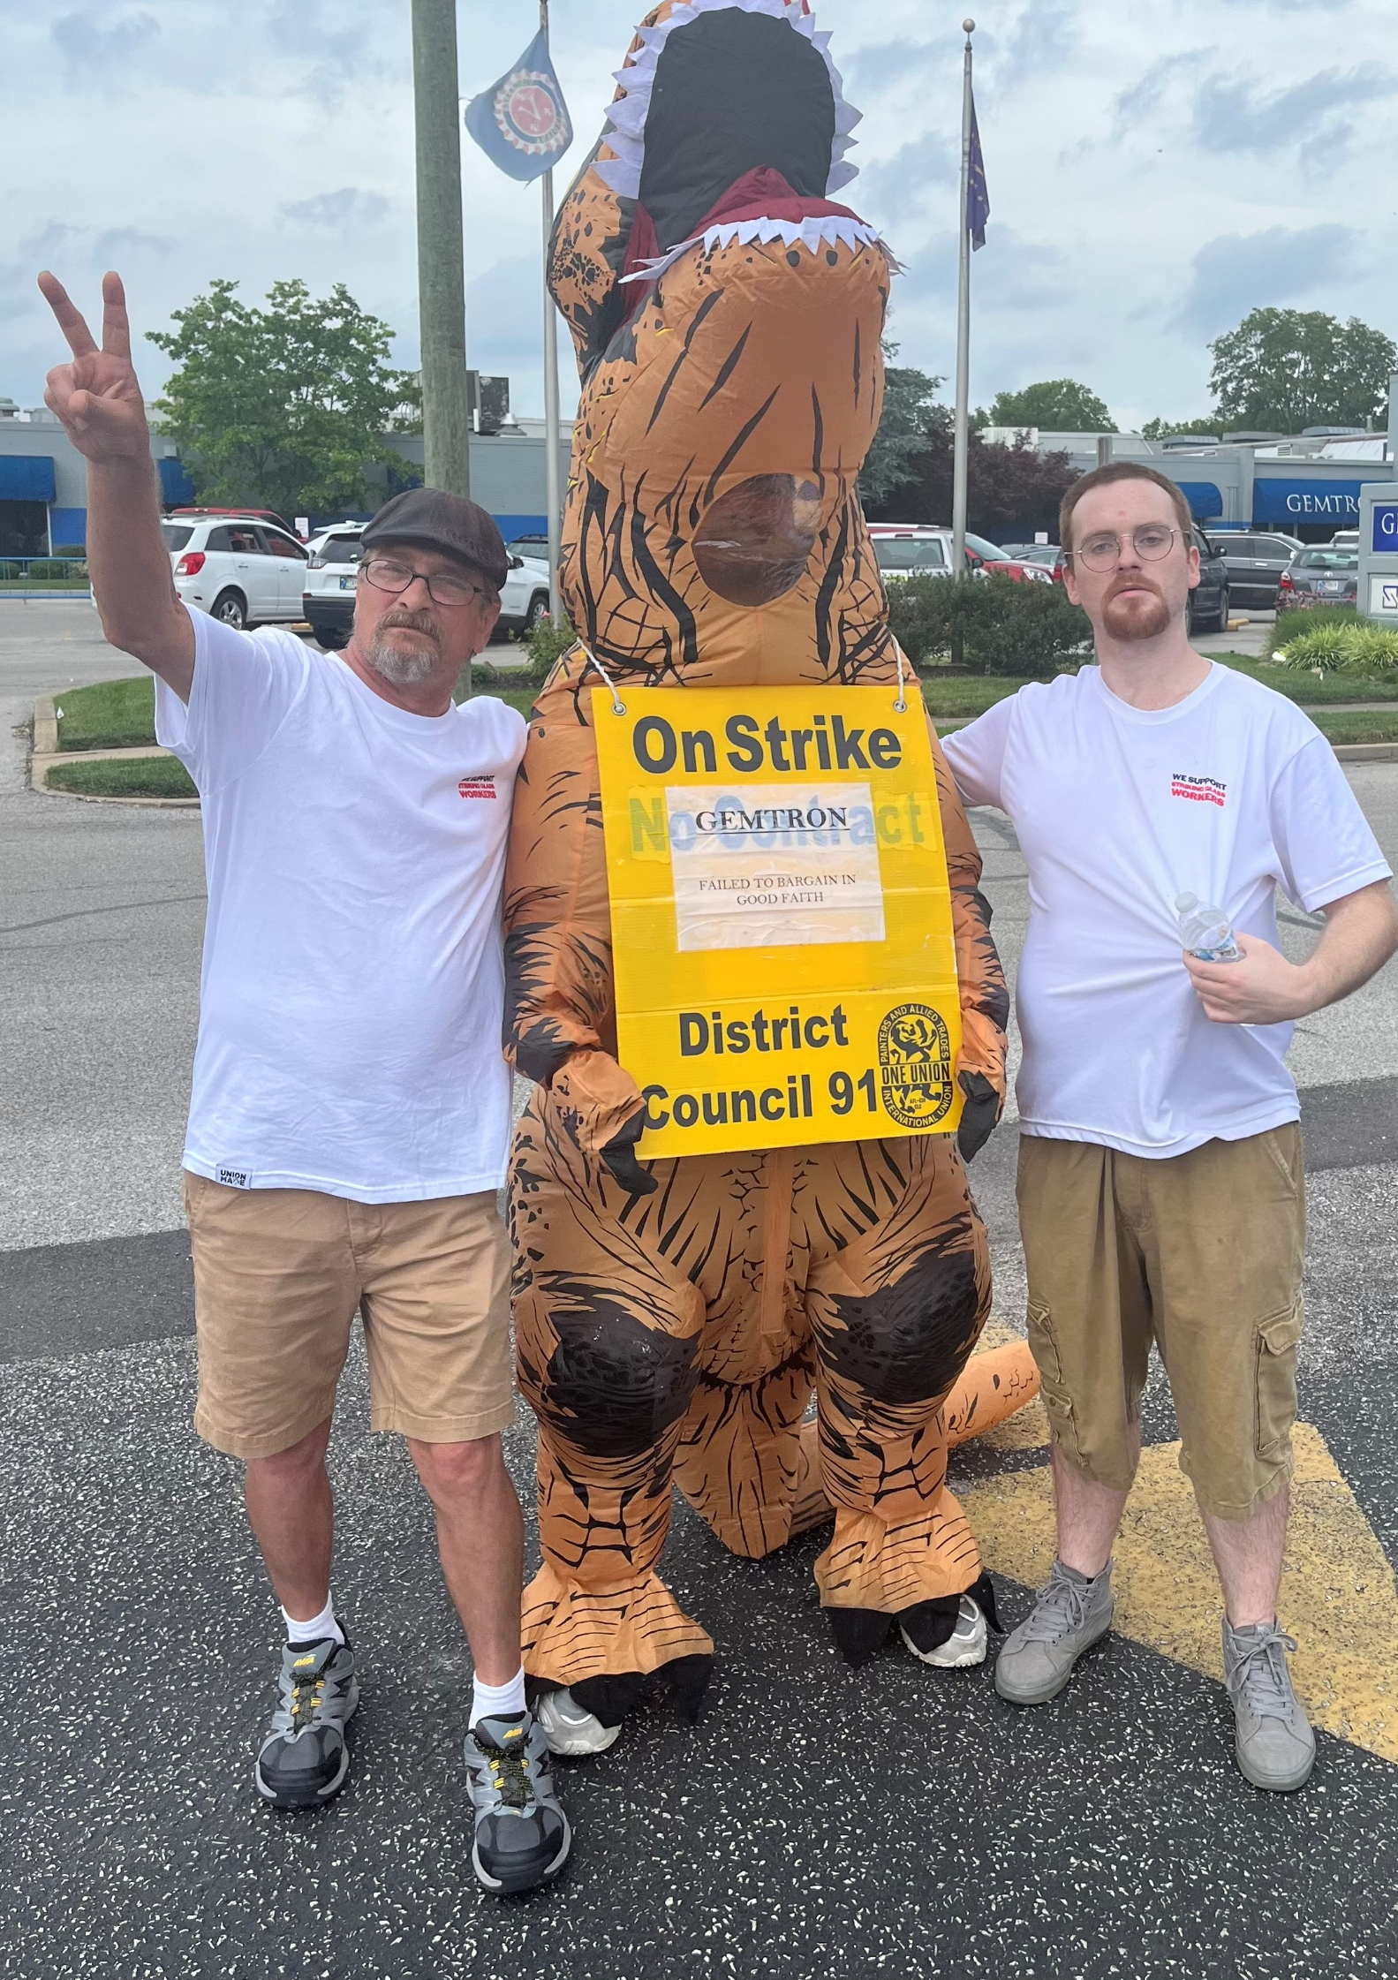
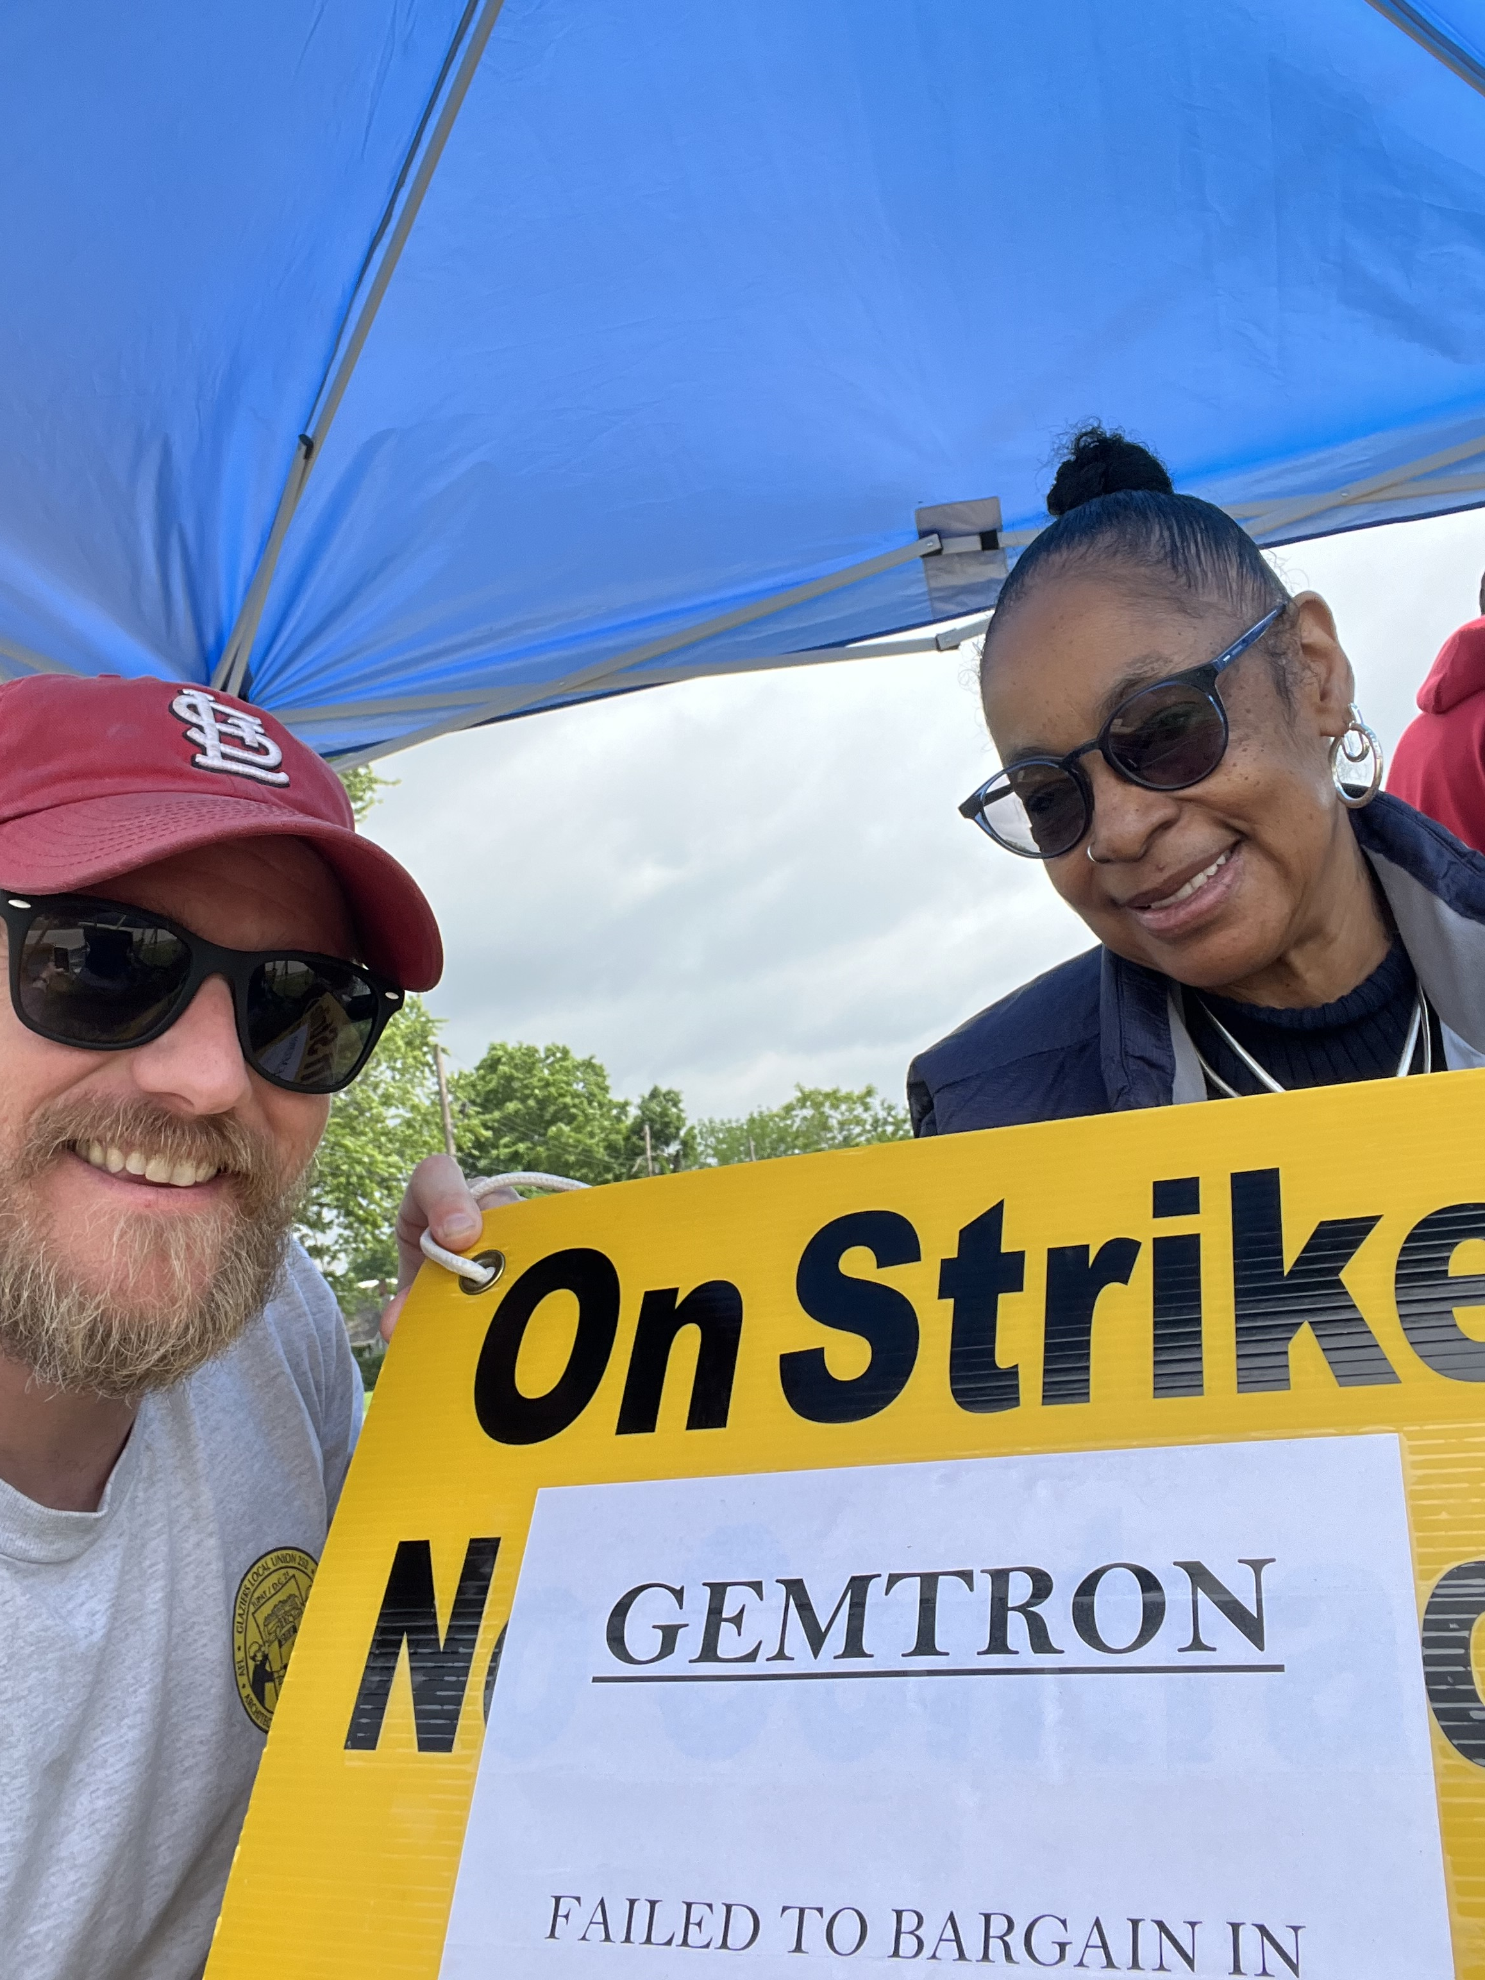
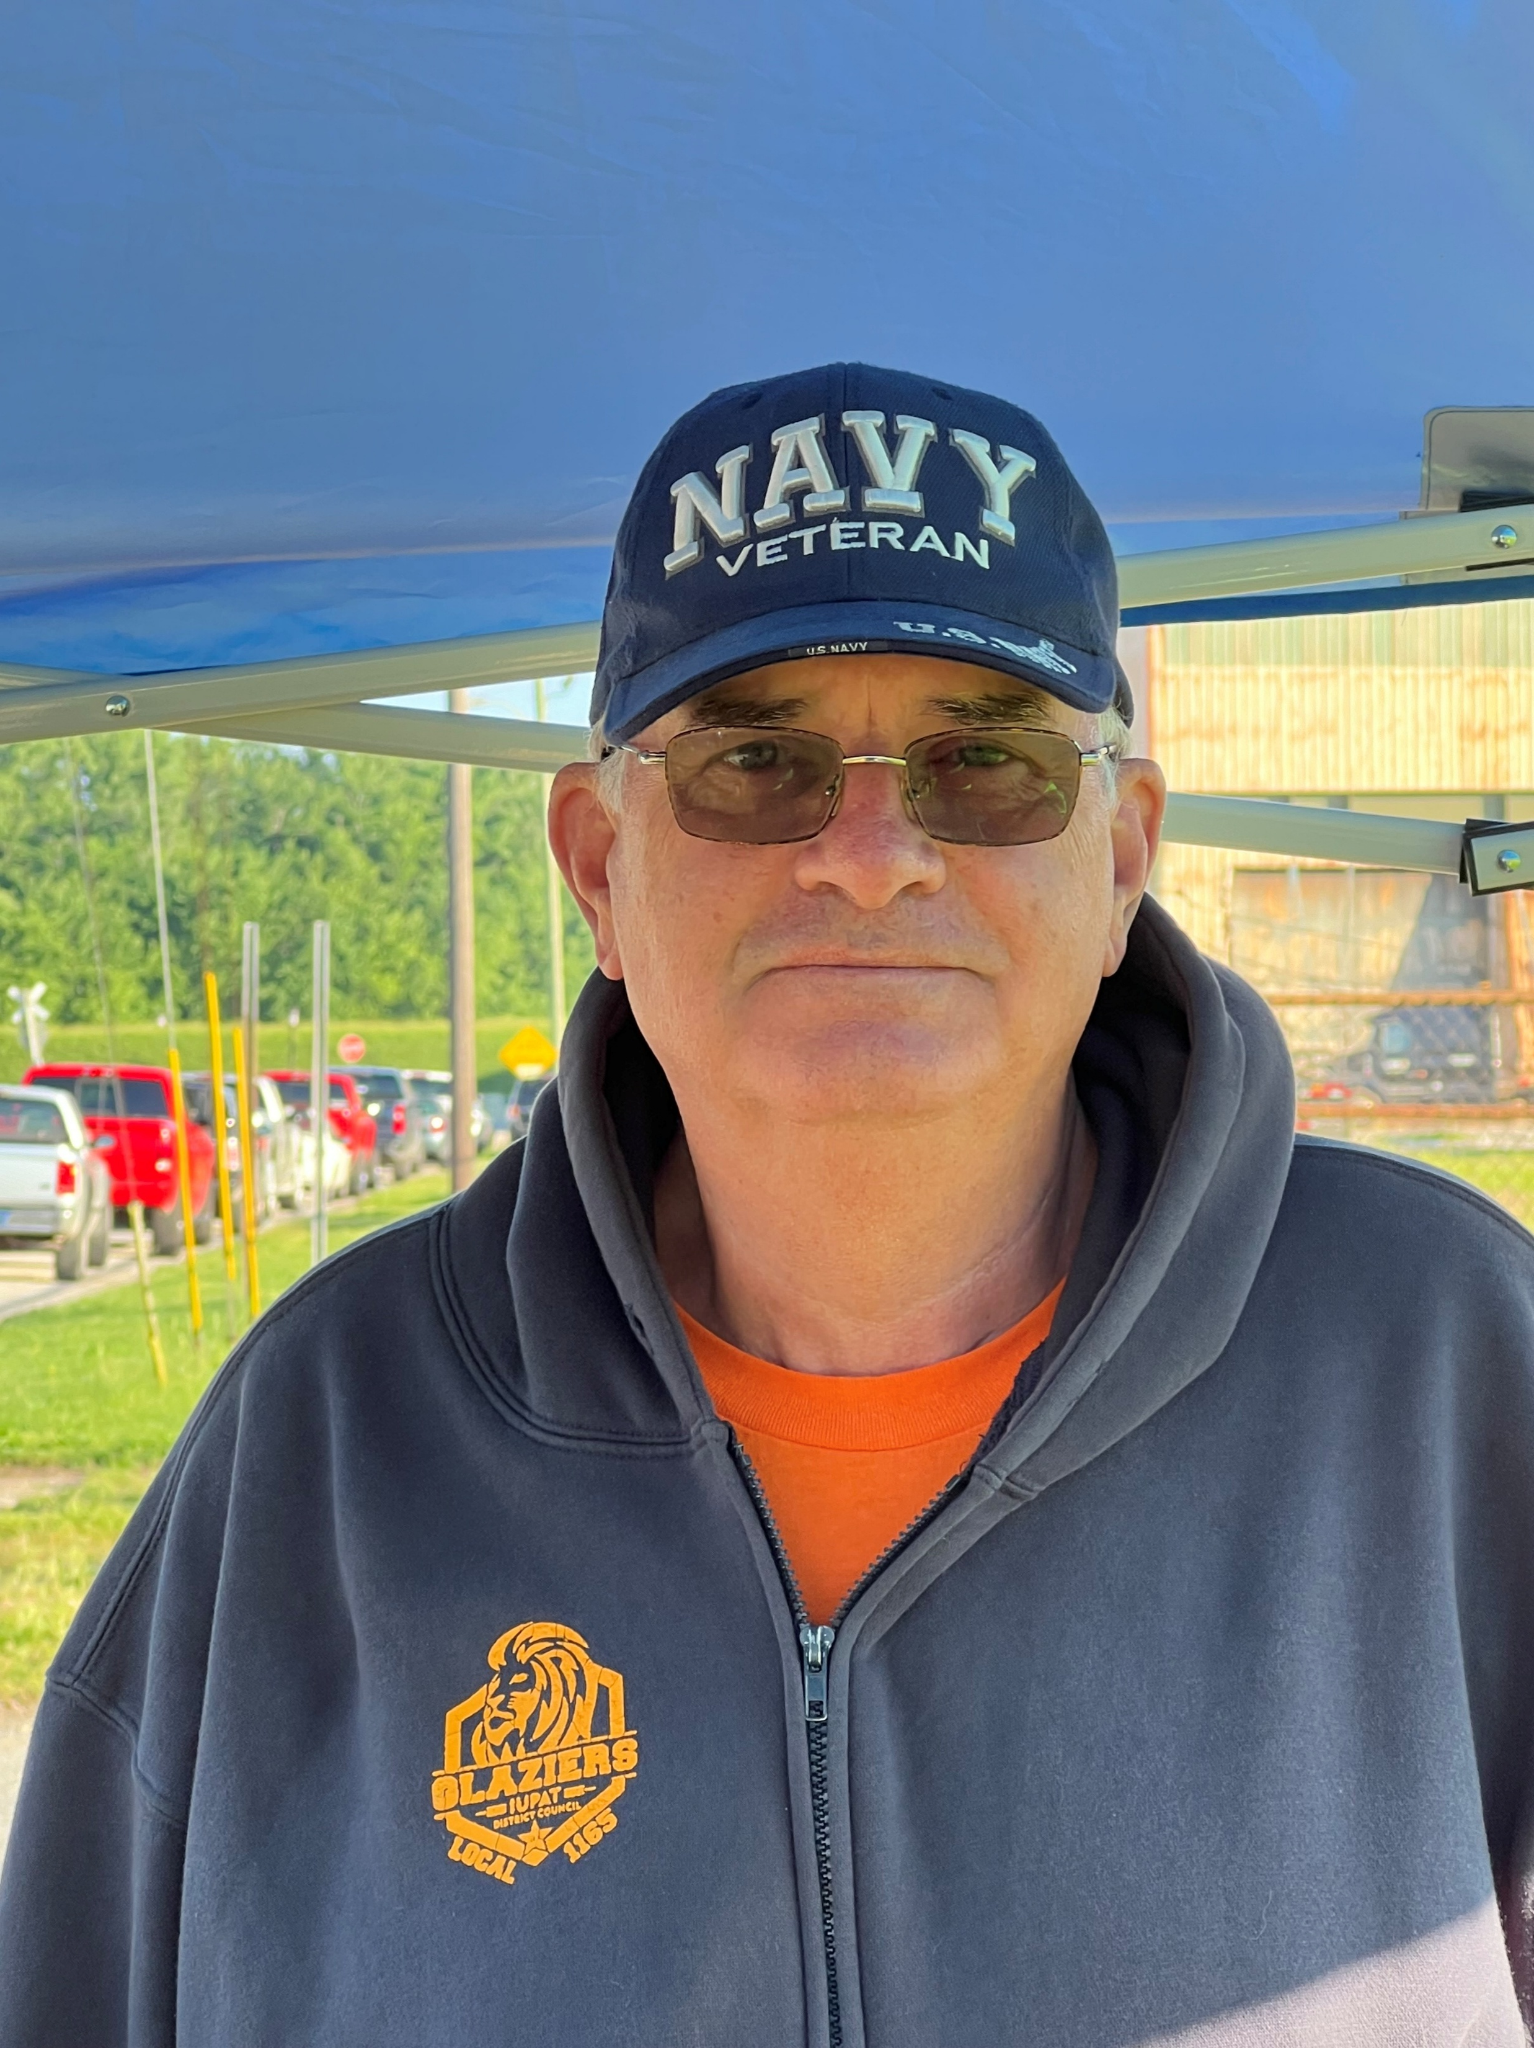
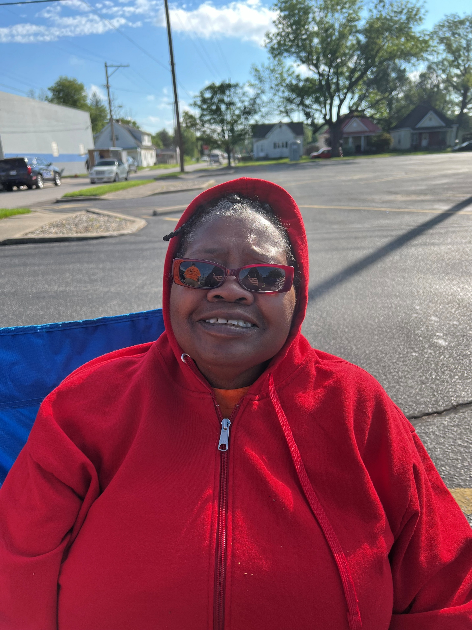



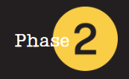
COR 1274 Internal Organizing - Member
One Union One Family One Fight!
Notes:
FACILITATOR NOTES:
PREPARE the course materials and equipment to present this course effectively.
Course Materials and Equipment:
PowerPoint Presentation - Instructor Computer, Internet Connection, TV/Projector
Handouts – Value Statement
Case Studies/Simulations
Flip Chart(s) / Markers (at least three colors) for brainstorming or group activities
Name Tents/Tags
MAKE the necessary modifications when appropriate.
CHECK room setup. Is the room arranged in a way that is comfortable to the participants and conducive to learning? If possible, a U-shaped table and chair set-up should be used. A U-shape allows participants to interact with one another and the instructor.

Slide 2



Introduction
COR 1274 Internal Organizing - Member
Notes:
FACILITATOR NOTES:
ASK participants to answer the questions (1 minute):
Who You Are
What inspired you to join the campaign?
START the exercise with your answer.
Instructor: Should start by telling their story. When did you realize the power of the union? Who inspired you, and what got you to this point?
Co-Facilitator: Take quick notes on each member’s name/why to be used later.

Slide 3
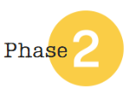
Course Description
IUPAT Internal Organizing Training
Internal Union Organizing training strengthens union membership and builds POWER within the workplace, Local Union, or District Council. This course covers practical strategies to build strong relationships, foster participation, and engage members through structured conversations and active listening.
The training emphasizes the importance of one-on-one engagement, overcoming objections, and fostering solidarity among members.
COR 1274 Internal Organizing - Member
Notes:
FACILITATOR NOTES:
EXPLAIN the course description.
ASK 2 participants what participation in the union looks like to them. Have the co-facilitator keep track of the time to make sure we go no longer than 5 minutes on the questions

Slide 4
Learning Outcomes
Create a workplace environment where union membership thrives and union power grows.
Strengthen relationships, foster active participation, and build solidarity.
Use structured conversations and develop strategies to boost engagement.
Apply active listening to address concerns and drive meaningful dialogue.
Develop impactful campaigns to grow membership, enhance bargaining power, and extend union influence.
Connect with members in various settings, such as job sites and home visits, to build union support.
COR 1274 Internal Organizing - Member
Notes:
FACILITATOR NOTES:
STATE the learning outcomes.

Slide 5

Course Topics
1
2
3
4
5
Internal Organizing: Basic Concepts
Initial Assessment Exercise
Getting Started: Internal Organizing Campaign
Structured Conversations
Active Listening Skills
COR 1274 Internal Organizing - Member
Notes:
FACILITATOR NOTES:
STATE that there are 5 topics in the course.

Slide 6

Internal Organizing:
Basic Concepts
01
®
iFTI.edu
Notes:
FACILITATOR NOTES:
EXPLAIN the basic concepts of internal organizing. To build a union culture, remember your why and what a union is or isn’t.

Slide 7
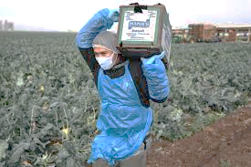
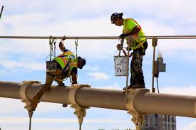
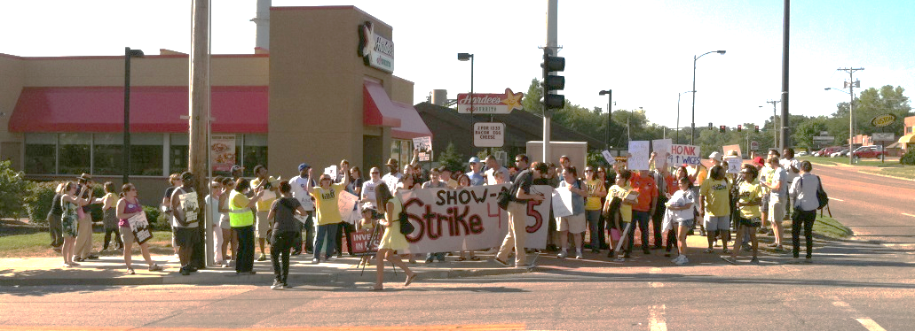
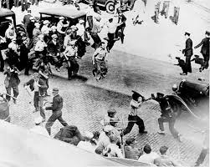
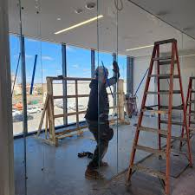
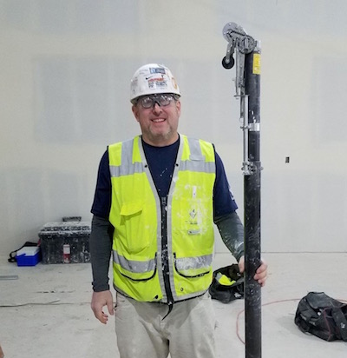
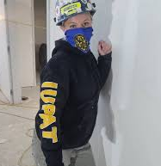
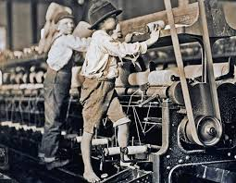
Remember Your ‘Why’
COR 1274 Internal Organizing - Member
Notes:
FACILITATOR NOTES:
REVIEW the whys from the participants’ introduction. Pinpoint a few people and say you told me why this is.
EMPHASIZE that it is important to remember your why when conversations get hard.

Slide 8
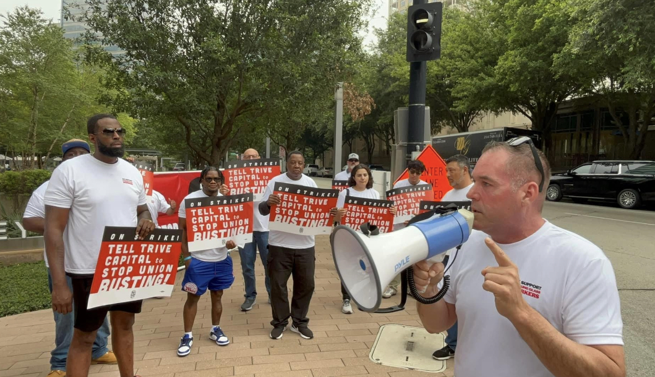
Internal Organizing: Basic Concepts
Commit to building a strong Union Culture across your District Council.
COR 1274 Internal Organizing - Member
Notes:
FACILITATOR NOTES:
REMIND people about the union and the culture we are trying to build. (Found on Phase 1 Culture talking points)
ASK 3 to 4 participants what union culture is to them.
Facilitate the Commitment Round (5-10 minutes, depending on group size):
Go around the room and invite each person to respond.
Use names whenever possible to personalize the interaction.
ASK – “Are you committed to building union culture in your Local and District Council?” Go first to set the tone. Example: "I’m [Facilitator Name], and I am committed to building a strong, inclusive union culture in my Local and District Council.“
Wrap-Up: Acknowledge the courage and unity in the room. Reinforce the importance of collective commitment: "Your voices today reflect a shared promise to lead and uplift our union culture. This is how movements grow—together."

Slide 9
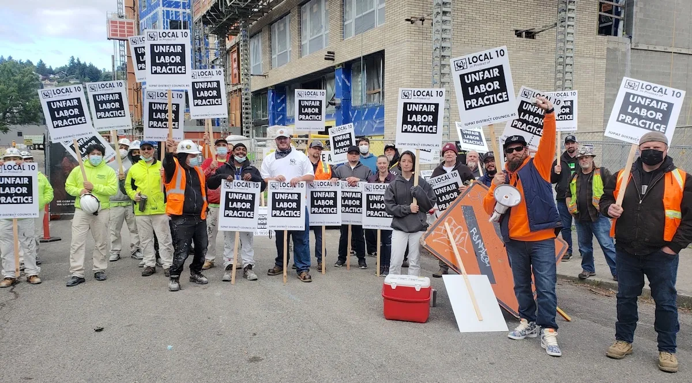
Remember What A Union Is
A Union is a group of workers acting together for mutual aid and protection.
COR 1274 Internal Organizing - Member
Notes:
FACILITATOR NOTES:
ASK – What is a union? A union is an organization of workers formed to collectively negotiate with employers over wages, benefits, and working conditions, giving employees a stronger voice and bargaining power in the workplace.

Slide 10
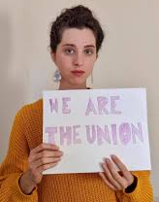
Remember What A Union Isn’t
A Union is not an employment agency.
A Union is not a third party.
A Union is not a social service.
COR 1274 Internal Organizing - Member
Notes:
FACILITATOR NOTES:
STATE that a union is not:
A third party; it's an organization formed by workers to collectively advocate for their interests, and it's comprised of the workers themselves, not an external entity.
An employment agency. While unions can sometimes facilitate job placement through hiring halls, their primary function is to represent workers and negotiate with employers regarding wages, benefits, and working conditions, not to act as employment agencies.
A social service. While unions can offer benefits that indirectly improve social well-being, their primary function is to advocate for and negotiate the terms of employment for their members, not to provide social services directly.
REMIND members about our values and draw on them to explain how we are not a third party.

Slide 11

Internal Organizing: Basic Concepts
COR 1274 Internal Organizing - Member
Notes:
FACILITATOR NOTES:
ASK the group if they are willing to commit to the basic concepts. Is it always talking to a fellow member about issues with the collective bargaining agreement or a grievance?
EMPHASIZE that we have to be okay with being uncomfortable and put ourselves in the proper headspace to have the right conversations.

Slide 12
Internal Organizing:
Initial Assessment Exercise
02
®
iFTI.edu
Notes:
FACILITATOR NOTES:
DISCUSS the slides asking how members view the Union and how members experience the Union.

Slide 13

How do YOU view our Union?
As a Representative?
As a Dues Collector?
As part of a Movement?
WHY?
COR 1274 Internal Organizing - Member
Notes:
FACILITATOR NOTES:
CONDUCT a group activity:
Divide into groups of 3 (groups pre-selected by the facilitator(s) and director(s)).
Each group is given 6 flipchart pages with the headings Representative, Dues Collector, and Movement for the first part of the exercise, and Negative, Transactional, and Inspirational for the second part.
PART 1: STATE that the groups have 25 minutes to chart why members would view the Union as Representative, why members would view the Union as a Dues Collector, and why members would view the Union as part of a Movement.
DEBRIEF the participants and give each group 5-7 minutes to present what they came up with, and lead a discussion about how members view the Union.
ASK if anyone has been a part of another organization and what their experience was like.

Slide 14
How do YOU experience our Union?
In a Negative sense?
In a Transactional sense?
In an Inspirational sense?
WHY?
COR 1274 Internal Organizing - Member
Notes:
FACILITATOR NOTES:
CONDUCT a group activity:
Divide into groups of 3 (groups pre-selected by the facilitator(s) and director(s)).
Each group is given 6 flipchart pages with the headings Representative, Dues Collector, and Movement for the first part of the exercise and Negative, Transactional, and Inspirational for the second part of the exercise.
Part 2: EXPLAIN that the same groups are given 25 minutes to chart Negative experiences members might have with the Union, Transactional experiences members might have with the Union, and Inspirational experiences members might have with the Union.
EXPLAIN that a transactional conversation focuses on a specific task or information exchange, while a transformative conversation aims to inspire, build relationships, and foster deeper connections, often leading to personal or organizational growth.
DEBRIEF the participants and give each group 5-7 minutes to present what they came up with and lead a discussion about different experiences members have with the Union. This is about how they feel about the union.
ASK the following questions:
How does it feel to be sitting in the room with your fellow members, having this conversation?
How is this conversation different from past experiences?
How many of you have had similar experiences?

Slide 15
Getting Started:
Internal Organizing Campaign
03
®
iFTI.edu
Notes:
FACILITATOR NOTES:
ASK - Why should we run an Internal Organizing Campaign?
DISCUSS how internal organizing might help grow both our membership numbers and, more importantly, our overall POWER.

Slide 16
Why should we run an Internal Organizing Campaign?
Engaging and activating members around internal power-building initiatives is essential to winning better contracts and increasing market share.
An active and engaged membership can be plugged into external organizing campaigns that bring in new members and improve overall conditions, and increase worker POWER in the construction industry and other IUPAT-represented workplaces.
Engaged membership expands capacity to increase Power-Base by engaging the broader communities in which they live in contract campaigns.
Rank-and-file union members are the best communicators of the worker narrative that builds support for pro-union policies and worker POWER building initiatives among the general public.
COR 1274 Internal Organizing - Member
Notes:
FACILITATOR NOTES:
DISCUSS how internal organizing helps grow both our membership numbers and, more importantly, our overall POWER. Use the answers they give to reinforce the topics on the slide.
ASK the following questions:
How many of you have wondered why organizers are not adding contractors? How could internal organizing help thieves?
How many of you have been unhappy with contract negotiations? How could internal organizing help this?

Slide 17



Meet Workers Where They’re At
One-on-One Conversations
Jobsites
House Calls
COR 1274 Internal Organizing - Member
Notes:
FACILITATOR NOTES:
STATE that Internal organizing starts with one-on-one conversations with union members and potential union members.
EMPHASIZE that we must meet workers where they’re at, what that means, and how to do it.
Jobsites- we must be present at the jobsites or workplace. Visibility matters!
House Calls- we must meet members/workers where they live. There’s no way around it.
SHARE experiences with meeting workers where they’re at and how it has driven real-life campaigns.
DEMONSTRATE why meeting people where they are is important. Start by walking across the room slowly, as if someone is approaching you.
Say, "Imagine someone has made the effort to come over to me — they’re interested, open, maybe even a little nervous. Now, I have a choice: do I wait for them to make the next move, or do I step forward and meet them where they are?
Pause, then walk toward a different person who hasn’t moved. Say, "Now watch what happens when I walk up to someone who hasn’t shown interest. Do they want to engage? Are they ready? Maybe not.
End with this reflection: "Meeting people where they are means recognizing readiness, emotion, and openness. It’s not about convenience — it’s about connection."
ASK the following questions:
How many of you have ever had a representative house call? What was that like? How did you feel?
How many of you would appreciate a union representative coming to your home to get your input?

Slide 18
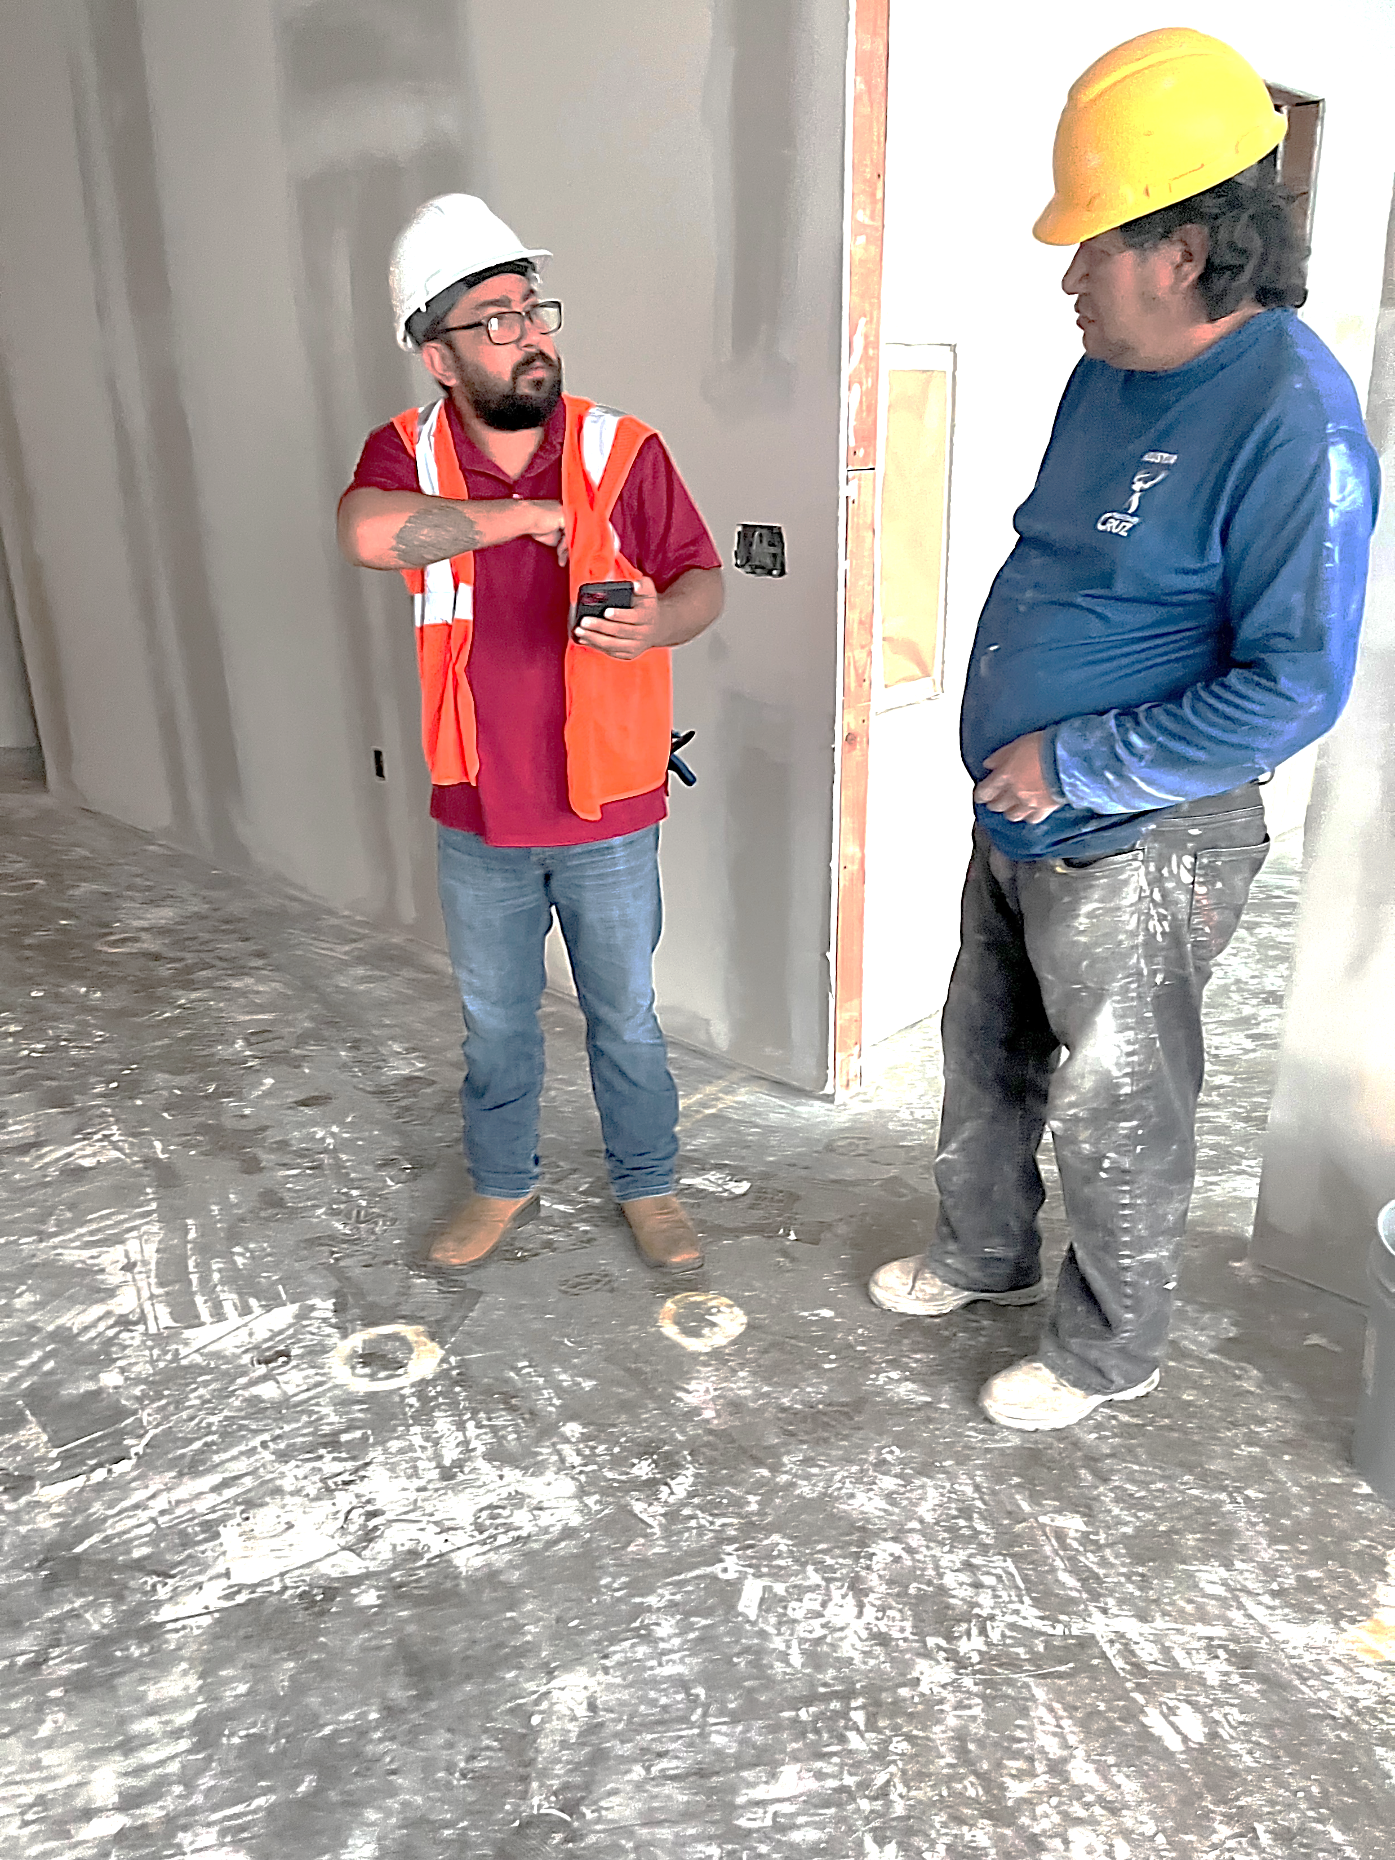
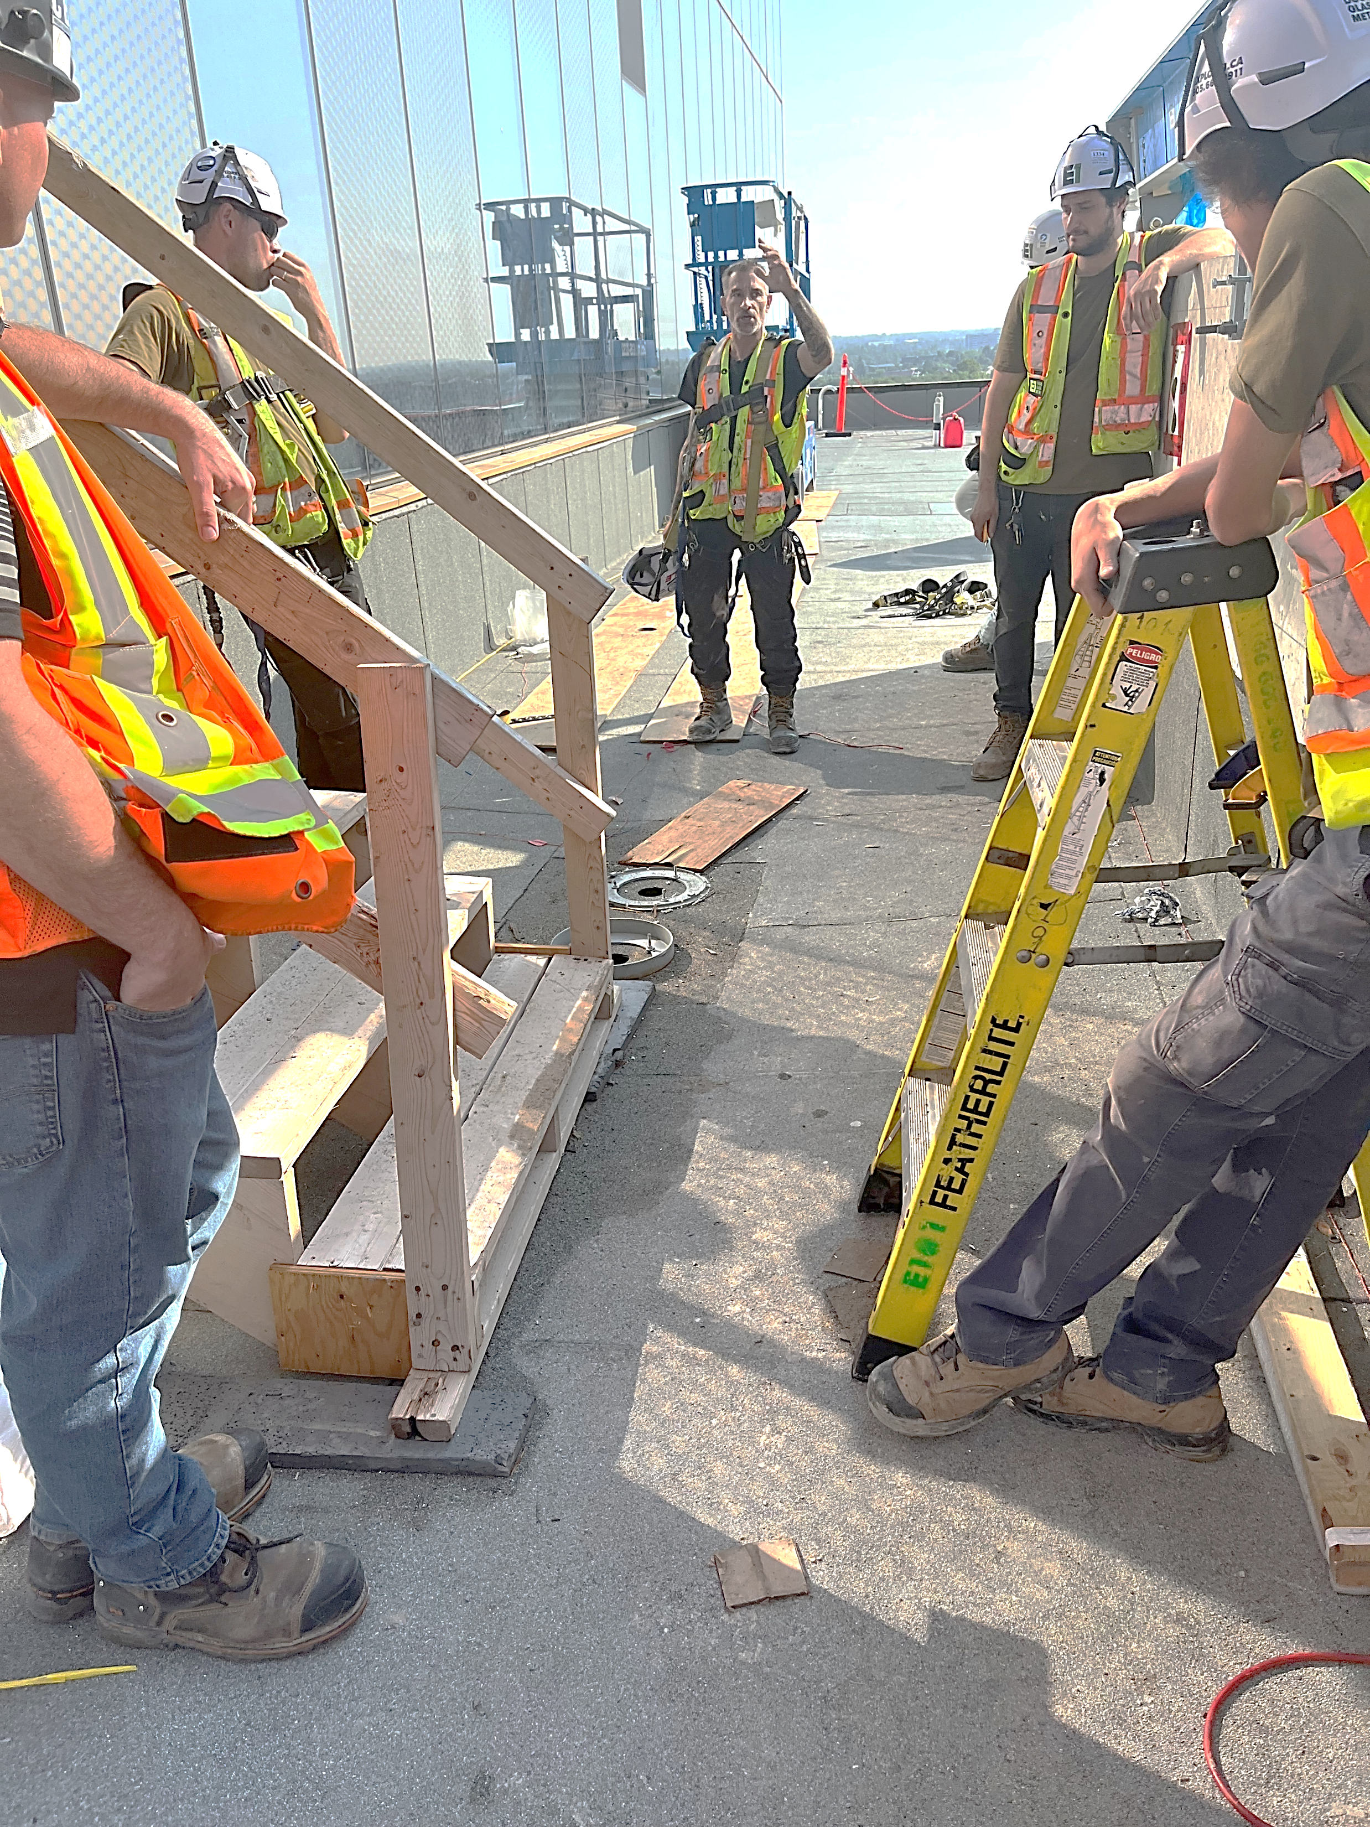
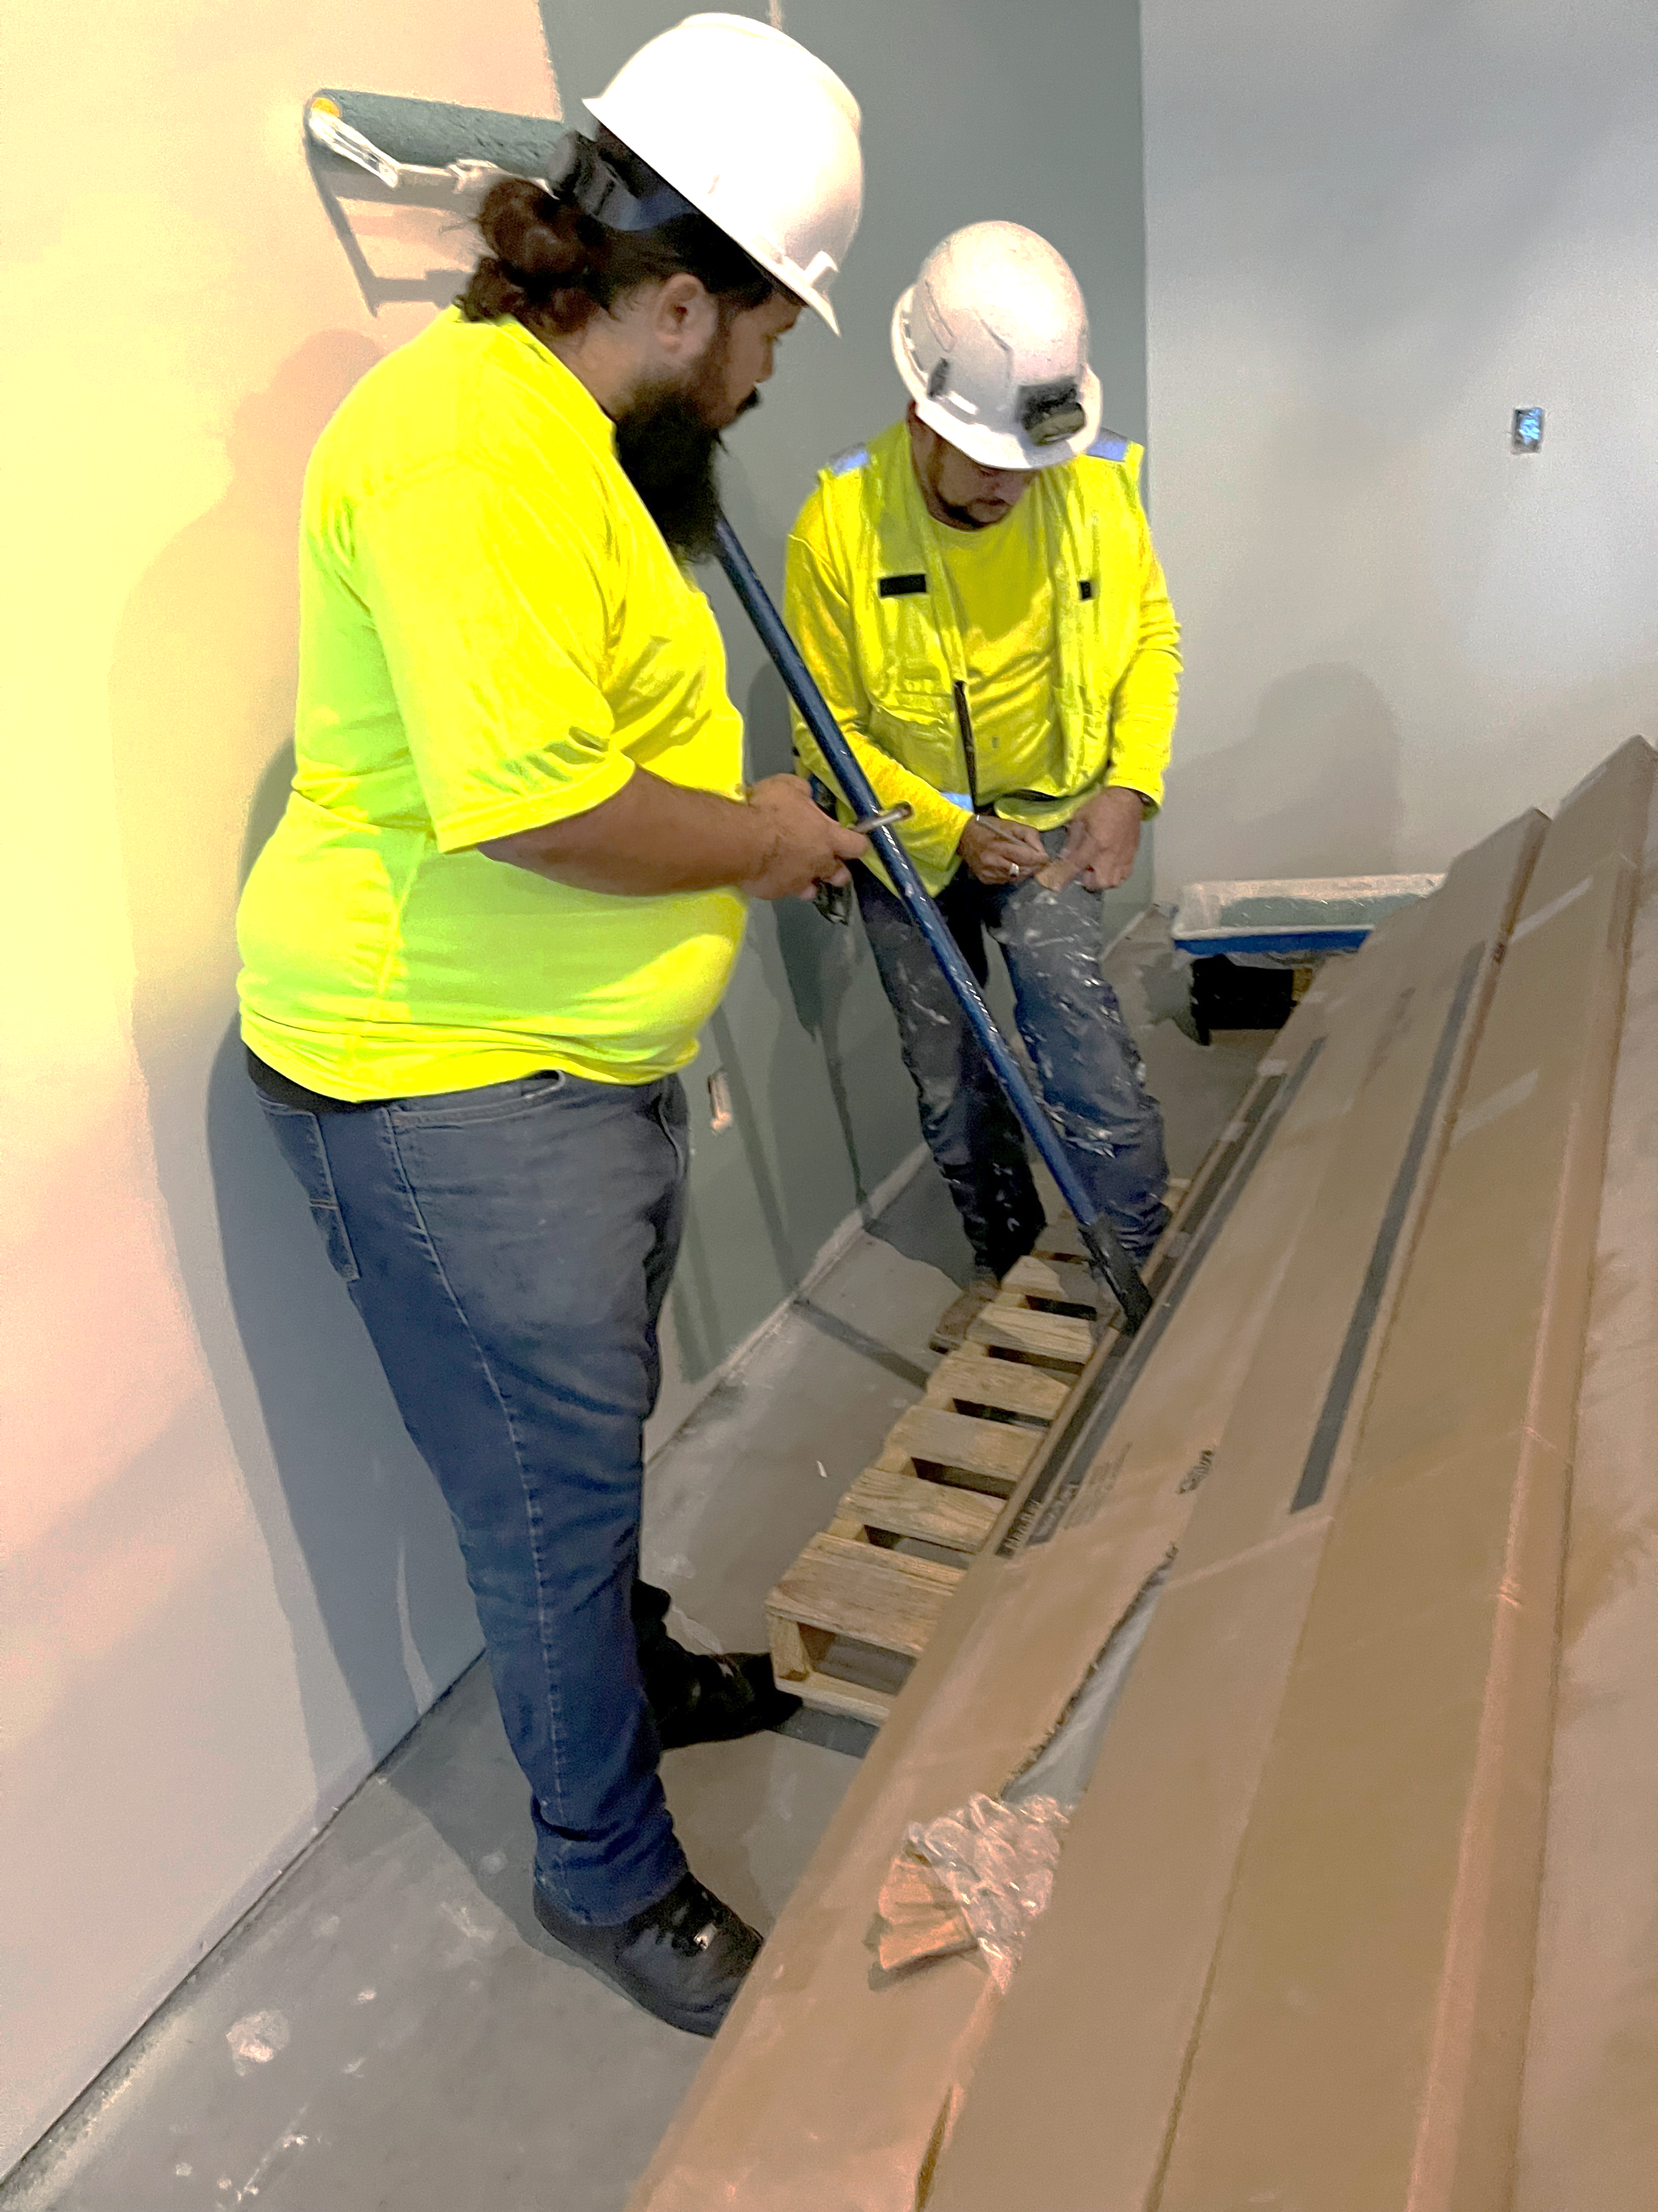
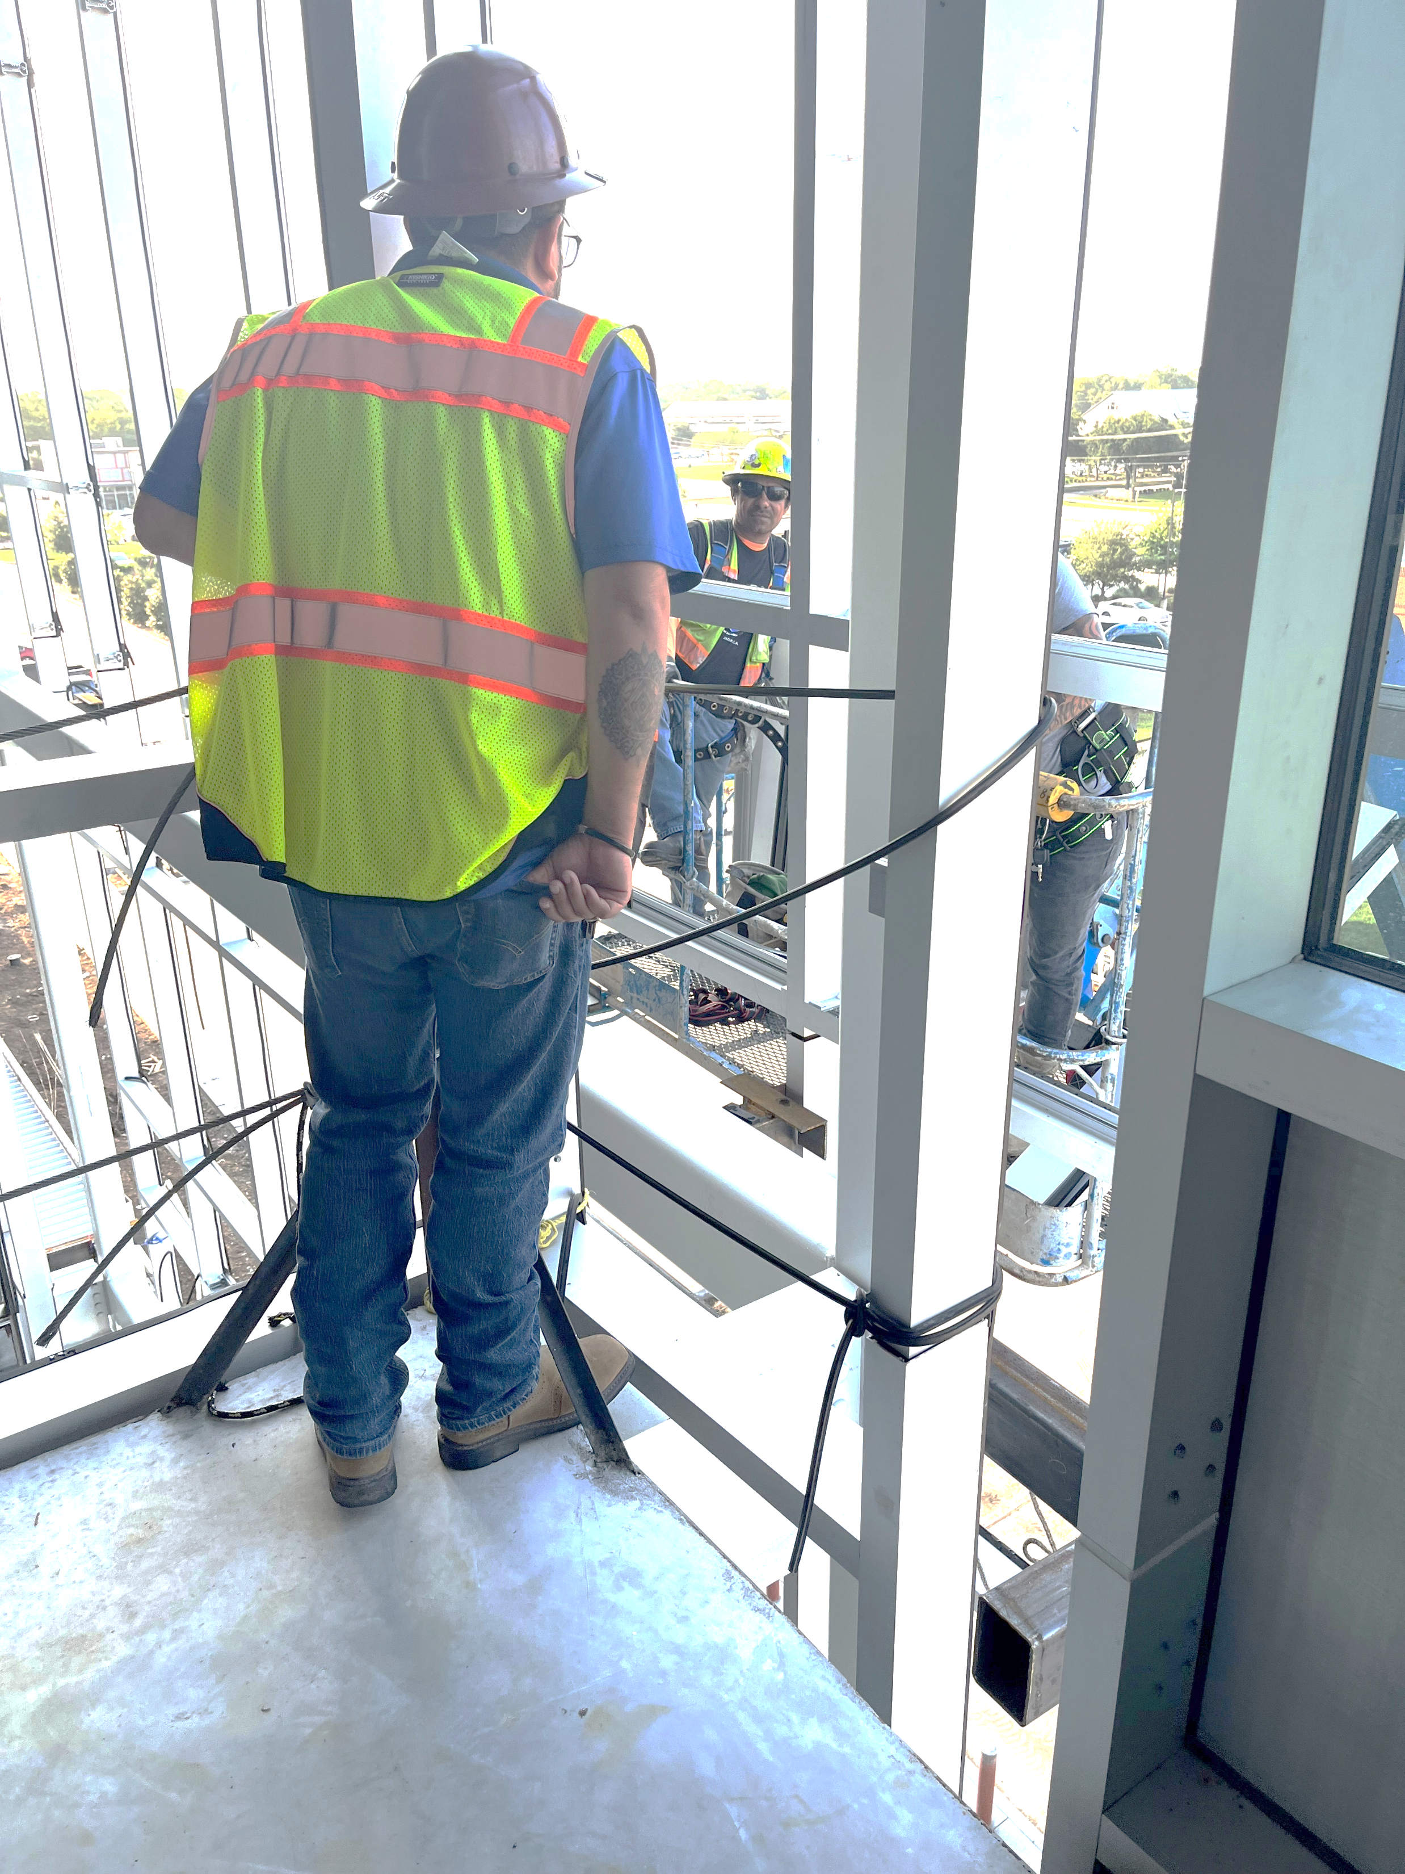
Let’s Talk About Jobsite Visits
COR 1274 Internal Organizing - Member
Notes:
FACILITATOR NOTES:
EXPLAIN when, where, and how to approach co-workers on the job site.
ASK the following questions (7-8 minutes):
When you typically talk about the union (if at all) on the job site, how do those conversations go?
What are the potential roadblocks?
Do these conversations positively portray us?
TRANSITION to house calls.

Slide 19
Let’s Talk About House Calls
House Calls
Why do we want to meet members at home?
What are some common objections or myths about housecalling members/workers?
Remember our commitment to building a Strong Union Culture throughout our Council.
COR 1274 Internal Organizing - Member
Notes:
FACILITATOR NOTES:
ASK – Where will workers be more open and honest about the union and what they are going through personally?
ADDRESS people’s common concerns about house calls and refute them with real-world anecdotal examples.
REMIND participants about the conversations about meeting people where they are at.

Slide 20
Internal Organizing:
Structured Conversations
04
®
iFTI.edu
Notes:
FACILITATOR NOTES:
DISCUSS the difference between transactional interactions with our members and transformative interactions with our members.
REVISIT Union Culture discussion in Phase 1 and then move into what a structured conversation looks like and how to have one with a member in the context of internal organizing.
INTRODUCE the topic by calling a couple of people up and telling them to introduce our union in 30 seconds. Then highlight that we talked about transactional vs transformational.

Slide 21

Structured Conversations
How do we approach conversations with members?
Transactional?
Transformative?
COR 1274 Internal Organizing - Member
Notes:
FACILITATOR NOTES:
ASK – How do we approach conversations with members? Is the interaction Transactional or Transformative?
CONDUCT a group activity (minimum of 3 participants for each group, depending on the size of the group). The goal is to identify transactional vs transformative interactions.
Each participant comes up and approaches a potential member on the job.
Encourage the potential member to join the union (or a contract campaign or some other type of internal campaign).
Each participant will have 2 minutes and hold off giving feedback until the end. Participants will usually try to sell wages and benefits and third-party the union.
DEBRIEF and use the sample conversations to illustrate the necessity of having a transformative conversation.

Slide 22
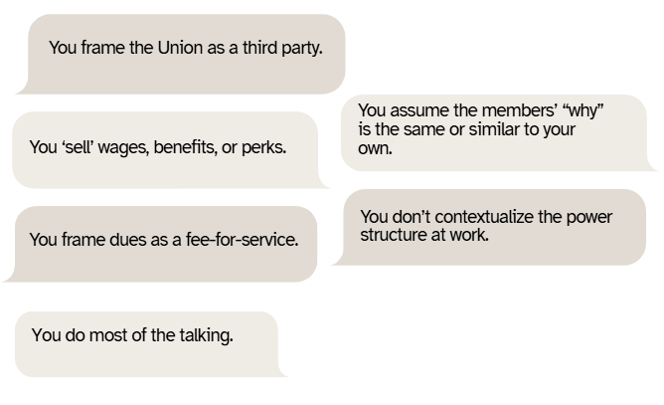


What are the characteristics of a Transactional Interaction?
COR 1274 Internal Organizing - Member
Notes:
FACILITATOR NOTES:
DISCUSS the characteristics of a transaction interaction with a member or a potential member.
Union Rep does most of the talking.
Union Rep ‘sells’ wages, benefits, or perks.
Union Rep frames dues as a fee-for-service
Union Rep frames the Union as a third party
Union Rep assumes the members’ “why” is the same or similar to their own.
Rep doesn’t contextualize the power structure at work.

Slide 23
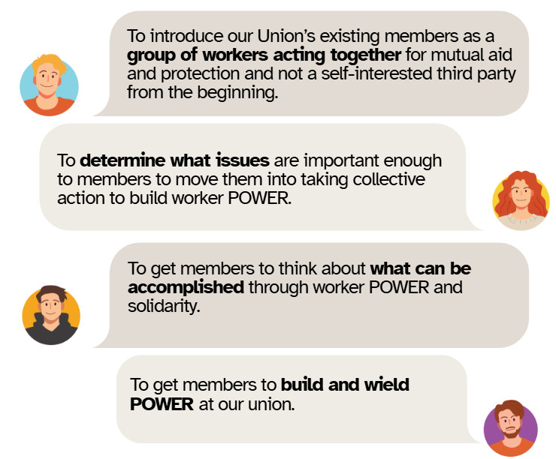
Why We Need to Have Conversations with other Fellow Members
COR 1274 Internal Organizing - Member
Notes:
FACILITATOR NOTES:
EXPLAIN why we need to approach conversations with members and potential members differently.

Slide 24
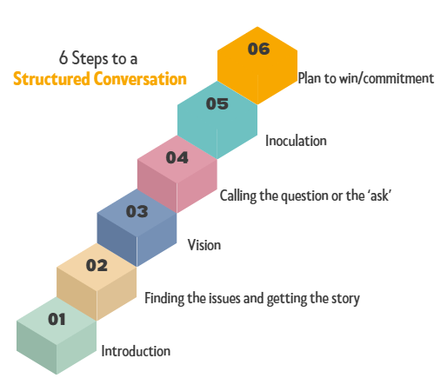
What are the 6 Steps to a Structured Conversation?
COR 1274 Internal Organizing - Member
Notes:
FACILITATOR NOTES:
EXPLAIN Structured Conversations. A structured conversation is a purposeful, member-centered dialogue used to build relationships, uncover motivations, and inspire collective action. It follows a thoughtful flow that connects each member’s personal “why” to the broader goals of the union, helping to break down barriers to participation and build lasting engagement.
ASK – How does it help have a transformative member interaction?
INTRODUCE the 6-step conversation. A 6-Step Conversation focused on listening to and understanding membership concerns and developing solutions based on their ‘why’. A conversation that identifies individual member issues that can be connected to and addressed through member-to-member solidarity and POWER building.
A conversation that identifies Internal Organizing Issues.
DISCUSS the 6 Steps to a structured conversation.
Introduction
Finding the issues and getting the story
Vision
Calling the question or the ‘ask’
Inoculation
Plan to win/commitment

Slide 25
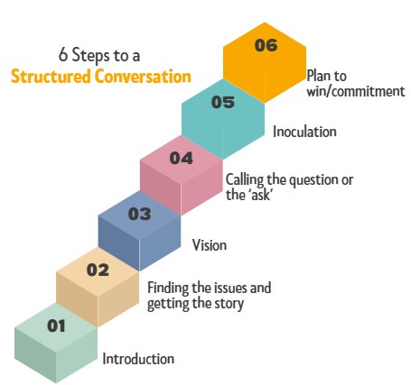

Step 1: Introduction
What makes a good introduction?
Who you are and Why you are there. THAT’S IT!
Make why you are there about members taking collective action.
Sample:
“I’m Danny Vuyk with the Glaziers Union and I’m here because your co-workers at Gemtron are fighting back against the company’s proposed elimination of your pension”.
COR 1274 Internal Organizing - Member
Notes:
FACILITATOR NOTES:
ASK – What makes a good introduction?

Slide 26
Step 2: Finding the issues and getting the story
How do we identify issues and get the story?
Start with an Icebreaker
Ask Open-Ended Questions
Go Broad, and then Go Deep
Listen, Don’t be Defensive
Get Personal, that’s where the ‘why’ is.
Follow up, don’t rush, and learn as much as you can about the member, their life, and concerns.
COR 1274 Internal Organizing - Member
Notes:
FACILITATOR NOTES:
ASK – How do we identify issues and get the story?
Examples of open-ended questions:
How does that affect your life at home?
What did you do before you worked here?
How would you describe a typical day at work?
How have things at work changed for you over (selected timeframe, since the recession, etc)?
What do you like/dislike about the industry?
Do conditions at work allow you to be/do your best?

Slide 27
Step 3: Vision
How do we lay out the Vision for our Members?
What is the Vision?
  Collective Action and Worker POWER is the Solution.
Laying it out:
More open-ended questions
What would it take to change things?
What would happen if we all stood together?
POWER OF ONE VS. POWER OF MANY!
COR 1274 Internal Organizing - Member
Notes:
FACILITATOR NOTES:
ASK – How do we lay out the vision for our members?
Examples of open-ended questions:
What would you change at work if you had a chance?
What would it take/what would need to happen for you to earn more/get respect?
Can you change any of that on your own?
Do other people on your job/in your trade feel that way too?
What would happen if everyone stood together and demanded change?

Slide 28
Step 4: Calling the Question or the ‘Ask’
How do we call the Question?
The ‘Question’ is a choice between POWER and powerlessness at work and a commitment to fight for the vision- Which side are you on?
Frame the Choice
Abandon Comfort Zones
Tell your Union Story
Make the ‘Ask’
COR 1274 Internal Organizing - Member
Notes:
FACILITATOR NOTES:
ASK – How do we call the Question?
STATE that organizers at this stage are doing four things (not necessarily in this order).
Tell Your Union Story - Go around the room. Pick 3 to 4 people and say ‘Your union story was this…’, and then ask. ‘When I introduced myself, what was my union story?’

Slide 29
Step 5: Inoculation
How and why do we inoculate our members?
Inoculation is about preparing members/workers for the long struggle and roadblocks up ahead.
We need to be real with them about how others will inevitably react to collective action.
We need to be real about the fact the victories are hard to come by and always take a fight.
COR 1274 Internal Organizing - Member
Notes:
FACILITATOR NOTES:
ASK – How and why do we inoculate our members?
ASK the following questions:
How many of you have been in a contract negotiation and it didn’t go as you wanted. How did that feel when you go the news? Were you prepared for it?
What could have prepared you for that? Did you still want to stay involved?

Slide 30
Step 6: Plan to Win/Commitment
Making a Plan to Win with a Member/Worker
Assess members’ level of commitment to the Union as a whole and the campaign at hand.
Give members realistic hope for the future and commit them to being involved.
Help members understand that the first step to winning anything is to bring workers together.
Don’t do things for members.
COR 1274 Internal Organizing - Member
Notes:
FACILITATOR NOTES:
ASK the following questions:
How do we plan to win with a member/worker?
What does a plan to win look like?
EMPHASIZE that their involvement in the Building Union Power campaign will strengthen our union. Then encourage them to attend Phase 1 training and sign the pledge.

Slide 31
Internal Organizing:
Active Listening Skills
05
®
iFTI.edu
Notes:
FACILITATOR NOTES:
PRESENT the listening skills slides and DISCUSS real-world scenarios where they have been applied.
DISCUSS the importance of applying listening skills during a transformative conversation with a member.

Slide 32
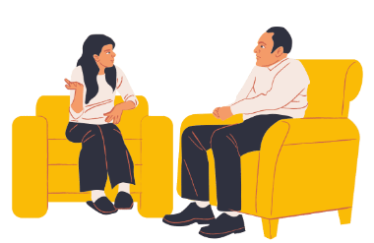
What is Active Listening?
Active Listening is an essential skill for fostering effective communication, particularly in union settings where challenging or sensitive conversations are common.
COR 1274 Internal Organizing - Member
Notes:
FACILITATOR NOTES:
STATE that Active listening is essential for fostering effective communication, particularly in union settings where challenging or sensitive conversations are common. Active listening involves fully concentrating, understanding, responding, and remembering what the other person is saying. It requires not just hearing the words but also recognizing the speaker's emotions, body language, and underlying concerns. This approach helps to build trust, resolve conflicts, and improve relationships with union members.
STATE that on the next slides, you will review key elements of active listening and examine the top 3 questions from members. These scenarios provide an opportunity to practice active listening and dealing with difficult situations.
EXPLAIN that Listening isn’t waiting for your turn to speak. Listening is the ability to make others feel heard. One of the ways to do that is to practice using these three statements when someone is telling you something: “Tell me more.“ "Go on.” “What else?” If you try this, you will quickly learn how much effort it takes to pay attention to what the person you’re talking to is saying and resist the urge to interrupt, correct, or fix what they say. And that’s why it’s a skill. Because all skills take effort, and in this case, the effort is worth it.
Additional Resources:
Video Link - Simon Sinek on LinkedIn: Listening isn’t waiting for your turn to speak. - https://www.linkedin.com/videos/simonsinek_listening-isnt-waiting-for-your-turn-to-activity-7290821845153435649-6I3I/
Video Link - How To Actively Listen (Even During Uncomfortable Conversations) - https://www.youtube.com/embed/Lkj86o69c5c

Slide 33
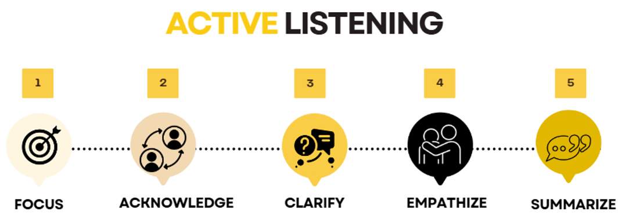
Key Elements of Active Listening
COR 1274 Internal Organizing - Member
Notes:
FACILITATOR NOTES:
DISCUSS the key elements of active listening.
Focus – Stop talking. Pay full attention to the speaker.
Avoid Distractions - Keep phones, notebooks, etc. put away. Look members in the eye for the entire conversation.
Be Observant – Take note of your surroundings. You can learn a lot about a member through their surroundings.
Focus your attention on their words, their ideas, and feelings related to the subject. Watch their facial expressions, hand gestures, etc. Put down any papers, pens, etc. Sometimes you can learn as much from what is not being said as you can from what they say.
Slow Down - Our brains process thoughts four times faster than spoken words. It’s easy to skip ahead in conversation, using your assumptions to fill in the gaps and formulate a response. Resist this urge and focus on what is being said.
Keep an Open Mind - Never assume that you already know what is important to the member you are speaking with.
Don’t Interrupt - Take the time to listen to the member or worker’s entire story. Let the speaker express their thoughts fully before responding. Everything the member wants to tell us has value in moving a campaign forward.
Don’t Fish - Avoid asking leading questions like ‘wouldn’t you agree that…..’
Acknowledge – Show that you are engaged by nodding, maintaining eye contact, and using brief verbal acknowledgments ("I see," "Go on").
Clarify – Ask questions to clarify the message. Be careful not to ask questions that might embarrass the speaker. Get to the main points. Concentrate on the ideas and not the illustrative material, i.e., examples, statistics, etc.
Empathize – Sometimes members need to blow off steam. Let them. We’re there to listen, not to judge. Show understanding of the speaker's feelings. Recognize your prejudices. Don’t allow your feelings towards the person to influence your interpretation of what they are saying.
Don’t Dismiss a Member or Worker’s Concerns - Even if a member expresses disappointment with the Union or with you, let them know you hear them and ask what it would take to make things right.
Find common ground - You don’t have to agree on everything. Acknowledge points on which you disagree. Emphasize points on which you do. Look for areas on which you agree and ask questions around that. Workers and Members will respect your opinion if you respect theirs.
Don’t feel the need to sell something - A Union representative is not a salesperson. We are genuinely looking to learn the Member’s point of view and build something collectively around that.
Organizing vs. Gathering: Remember the Difference - Organizing is more than putting several people with the same views in one place. It’s bringing people from different viewpoints together around a common cause.
Summarize – Paraphrase what was said to confirm understanding. Avoid jumping to conclusions.
Show that you hear what the member is saying - React. Match body language. Repeat what you said as you understood it. If you don’t understand or misunderstand, ask to clarify.

Slide 34
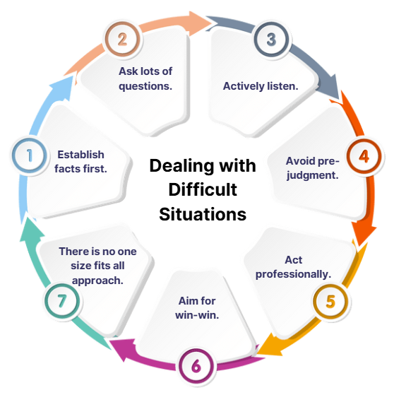
7 Key Tips for Dealing with Difficult Situations
COR 1274 Internal Organizing - Member
Notes:
FACILITATOR NOTES:
DISCUSS the tips in dealing with difficult situations.
Establish facts first. When difficult situations arise, it is all too easy to jump to solution mode too quickly. While there may be a limited amount of time when fast action is absolutely necessary, your first step to a successful resolution is to establish the facts. Remember that facts, as opposed to hearsay, or opinion, are verifiable. Be alert to being swayed by the opinion of those who are strong characters. When people make claims or assertions, ask for specific examples of what happened and when it happened. Often you find that there isn’t a lot of substance behind what is being said.
Ask lots of questions. Questions, especially the short powerful variety, are a great way of getting to the core issue rather than all the detail that someone is trying to provide to you. Think of it like peeling an onion, each layer is getting you closer to the core. Open questions are a much better way of getting to the core of the issue. Try these questions:
When did this issue arise?
How did it impact what you were trying to achieve?
What would be an ideal outcome from your perspective?
What are the options?
How can we move forward?
Actively listen. There is little point in asking questions if you are not actively listening to what is being said. Resist the temptation to jump in before you have properly listened to the different points of view. Most of the time we listen passively or not at all, simply going on the defensive or pushing our point of view. If you can listen with intent and pay attention to what is being said and the speaker’s body language, then you will do a much better job of listening. Better listening leads to better understanding and a better response.
Avoid pre-judgment. We all, if we are honest, will form some judgments immediately. While these might be right at the end of the day, don’t let pre-judgment get in the way of establishing the real issues. Aim to stay open-minded and objective rather than assuming or guessing.
Act professionally. The challenge for you is to remain professional at all times. A good test of this is to ask yourself how would you like to be treated if you were not the manager or leader but an aggrieved party. Think about the longer-term consequences for you and your career if you deal with a difficult situation unprofessionally. People will respect you more if you try to always be professional in your dealing with them, even on a difficult issue.
Aim for a win-win. While this is not always possible, you should aim to find solutions that don’t result in a feeling from one party that they had lost while another has won. This might require some careful negotiation around what would constitute a good outcome for all those involved. Accept that there may be situations where you have to be very direct, but make these situations the exception rather than the norm.
Remember there is no one-size-fits-all approach. Each situation is different. While there might be some common ground, remember there is unlikely to be a one-size-fits-all approach to difficult situations. Adapt your approach depending on the situation. Good planning and preparation will help make sure you can adapt while dealing with the situation or issue. Bottom line – Handling difficult situations is just part and parcel of managing and leading. Where do you need to focus your attention in terms of developing your competence?

Slide 35
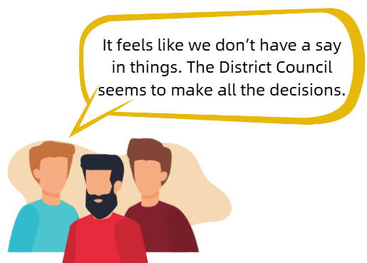
Practice Active Listening - Scenario 1: We Don’t Have A Voice.
COR 1274 Internal Organizing - Member
Notes:
FACILITATOR NOTES:
ASK - How will you address Scenario 1?
PRACTICE Active Listening Skills:
Focus: Give the member your full attention, eliminating any distractions.
Acknowledge: Nod, maintaining eye contact.
Clarify: Ask, “Can you give me some examples of situations where you felt like you didn’t have a say or weren’t involved in the decision-making?”
Empathize: “I totally hear where you're coming from, and I understand why you’d feel that way. It’s tough when it seems like decisions are being made without input from everyone.”
Summarize: “So, what I’m hearing is that you're frustrated because you don't feel heard or that your input isn't being valued. Is that correct?”
HIGHLIGHT ONE UNION value.

Slide 36
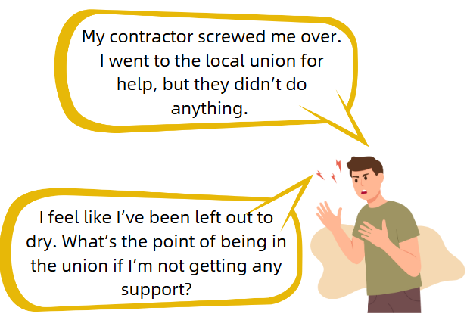
Practice Active Listening - Scenario 2: Our Union Does Not Support Me.
COR 1274 Internal Organizing - Member
Notes:
FACILITATOR NOTES:
ASK - How will you address Scenario 2?
PRACTICE Active Listening Skills:
Focus: Give the member your full attention, eliminating any distractions.
Acknowledge: Nod, maintaining eye contact.
Clarify: Ask, “Can you walk me through exactly what happened with the contractor? What steps did you take when you reached out to the union for help? I want to make sure I understand everything clearly so we can address this properly.”
Empathize: “It sounds like you’ve been through a lot, and I’m really sorry this has happened. The union should have been there to help you sooner. We’ll get this sorted and hold the people accountable. I’m going to personally follow up to make sure this is addressed.”
Summarize: “I want to make sure you’re taken care of. We’ll work together. I’ll also help ensure that the union does what it’s supposed to do for you. You’ve got my full support.”
HIGHLIGHT ONE FAMILY value.
Possible Scenario 2a: Union Member: “The union only wants my money. Where does my money go?"

Slide 37
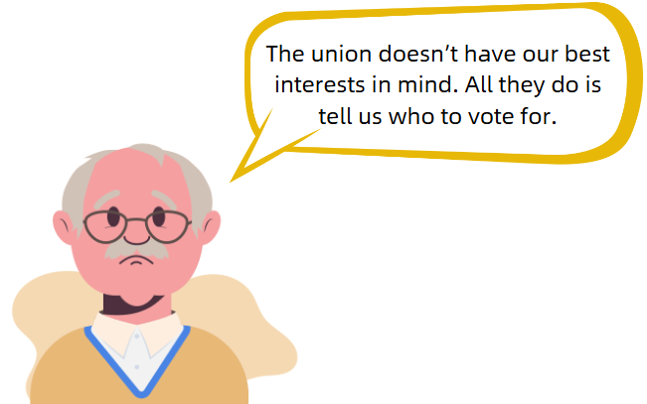
Practice Active Listening - Scenario 3: Failed To Prioritize Our Interests
COR 1274 Internal Organizing - Member
Notes:
FACILITATOR NOTES:
ASK - How you will address Scenario 3?
PRACTICE Active Listening Skills:
Focus: Give the member your full attention, eliminating any distractions.
Acknowledge: Nod, maintaining eye contact.
Clarify: Ask, “Can you tell me more about what makes you feel like the union doesn’t care for you?”
Empathize: “I understand how frustrating it must be to feel like your concerns aren't being addressed.”
Summarize: “We take your concerns seriously and will work to ensure you're supported moving forward.”
HIGHLIGHT ONE FIGHT value.

Slide 38
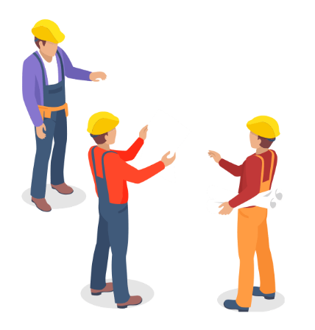
What Can YOU Do?
In your experience, what are some of the things you’ve heard as a member?
COR 1274 Internal Organizing - Member
Notes:
FACILITATOR NOTES: Break into groups.
ASK members - What are some of the things you’ve heard as a member, in your experience?
ASK - How you will address this scenario?
PRACTICE Active Listening Skills:
Focus: Give the member your full attention, eliminating any distractions.
Acknowledge: Nod, maintaining eye contact.
Clarify: Ask, “Can you give me some examples of situations where you felt like you didn’t have a say or weren’t involved in the decision-making?”
Empathize: “I totally hear where you're coming from, and I understand why you’d feel that way. It’s tough when it seems like decisions are being made without input from everyone.”
Summarize: “So, I’m hearing that you're frustrated because you don't feel heard or that your input isn't being valued. Is that correct?”
HIGHLIGHT ONE UNION value.
TELL participants to use their listening skills to probe on the job, talk to journeymen or other mentor figures; use active listening skills on the job

Slide 39
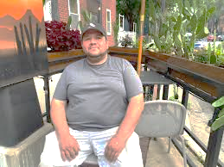
Member Conversation Roleplays
DEMONSTRATE a membership transformative conversation and how to use the structured conversation.
REVIEW available worker profiles.
DEBRIEF.
COR 1274 Internal Organizing - Member
Notes:
FACILITATOR NOTES:
CONDUCT a group exercise. Every participant will get the chance to do a member conversation roleplay (30-min practice)
After each roleplay, DEBRIEF and ask for feedback from the group.
The instructor and co-facilitator will demonstrate a transformative conversation.
Review available worker profiles with the group, then split them into groups.
Then, each member will demonstrate a transformative conversation using a profile that has been provided.
Each member will act as the person being approached and as the one approaching them.
After each role play facilitator will give feedback.

Slide 40

Summary
Stronger together, unstoppable as one!
Build union power, grow membership, and ignite solidarity.
Speak up, stand firm, and organize for a future where every worker’s voice is heard!
iFTI.edu
Notes:
FACILITATOR NOTES:
ASK participants to share their key takeaways.

Slide 41

Questions or Comments?
Contact Information
Daniel Vuyk
dvuyk@iupat.org
International Union of Painters and Allied Trades
7234 Parkway Drive
Hanover, MD 21076
http://www.iupat.org
ONE UNION. ONE FAMILY. ONE FIGHT!
iFTI.edu
Notes:
FACILITATOR NOTES:
ASK questions or comments from participants.
STATE contact information.

