Slide 1
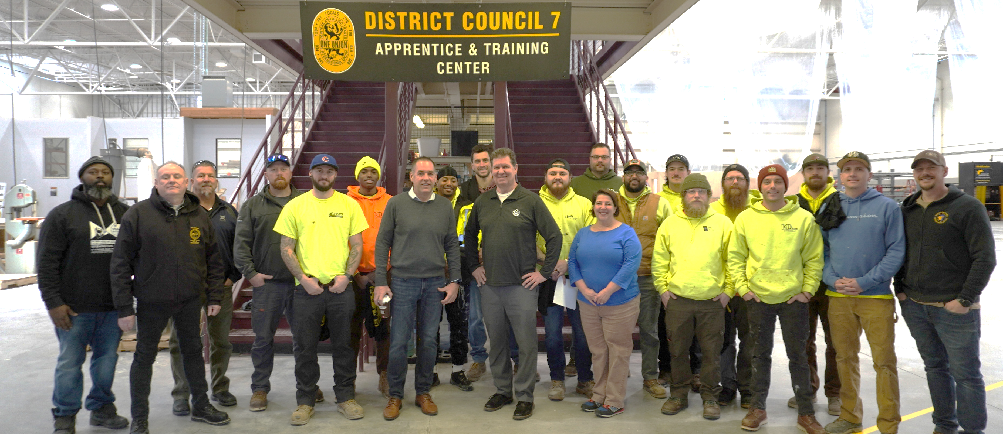
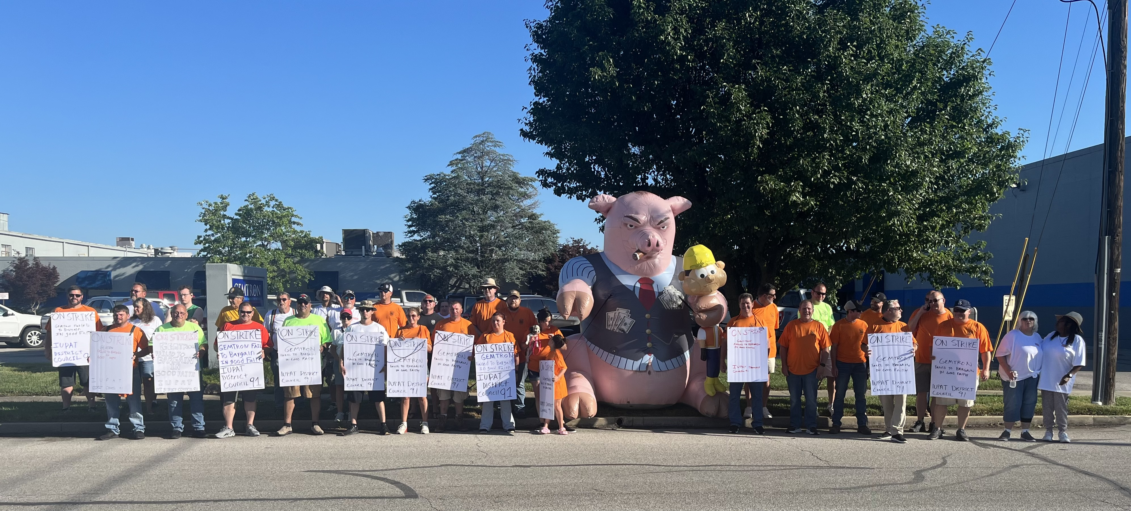
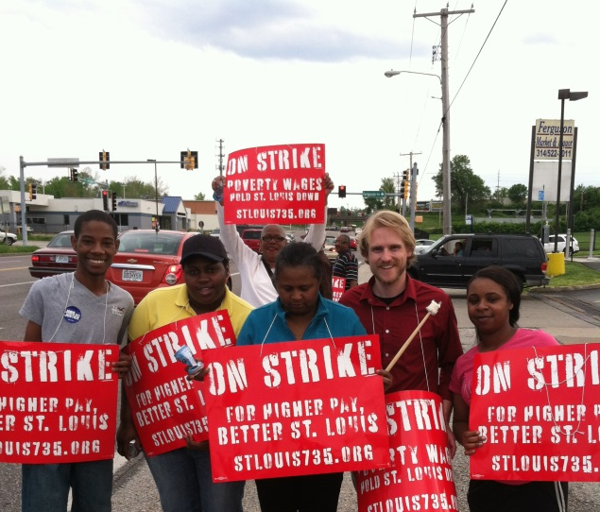
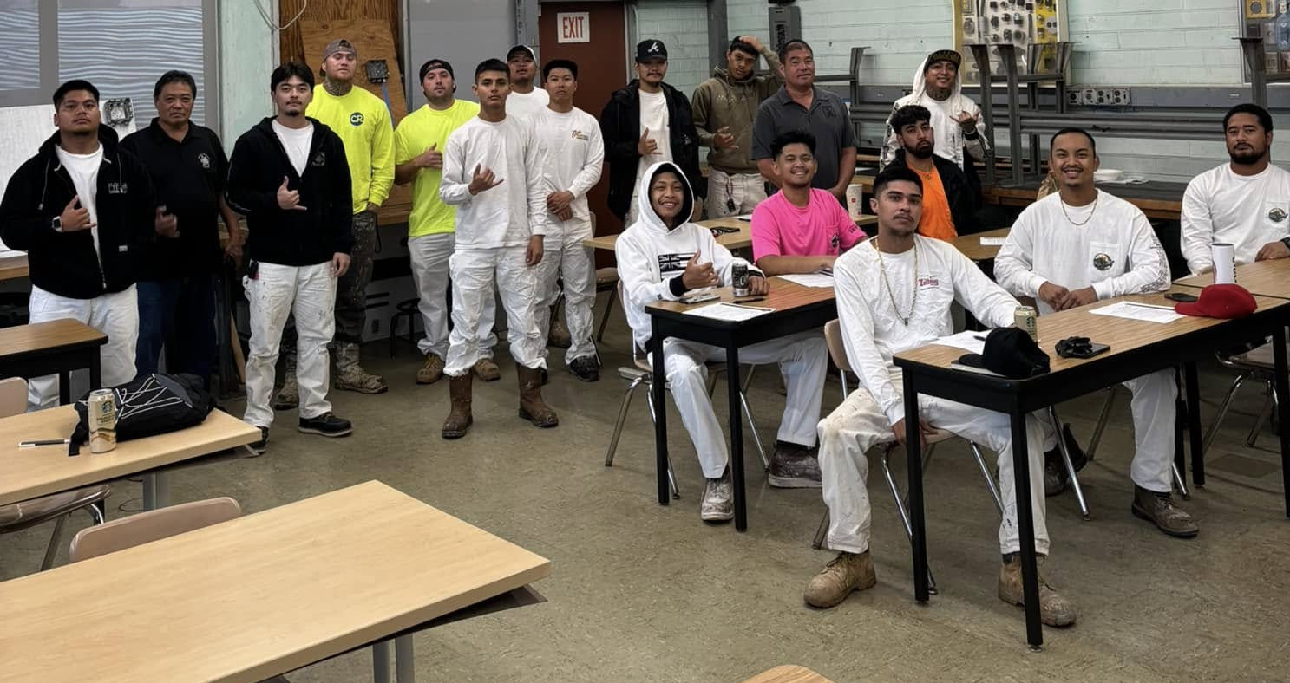
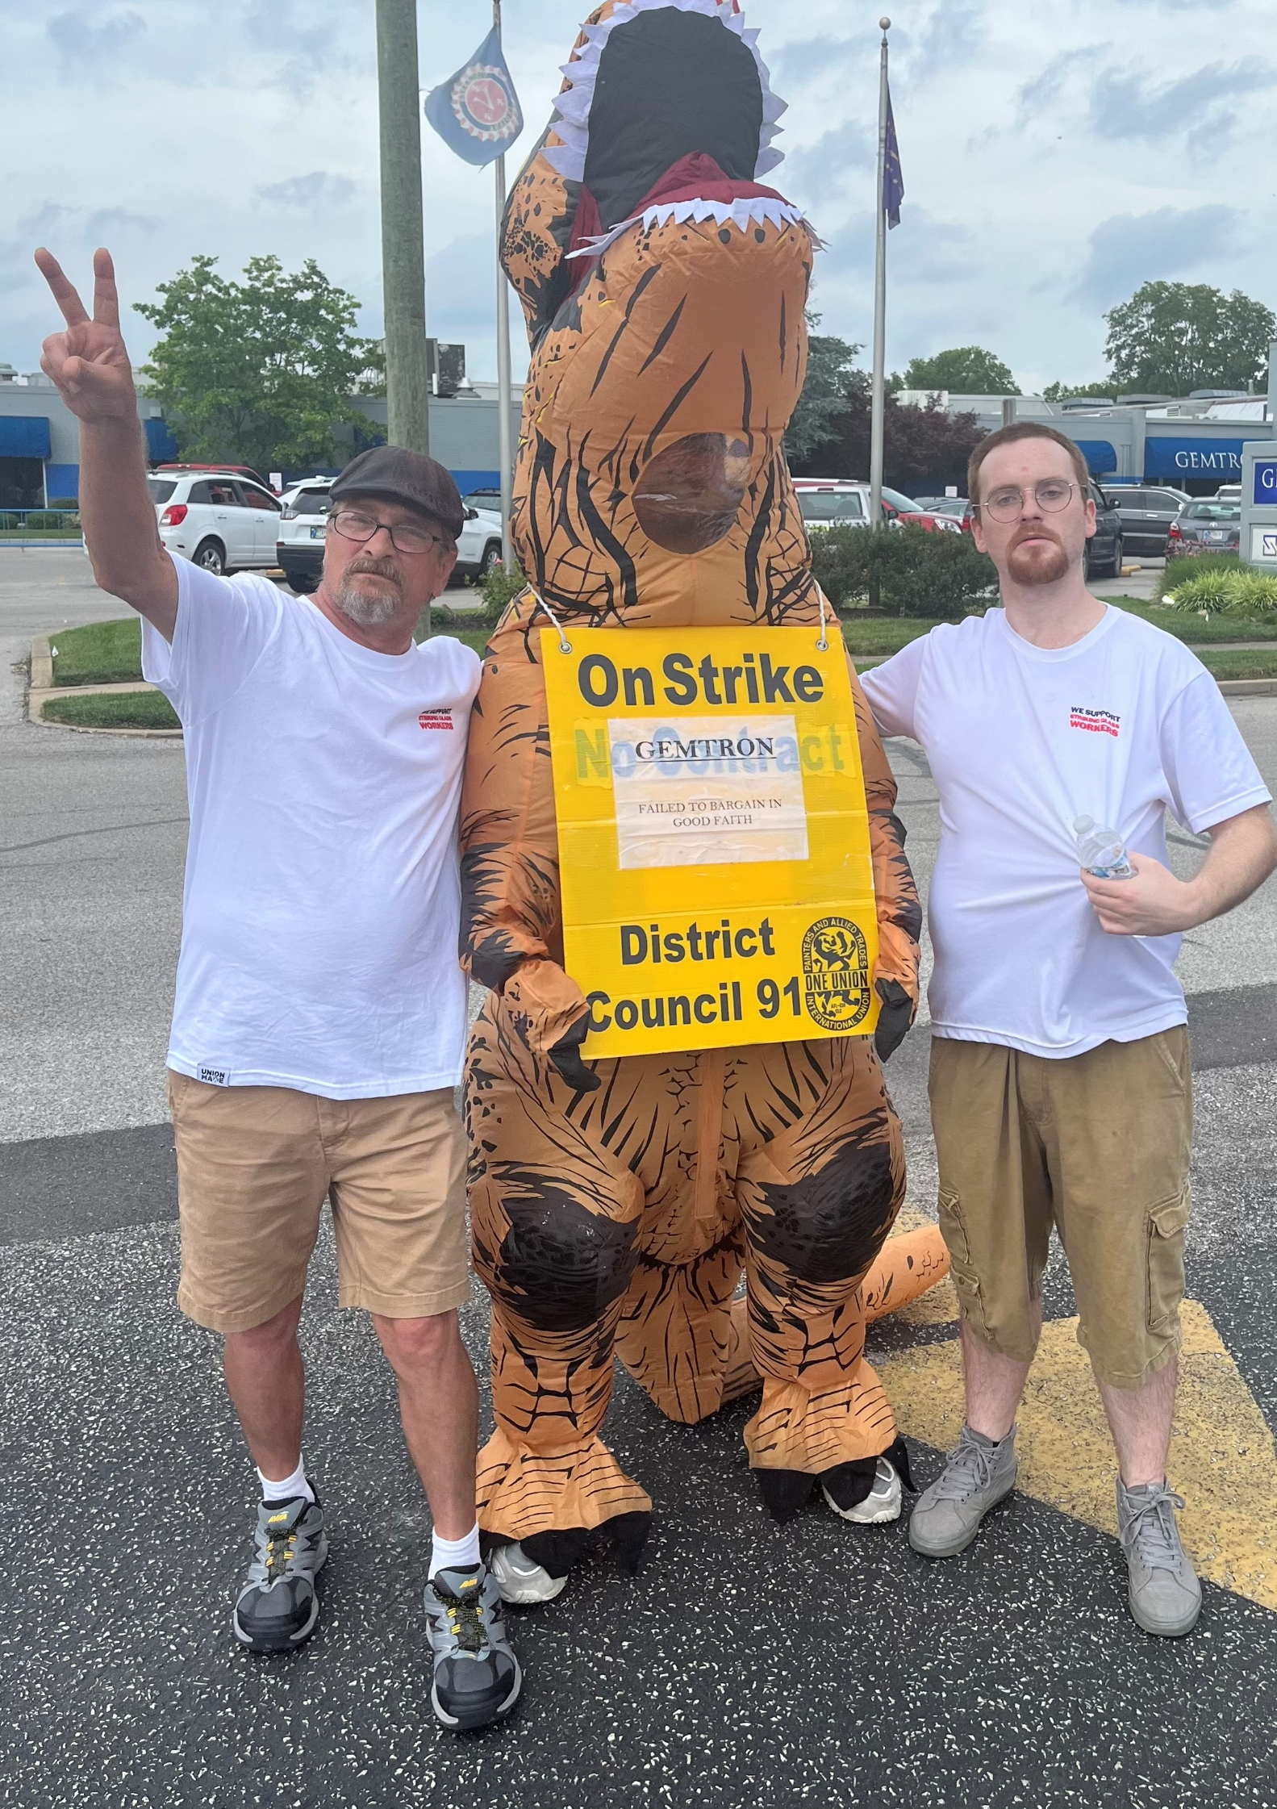
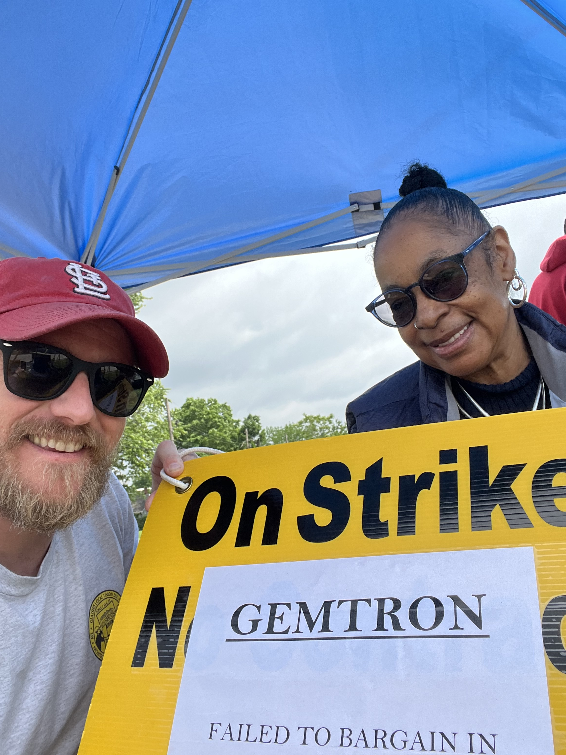
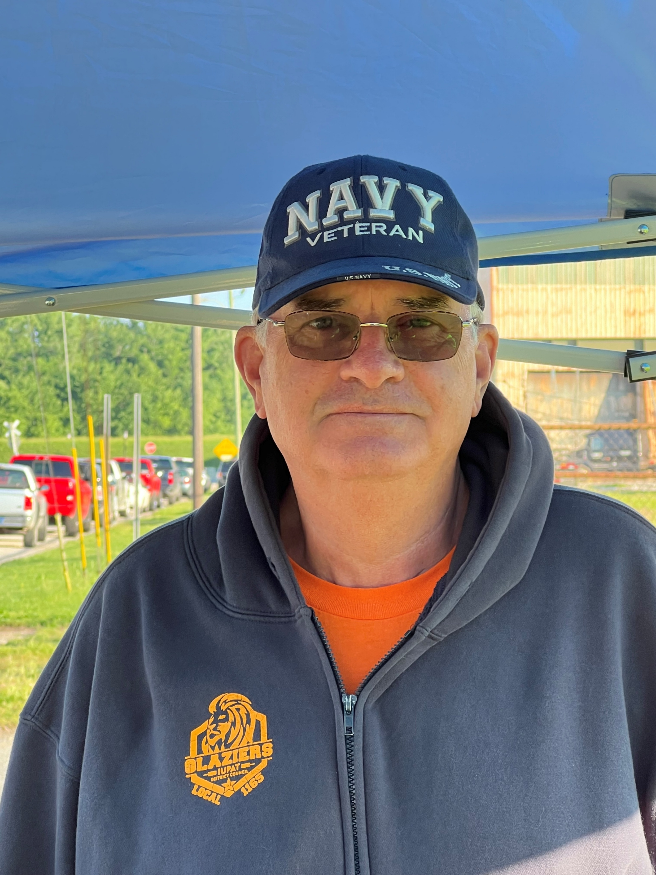
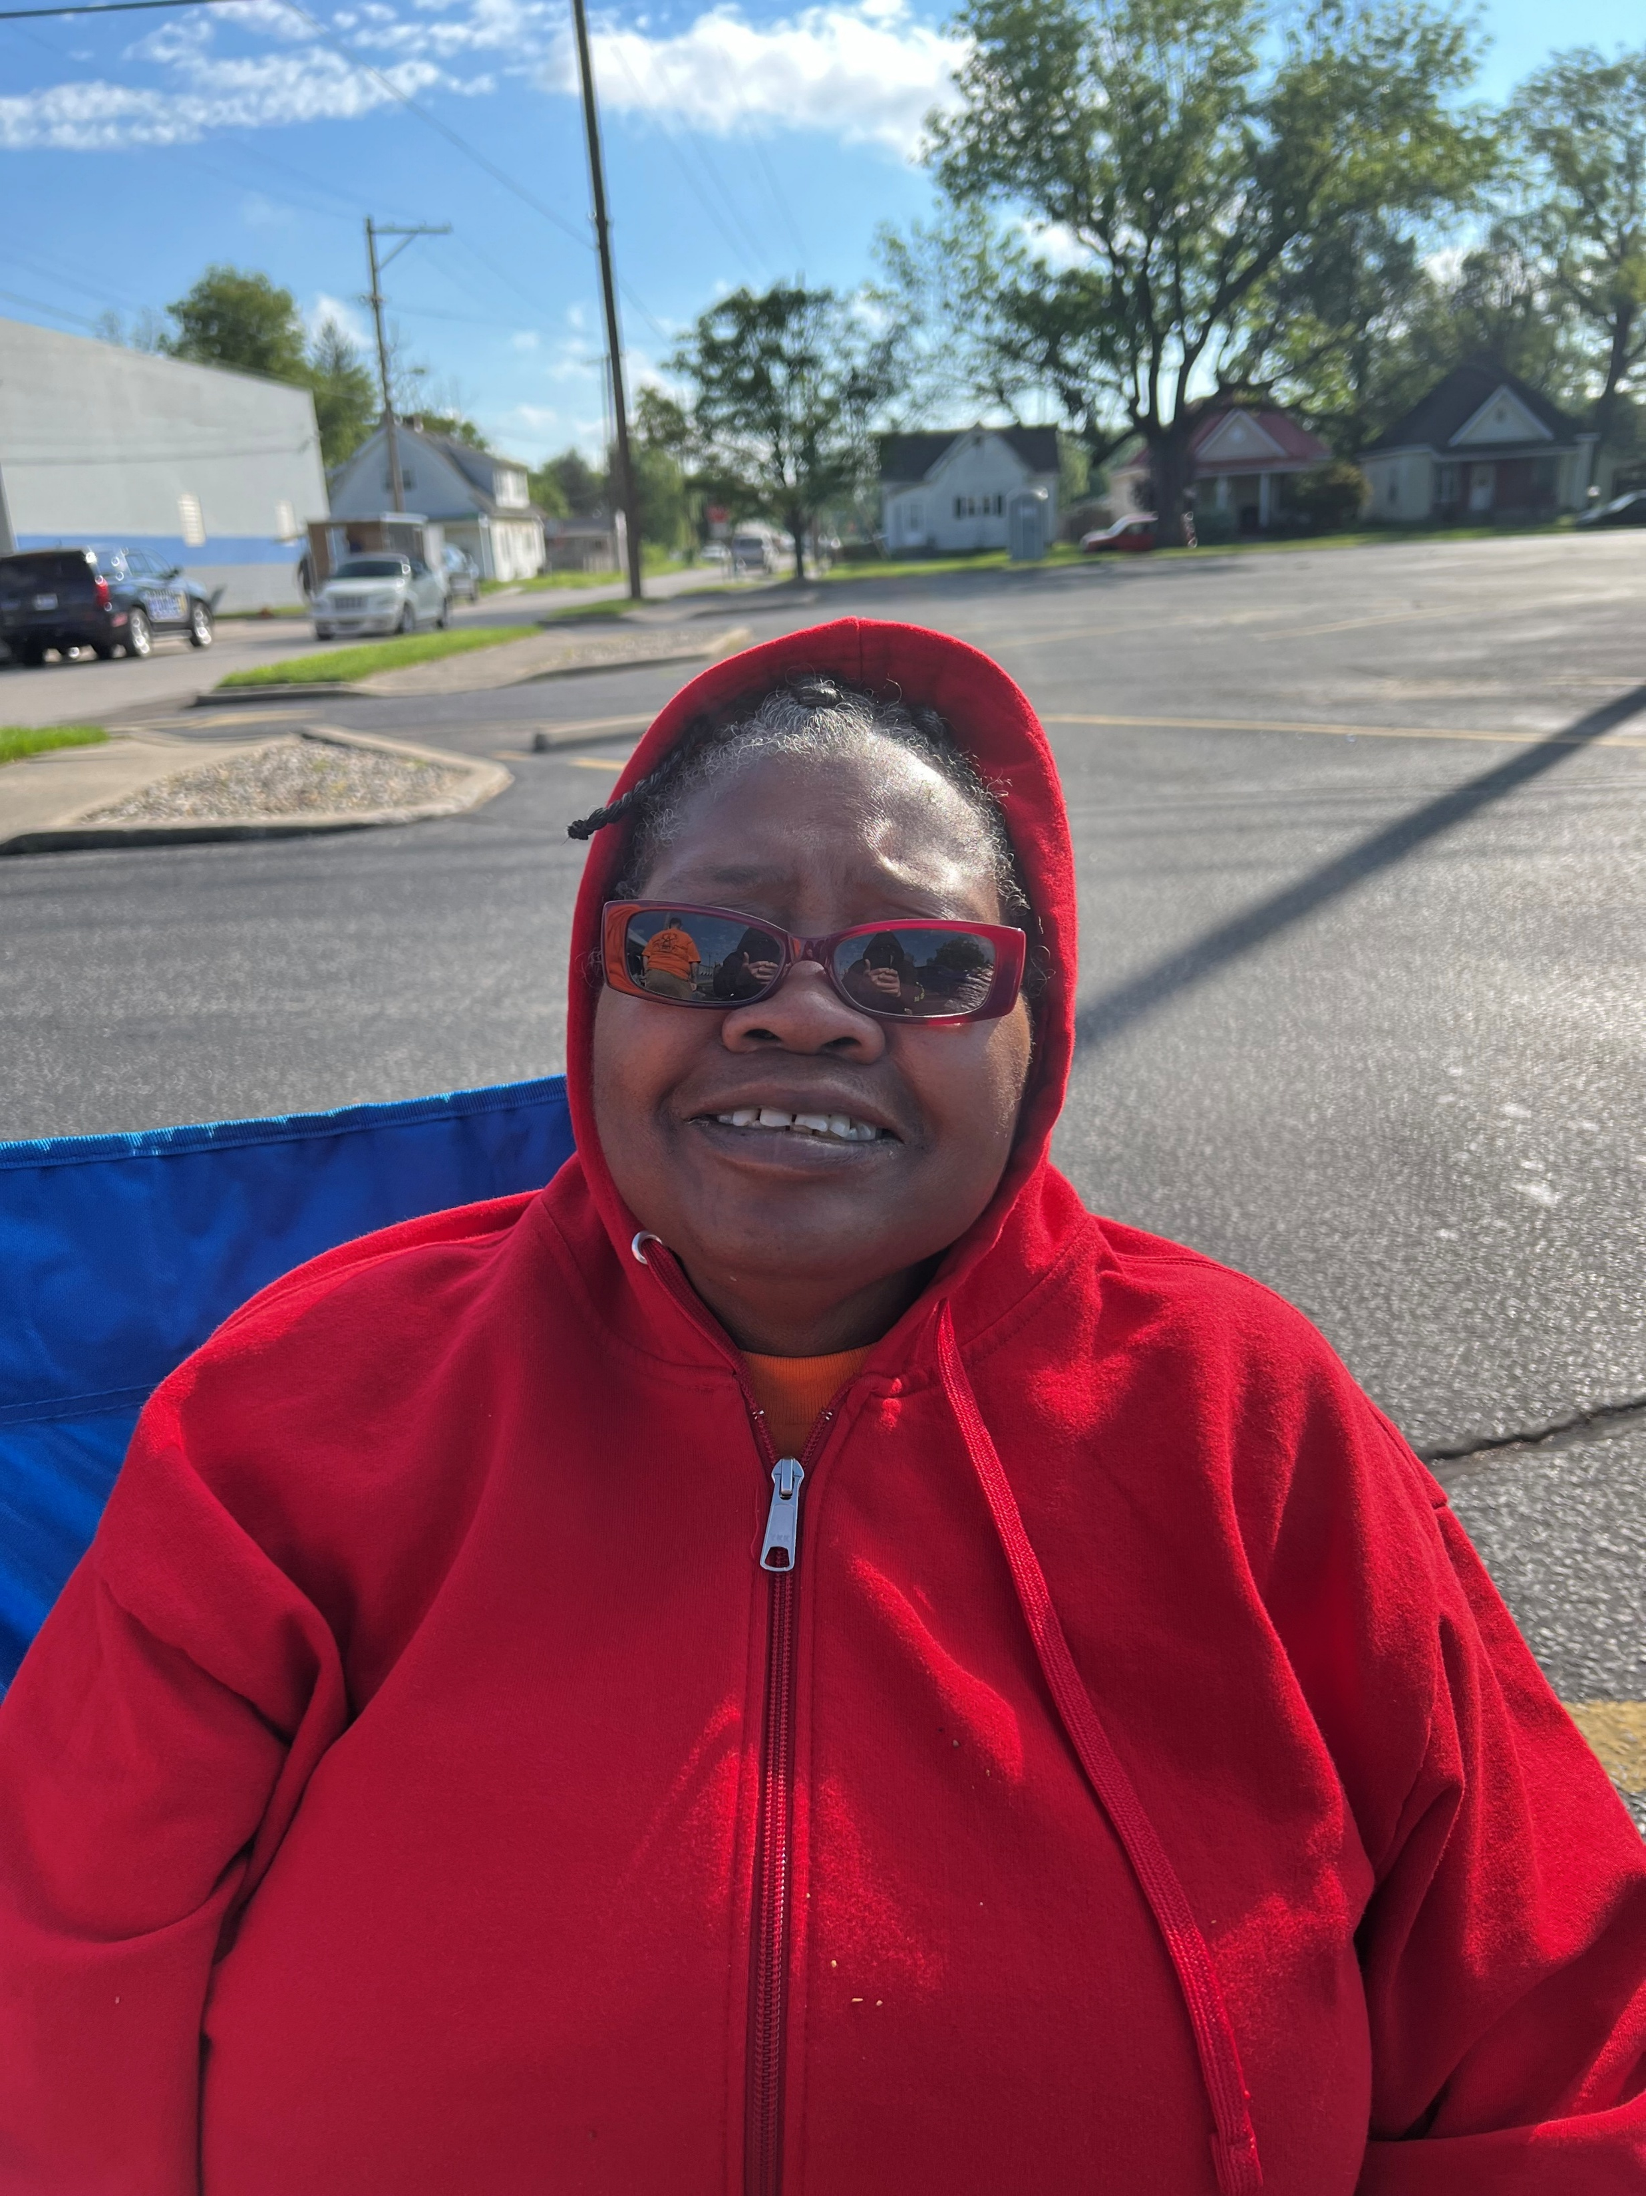



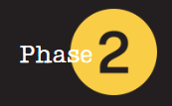
COR 1246 Internal Organizing - Staff
One Union One Family One Fight!
Notes:
FACILITATOR NOTES:
PREPARE the course materials and equipment to present this course effectively.
Course Materials and Equipment:
PowerPoint Presentation - Instructor Computer, Internet Connection, TV/Projector
Handouts – Value Statement
Case Studies/Simulations
Flip Chart(s) / Markers (at least three colors) for brainstorming or group activities
Name Tents/Tags
MAKE the necessary modifications when appropriate.
CHECK room setup. Is the room arranged in a way that is comfortable to the participants and conducive to learning? If possible, a U-shaped table and chair set-up should be used. A U-shape allows participants to interact with one another and the instructor.

Slide 2




Introduction
COR 1246 Internal Organizing - Staff
Notes:
FACILITATOR NOTES:
PREP WORK - Participants will be asked to come to the training prepared with a written 3-minute speech about their ‘whys’. Each speech will be timed and recorded. An email will be sent by the director to each participant outlining the assignment. The email will read as follows:
Please come prepared on day 1 of the training with a 3-minute written speech that outlines the following about yourself:
Who You Are
What inspired you to join the Labor Movement?
Why did you decide to become a Union Representative/Organizer?
You must speak for the entire 3 minutes on this topic, and your speech will be timed and recorded. Looking forward to seeing you next week at the training!
START the exercise with your answer.
Instructor: Should start by telling their story. When did you realize the power of the union? Who inspired you, and what got you to this point?
Co-Facilitator: Take quick notes on each member’s name/why to be used later.

Slide 3
Course Description
IUPAT Internal Organizing Training
Internal Union Organizing training strengthens union membership and builds POWER within the workplace, Local Union, or District Council. It covers key concepts such as developing a strong Union culture, conducting structured organizing conversations, assessing union strength, and launching internal organizing campaigns.
The training emphasizes the importance of one-on-one engagement, overcoming objections, and fostering solidarity among members.
COR 1246 Internal Organizing - Staff
Notes:
FACILITATOR NOTES:
ASK – How do you view internal organizing? (10–15-minute discussion). Participant answers are charted on a flip chart. After the discussion, the facilitator presents the definition of internal organizing and explains it.
EXPLAIN the course description.
ASK 2 participants what participation in the union looks like to them. Have the co-facilitator keep track of the time to make sure we go no longer than 5 minutes on the questions
STATE that practical exercises, including self-assessment quizzes, roleplays, and real-world organizing strategies, help union representatives enhance their effectiveness in mobilizing members and sustaining long-term union growth.

Slide 4
Learning Outcomes
Create a workplace environment where union membership thrives and union power grows.
Strengthen relationships, foster active participation, and build solidarity.
Use structured conversations and develop strategies to boost engagement.
Apply active listening to address concerns and drive meaningful dialogue.
Develop impactful campaigns to grow membership, enhance bargaining power, and extend union influence.
Connect with members in various settings, such as job sites and home visits, to build union support.
Address objections related to union dues, employer resistance, and other organizing challenges.
Align internal organizing initiatives with broader labor campaigns to enhance union impact.
COR 1246 Internal Organizing - Staff
Notes:
FACILITATOR NOTES:
STATE the learning outcomes.

Slide 5

Course Topics
1
2
3
4
5
6
7
8
Internal Organizing: Basic Concepts
Initial Assessment Exercise
Getting Started: Internal Organizing Campaign
Structured Conversations
Active Listening Skills
Building Internal Campaigns
Making House Calls
Individual Workplans
COR 1246 Internal Organizing - Staff
Notes:
FACILITATOR NOTES:
STATE that there are 8 topics in the course.

Slide 6

Internal Organizing:
Basic Concepts
01
®
iFTI.edu
Notes:
FACILITATOR NOTES:
EXPLAIN the basic concepts of internal organizing. To build a union culture, remember your why and what a union is or isn’t.

Slide 7
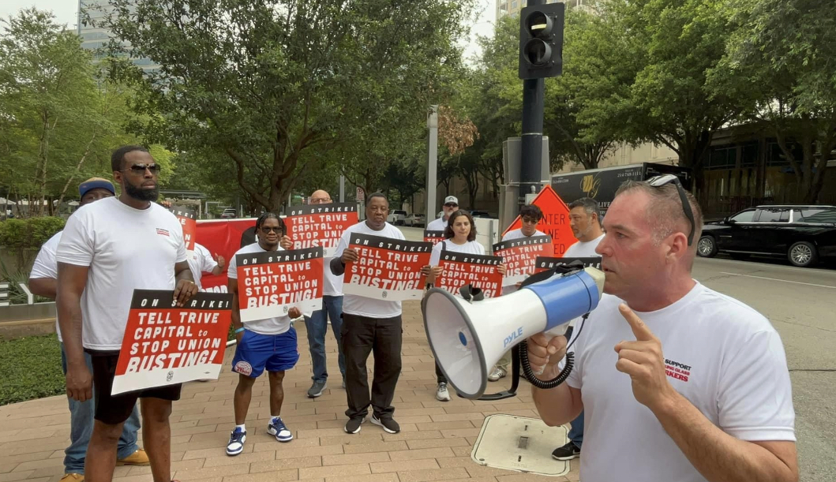
Internal Organizing: Basic Concepts
Commit to building a strong Union Culture across your District Council.
COR 1246 Internal Organizing - Staff
Notes:
FACILITATOR NOTES:
REMIND people about the union and the culture we are trying to build. (Found on Phase 1 Culture talking points)
ASK 3 to 4 participants what union culture is to them.
Facilitate the Commitment Round (5-10 minutes depending on group size):
Go around the room and invite each person to respond.
Use names whenever possible to personalize the interaction.
ASK – “Are you committed to building union culture in your Local and District Council?” Go first to set the tone. Example: "I'm [Facilitator Name], and I am absolutely committed to building a strong, inclusive union culture in my Local and District Council.“
Wrap-Up: Acknowledge the courage and unity in the room. Reinforce the importance of collective commitment: "Your voices today reflect a shared promise to lead and uplift our union culture. This is how movements grow—together."

Slide 8
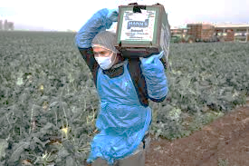
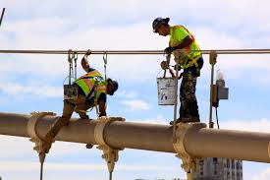
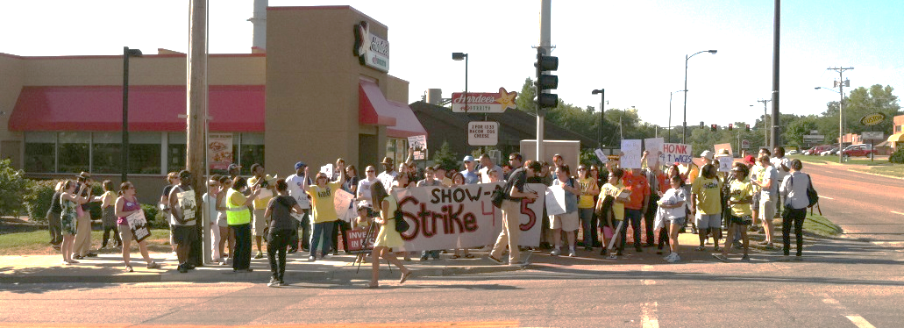
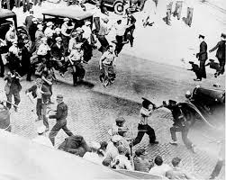
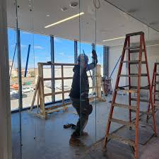
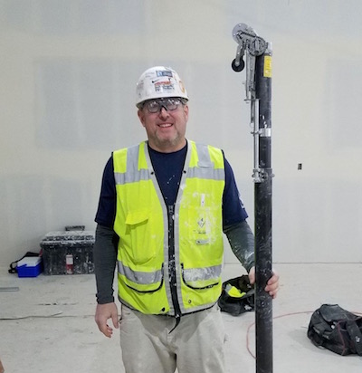
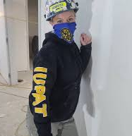
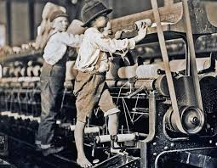
Remember Your ‘Why’
COR 1246 Internal Organizing - Staff
Notes:
FACILITATOR NOTES:
REVIEW the whys from the participants’ introduction. Pinpoint a few people and say you told me why this is.
EMPHASIZE that it is important to remember your why when conversations get hard.

Slide 9
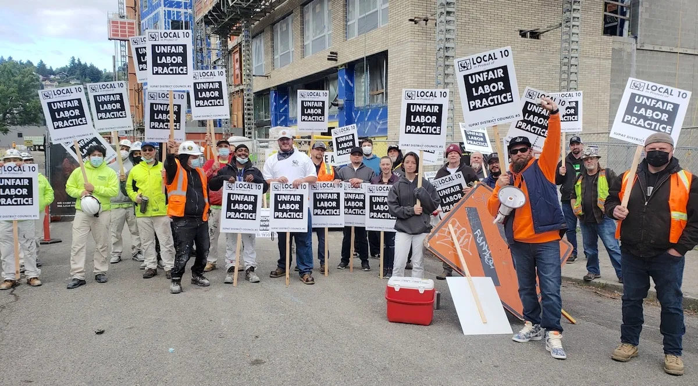
Remember What A Union Is
A Union is a group of workers acting together for mutual aid and protection.
COR 1246 Internal Organizing - Staff
Notes:
FACILITATOR NOTES:
ASK – What is a union? A union is an organization of workers formed to collectively negotiate with employers over wages, benefits, and working conditions, giving employees a stronger voice and bargaining power in the workplace.

Slide 10

Remember What A Union Isn’t
A Union is not an employment agency.
A Union is not a third party.
A Union is not a social service.
COR 1246 Internal Organizing - Staff
Notes:
FACILITATOR NOTES:
STATE that a union is not:
A third party; it's an organization formed by workers to collectively advocate for their interests, and it's comprised of the workers themselves, not an external entity.
An employment agency. While unions can sometimes facilitate job placement through hiring halls, their primary function is to represent workers and negotiate with employers regarding wages, benefits, and working conditions, not to act as employment agencies.
A social service. While unions can offer benefits that indirectly improve social well-being, their primary function is to advocate for and negotiate the terms of employment for their members, not to provide social services directly.
REMIND members about our values and draw on them to explain how we are not a third party.

Slide 11
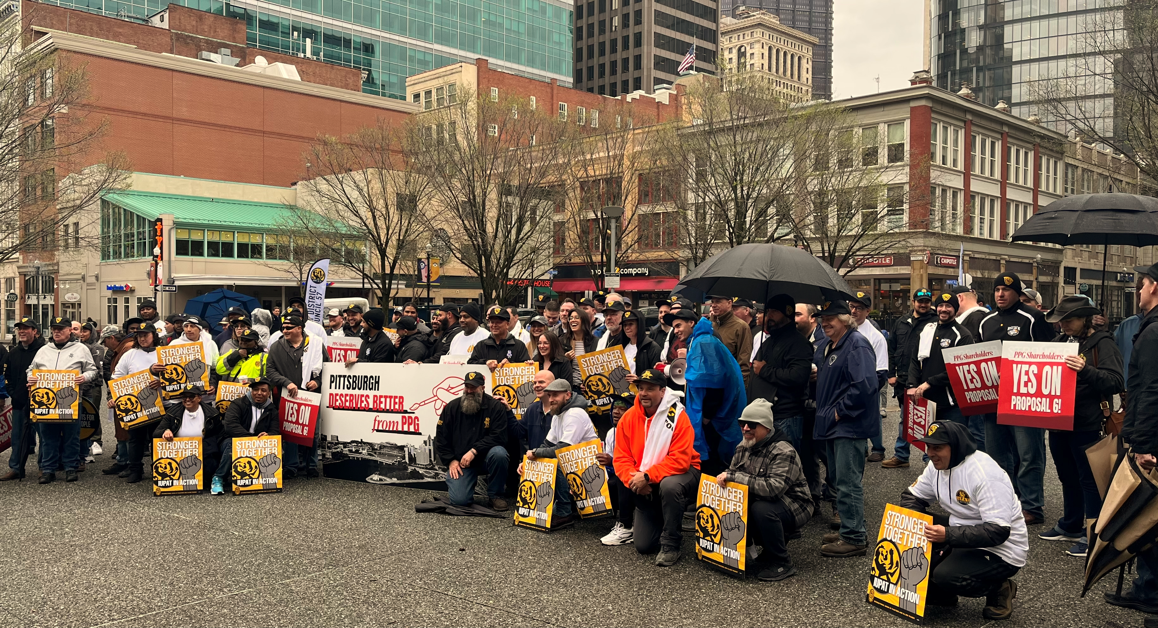
Types of Internal Campaigns
  Membership and Member-Driven Initiative and Policy Drives
  Membership Drives
  Contract Campaigns
  Recertification Campaigns
  9a Conversion Campaigns
  First Contract Campaigns
  Solidarity Initiatives
  Power-Building Campaigns
  Structure Tests
  Member-Driven Initiative & Policy Drives
COR 1246 Internal Organizing - Staff
Notes:
FACILITATOR NOTES:
DISCUSS the types of campaigns and how membership involvement drives each.
Membership Drives
Contract Campaigns
Recertification Campaigns
9a Conversion Campaigns
First Contract Campaigns
Solidarity Initiatives
Power-Building Campaigns
Structure Tests
Member-Driven Initiative & Policy Drives

Slide 12
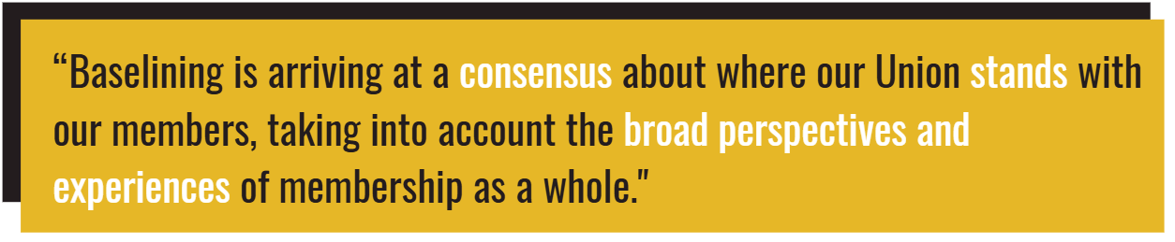
Get to Our Baseline
COR 1246 Internal Organizing - Staff
Notes:
FACILITATOR NOTES:
ASK – What is baselining? Baselining is arriving at a consensus about where our Union stands with our members, taking into account the broad perspectives and experiences of membership as a whole.
EMPHASIZE the importance of collective consensus and how baselining gets us all to the same starting line.
STATE the following points:
Before we engage in internal organizing to move our Union forward, we must first understand where we are today.
A solid baseline increases our chances of success in internal organizing by helping us meet members where they are.
DISCUSS baselining to tee up the exercises in section 2.

Slide 13

Internal Organizing: Basic Concepts
COR 1246 Internal Organizing - Staff
Notes:
FACILITATOR NOTES:
ASK the group if they are willing to commit to the basic concepts. Is it always talking to a fellow member about issues with the collective bargaining agreement or a grievance?
EMPHASIZE that we have to be okay with being uncomfortable and put ourselves in the proper headspace to have the right conversations.

Slide 14
Internal Organizing:
Initial Assessment Exercise
02
®
iFTI.edu
Notes:
FACILITATOR NOTES:
DISCUSS the slides asking how members view the Union and how members experience the Union.

Slide 15

How do Members view our Union?
As a Representative of Members?
As a Dues Collector?
As part of a Movement?
WHY?
COR 1246 Internal Organizing - Staff
Notes:
FACILITATOR NOTES:
CONDUCT a group activity:
Divide into groups of 3 (groups pre-selected by the facilitator(s) and director(s)).
Each group is given 6 flipchart pages with the headings Representative of Members, Dues Collector, and Movement for the first part of the exercise and Negative, Transactional, and Inspirational for the second part of the exercise.
Part 1: STATE that the groups have 25 minutes to chart reasons why members would view the Union as a representative of members, reasons why members would view the Union as a Dues Collector, and reasons why members would view the Union as part of a Movement. RECONVENE the participants and give each group 5-7 minutes to present what they came up with and lead a discussion about how members view the Union.
ASK if anyone has been a part of another organization and what their experience was like.

Slide 16
How do Members experience our Union?
In a Negative sense?
In a Transactional sense?
In an Inspirational sense?
WHY?
COR 1246 Internal Organizing - Staff
Notes:
FACILITATOR NOTES:
CONDUCT a group activity:
Divide into groups of 3 (groups pre-selected by the facilitator(s) and director(s)).
Each group is given 6 flipchart pages with the headings Representative, Dues Collector, and Movement for the first part of the exercise, and Negative, Transactional, and Inspirational for the second part of the exercise.
Part 2: EXPLAIN that the same groups are given 25 minutes to chart Negative experiences members might have with the Union, Transactional experiences members might have with the Union, and Inspirational experiences members might have with the Union. RECONVENE the participants and give each group 5-7 minutes to present what they came up with and lead a discussion about members’ different experiences with the Union.
EXPLAIN that a transactional conversation focuses on a specific task or information exchange, while a transformative conversation aims to inspire, build relationships, and foster deeper connections, often leading to personal or organizational growth.
DEBRIEF the participants and give each group 5-7 minutes to present what they came up with, and lead a discussion about members’ different experiences with the Union. This is about how they feel about the union.
ASK the following questions:
How does it feel to be sitting in the room with your fellow members, having this conversation?
How is this conversation different from past experiences?
How many of you have had similar experiences?
Part 3: HANDOUT the District Council Self-Assessment Snapshot quiz and explain it to the participants. STATE that everyone needs to answer each question as honestly as possible. EMPHASIZE that the results aren’t about judgment but are about providing insight as to where a starting point for internal organizing might be. ADVISE that there can only be one answer to each question, A, B, C, or D, and the group must arrive at a consensus on each answer. The facilitator breaks the participants back into their groups and gives them another 25 minutes to complete the quiz. Toward the end of the 25 minutes, the Facilitator passes out the quiz score guide and asks each group to score their answers.

Slide 17
District Council Self-Assessment Snapshot Quiz
Purpose of Exercise - Not to judge where we are now but to arrive at a starting point for Internal Organizing.
REMINDERS:
Answer each question honestly and accurately.
Select only one answer per question (A, B, C, or D).
Your group must reach a consensus for each question.
COR 1246 Internal Organizing - Staff
Notes:
FACILITATOR NOTES:
CONDUCT a group activity:
Divide into groups of 3 (groups pre-selected by the facilitator(s) and director(s)).
Each group is given 6 flipchart pages with the headings Representative, Dues Collector, and Movement for the first part of the exercise and Negative, Transactional, and Inspirational for the second part of the exercise.
Part 3: HANDOUT the District Council Self-Assessment Snapshot quiz and explain it to the participants. STATE that everyone needs to answer each question as honestly and accurately as possible. EMPHASIZE that the results aren’t about judgment but are about providing insight as to where a starting point for internal organizing might be. ADVISE that there can only be one answer to each question, A, B, C, or D, and the group must arrive at a consensus on each answer. The facilitator breaks the participants back into their groups and gives them another 25 minutes to complete the quiz. Toward the end of the 45 minutes, the Facilitator passes out the quiz score guide and asks each group to score their answers.
After the exercise is completed, the facilitator runs through the Initial Assessment: Takeaways slides. At the end of this section, the facilitator asks the participants if they think internal organizing in District Council X is a good idea, necessary, or urgent and why they think so (or don’t think so).

Slide 18
How did your District Council score?
0-11
Red Zone
Your council is extremely vulnerable to employer attacks that could lead to decertification, bad contract proposals, etc. You are also at high risk of raids and member dropouts. If you are in the red, Internal Organizing isn’t just necessary, it is an urgent matter of your Union’s survival.
12-24
Yellow Zone
Your council is still vulnerable to attack, but you likely have a small but growing base of rank-and-file activists from which you can create internal campaigns to fortify your Union’s strength and bargaining POWER. There’s still much work to do to get members involved and grow.
25+
Green Zone
Your council likely boasts strong membership committees, with impressive meeting turnout and members who are always strike-ready. The average member speaks highly of the Union and strongly believes in collective action. However, never underestimate the importance of Internal Organizing—employers can be sneaky!
COR 1246 Internal Organizing - Staff
Notes:
FACILITATOR NOTES:
DISCUSS the following results:
RED ZONE - If you landed in the red zone, your council is extremely vulnerable to employer attacks that could lead to decertification, bad contract proposals, etc. You are also at high risk of raids and member dropouts. If you are in the red, Internal Organizing isn’t just necessary, it is an urgent matter of your Union’s survival.
YELLOW ZONE - If you landed in the yellow zone, your council is still vulnerable to attack, but you likely have a small but growing base of rank-and-file activists from which you can create internal campaigns to fortify your Union’s strength and bargaining POWER. There’s still much work to do to get members involved and grow.
GREEN ZONE - If you landed in the green zone, your council likely boasts strong membership committees, with impressive meeting turnout and members who are always strike-ready. The average member speaks highly of the Union and strongly believes in collective action. However, never underestimate the importance of Internal Organizing—employers can be sneaky!

Slide 19
Getting Started:
Internal Organizing Campaign
03
®
iFTI.edu
Notes:
FACILITATOR NOTES:
ASK - Why should we run an Internal Organizing Campaign?

Slide 20
Getting Started
Is there a need for internal organizing in your District Council?
Where can internal organizing increase union membership in your District Council?
Where can internal organizing support new organizing campaigns and build power?
COR 1246 Internal Organizing - Staff
Notes:
FACILITATOR NOTES:
CONDUCT the following activities for each question:
Question 1: Break staff back into their groups from the council assessment, then answer the three questions and they have to have a consensus on their answers.
Question 2. : Ask them to identify places where internal organizing can increase membership or power, and there must be a consensus around the areas they pick
Question 3: Have them think about how members could be involved and how that could help, guided by the facilitator
Based on the Council Self Assessment, ask the questions on the slide. Pick 3 people for each question.
If your not getting answers, give an example of a tough contract negations or when a contractor tried to decertify the union (Gemtron: started with 25 people on the line and grew to 45 and was able to stay on strike for 4 months) or talk about times when members played a role in one of your organizing campaigns. Did they help with job action, block walk, speak at a city council meeting, help house call, a potential member, etc.

Slide 21
Why should we run an Internal Organizing Campaign?
Engaging and activating members around internal power-building initiatives is essential to winning better contracts and increasing market share.
An active and engaged membership can be plugged into external organizing campaigns that bring in new members and improve overall conditions, and increase worker POWER in the construction industry and other IUPAT-represented workplaces.
Engaged membership expands capacity to increase Power-Base by engaging the broader communities in which they live in contract campaigns.
Rank-and-file union members are the best communicators of the worker narrative that builds support for pro-union policies and worker POWER building initiatives among the general public.
COR 1246 Internal Organizing - Staff
Notes:
FACILITATOR NOTES:
DISCUSS how internal organizing helps grow both our membership numbers and, more importantly, our overall POWER.
ASK the following questions:
How many of you have wondered why organizers are not adding contractors? How could internal organizing help thieves?
How many of you have been unhappy with contract negotiations? How could internal organizing help this?

Slide 22



Meet Workers Where They’re At
One-on-One Conversations
Jobsites
House Calls
COR 1246 Internal Organizing - Staff
Notes:
FACILITATOR NOTES:
STATE that Internal organizing starts with one-on-one conversations with union members and potential union members.
EMPHASIZE that we must meet workers where they’re at, what that means, and how to do it.
Jobsites- we must be present at the jobsites or workplace. Visibility matters!
House Calls- we must meet members/workers where they live. There’s no way around it.
SHARE experiences with meeting workers where they’re at and how it has driven real-life campaigns.
DEMONSTRATE why meeting people where they are is important. Start by walking across the room slowly, as if someone is approaching you.
Say, "Imagine someone has made the effort to come over to me — they’re interested, open, maybe even a little nervous. Now, I have a choice: do I wait for them to make the next move, or do I step forward and meet them where they are?
Pause, then walk toward a different person who hasn’t moved. Say, "Now watch what happens when I walk up to someone who hasn’t shown interest. Do they want to engage? Are they ready? Maybe not.
End with this reflection: "Meeting people where they are means recognizing readiness, emotion, and openness. It’s not about convenience — it’s about connection."
ASK the following questions:
How many of you have ever had a representative house call? What was that like? How did you feel?
How many of you would appreciate a union representative coming to your home to get your input?

Slide 23
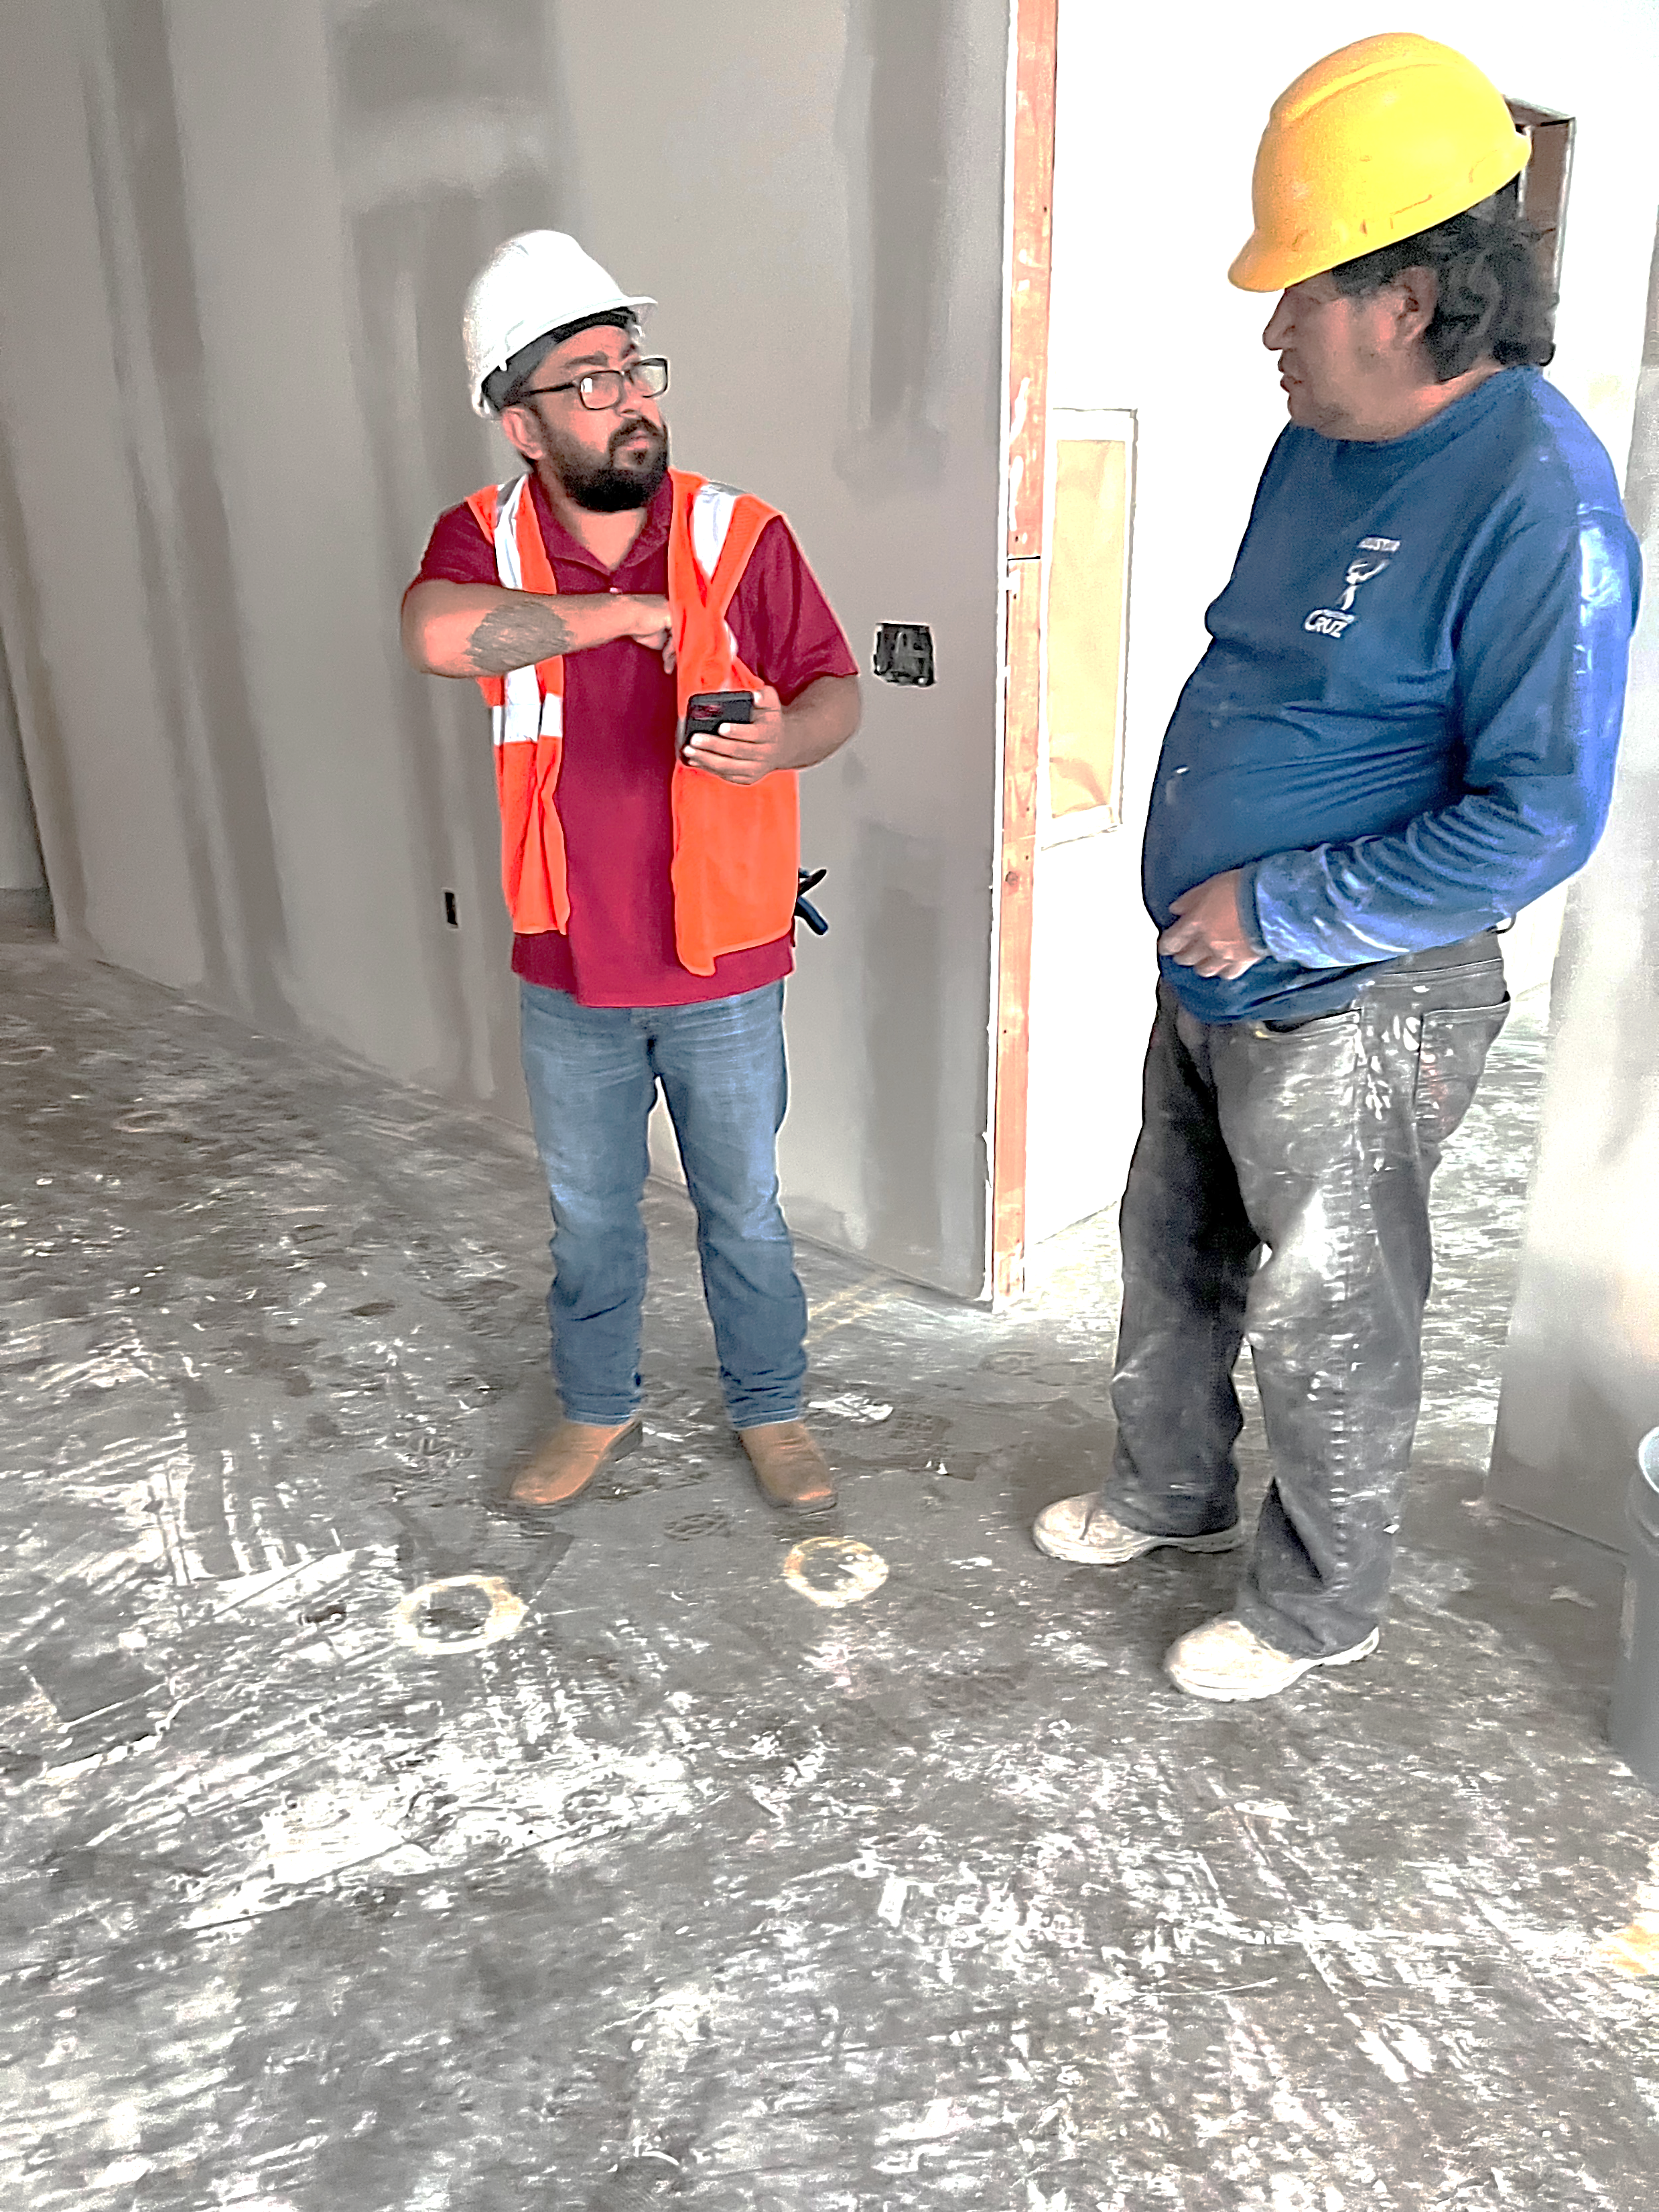
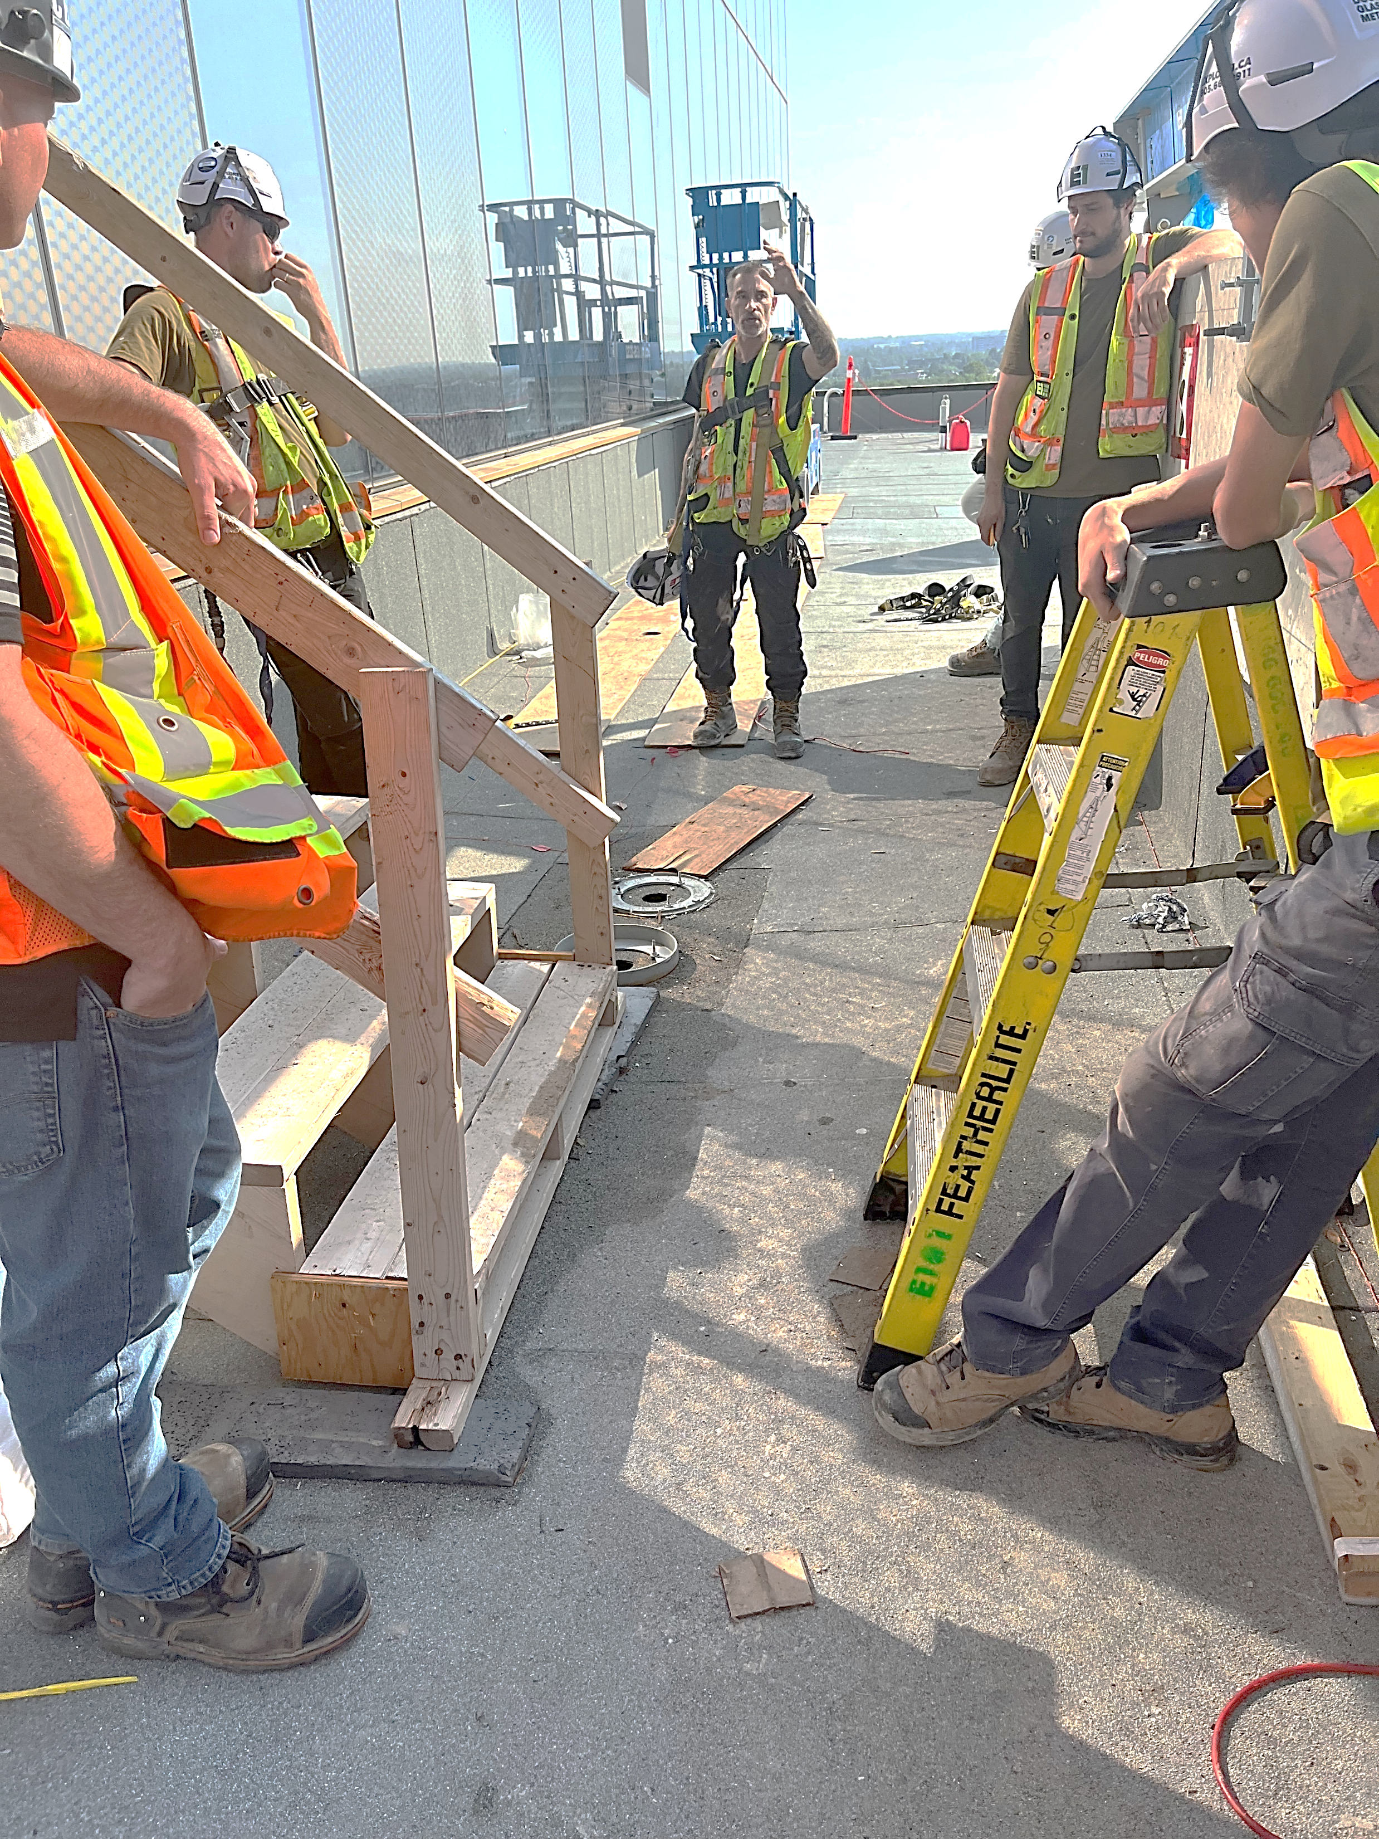
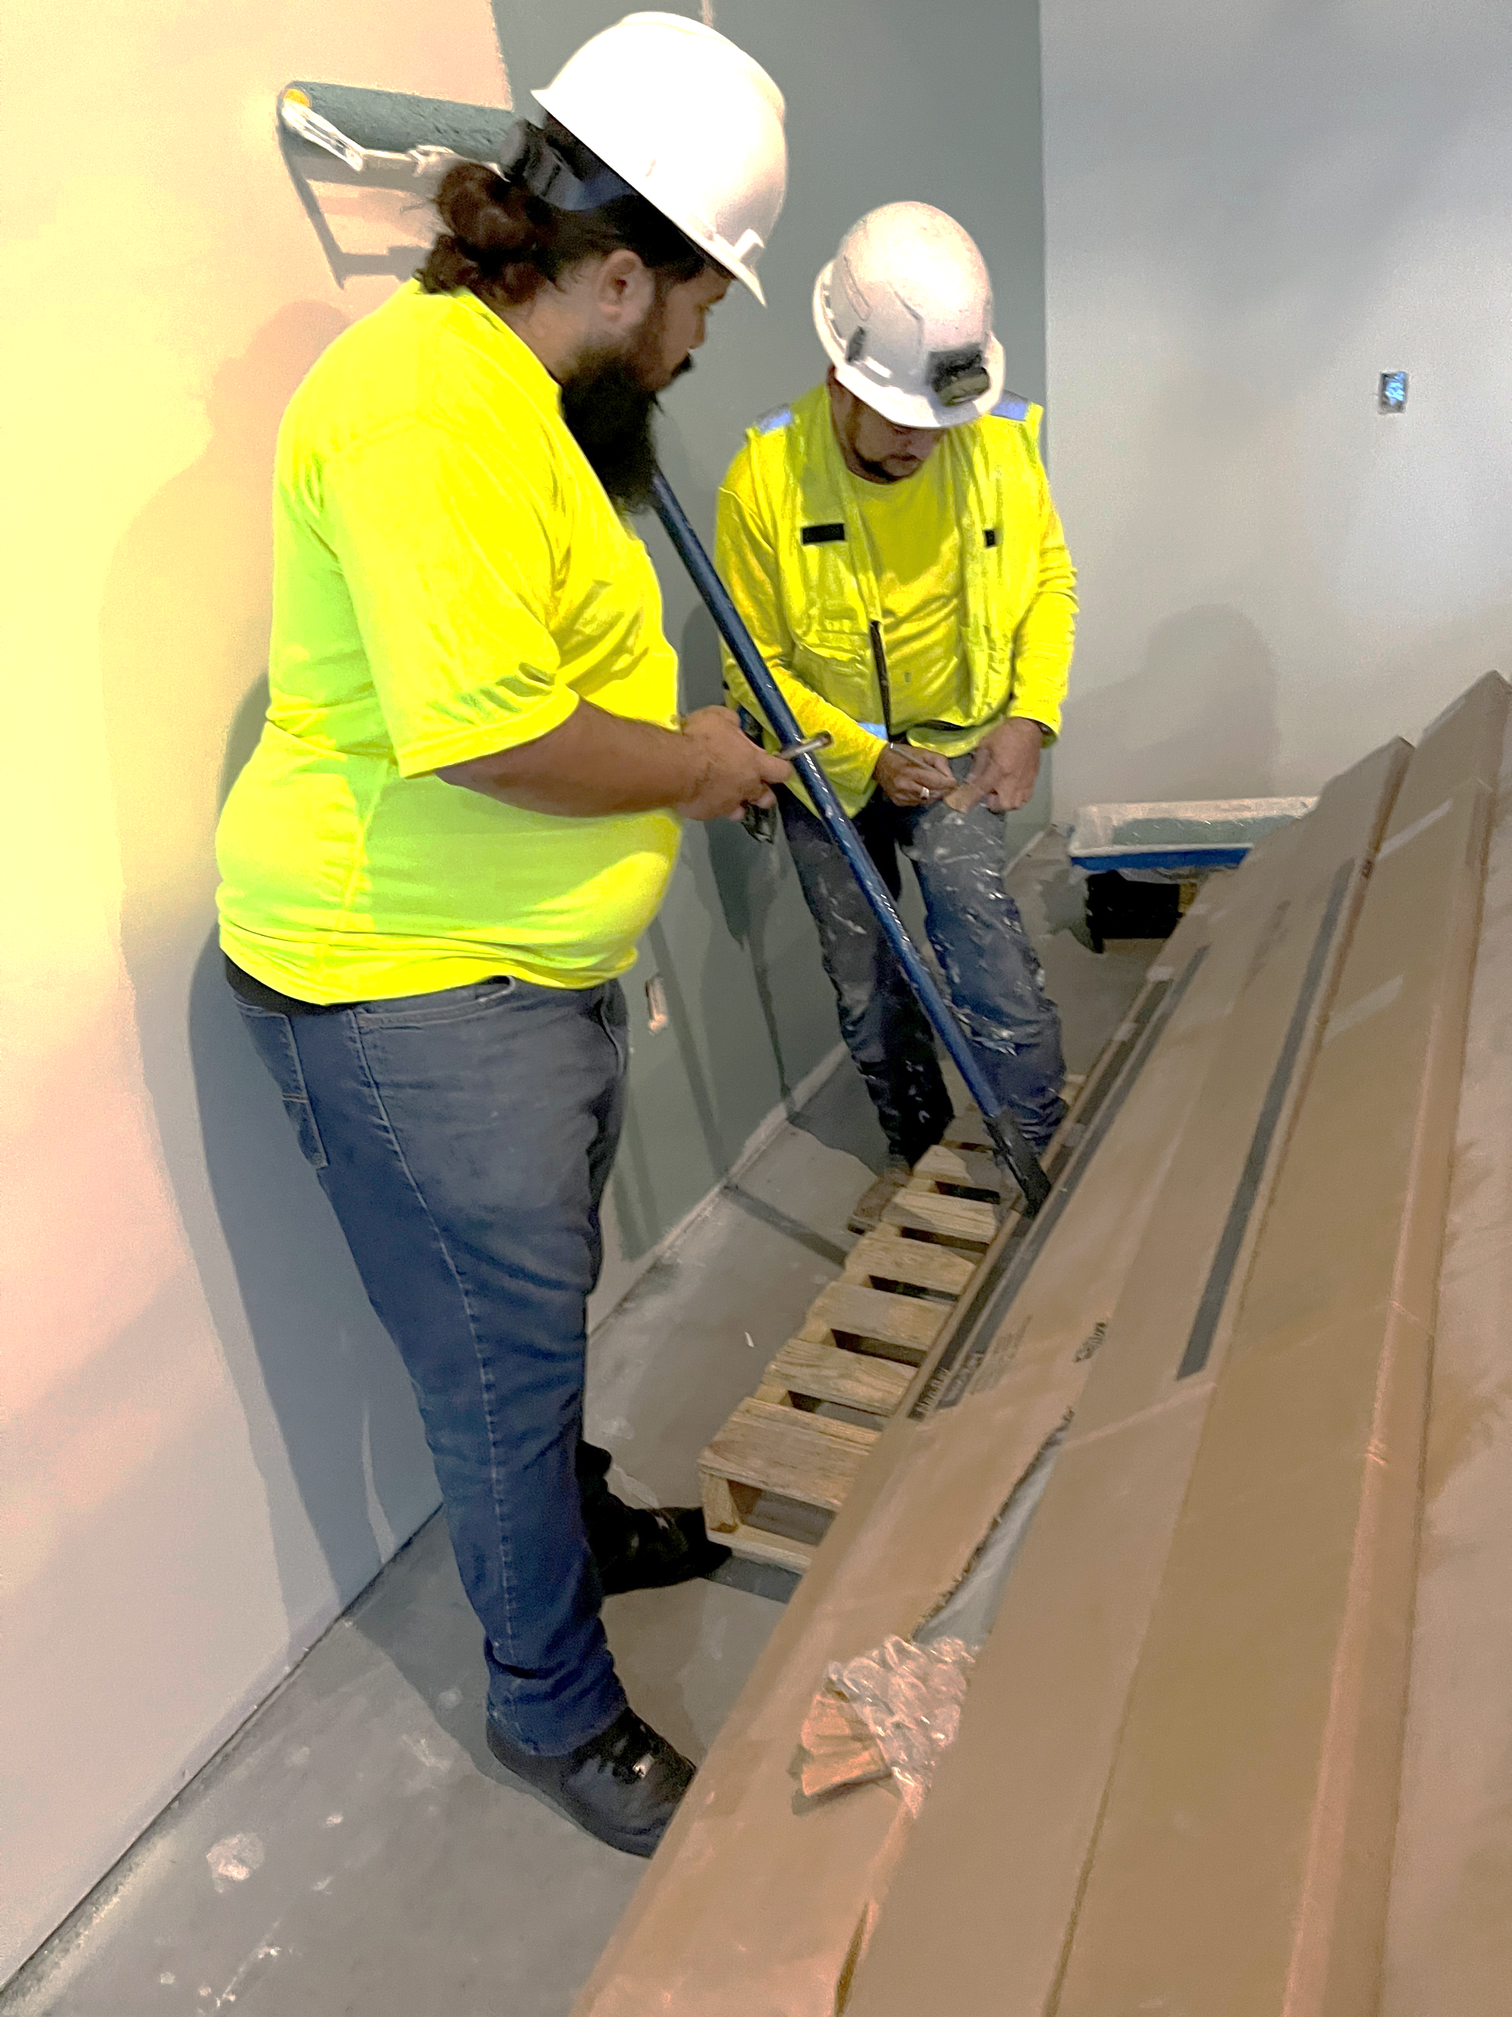
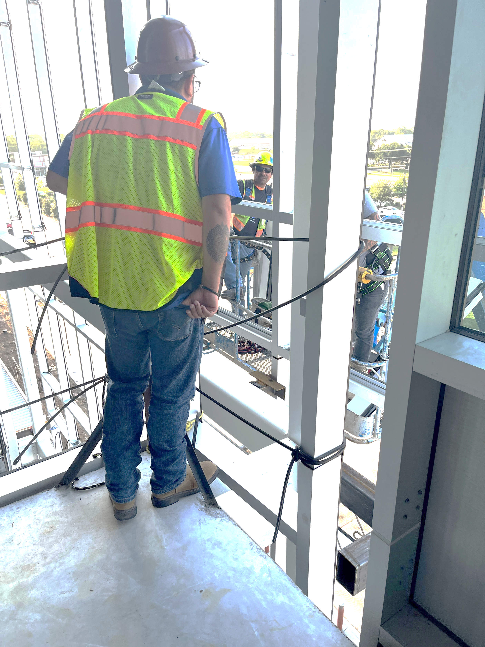
Let’s Talk About Jobsite Visits
COR 1246 Internal Organizing - Staff
Notes:
FACILITATOR NOTES:
ASK the following questions (7-8 minutes):
When you typically talk about the union (if at all) on the job site, how do those conversations go?
What are the potential roadblocks?
Do these conversations positively portray us?
TRANSITION to house calls.

Slide 24
Let’s Talk About House Calls
House Calls
Why do we want to meet members at home?
What are some common objections or myths about housecalling members/workers?
Remember our commitment to building a Strong Union Culture throughout our Council.
COR 1246 Internal Organizing Training
Notes:
FACILITATOR NOTES:
ASK – Where workers might be more open and honest about the union and what they are going through personally at their house.
DISCUSS common objections to house calls, and refute them with real world anecdotal examples.
REMIND participants about the conversations about meeting people where they are at.

Slide 25
Internal Organizing:
Structured Conversations
04
®
iFTI.edu
Notes:
FACILITATOR NOTES:
DISCUSS the difference between transactional interactions with our members and transformative interactions with our members. Using the slides as a guide but focusing on the discussion coming from the group. Revisit the Union Culture discussion from earlier and then move into what a structured conversation looks like and how to have one with a member in the context of internal organizing.
INTRODUCE the topic by calling a couple of people up and telling them to introduce our union in 30 seconds. Then highlight that we talked about transactional vs transformational.

Slide 26

Structured Conversations
How do we approach conversations with members?
Transactional?
Transformative?
COR 1246 Internal Organizing - Staff
Notes:
FACILITATOR NOTES:
ASK – How do we approach conversations with members? Is the interaction Transactional or Transformative?
CONDUCT a group activity (minimum of 3 participants for each group, depending on the size of the group). The goal is to identify transactional vs transformative interactions.
Each participant comes up and approaches a potential member on the job.
Encourage the potential member to join the union (or a contract campaign or some other type of internal campaign).
Each participant will have 2 minutes and hold off giving feedback until the end. Participants will usually try to sell wages and benefits and third-party the union.
DEBRIEF and use the sample conversations to illustrate the necessity of having a transformative conversation.

Slide 27
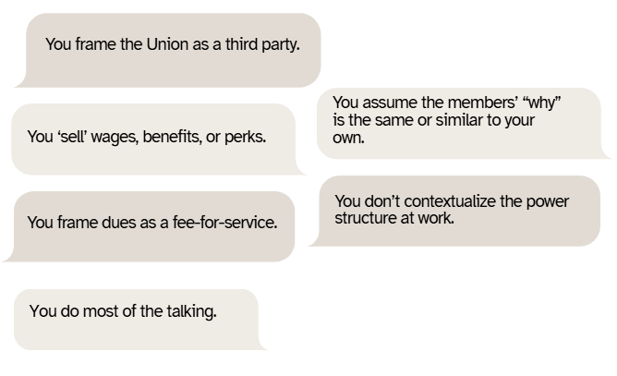


What are the characteristics of a Transactional Interaction?
COR 1246 Internal Organizing - Staff
Notes:
FACILITATOR NOTES:
DISCUSS the characteristics of a transaction interaction.
Union Rep does most of the talking.
Union Rep ‘sells’ wages, benefits, or perks.
Union Rep frames dues as a fee-for-service
Union Rep frames the Union as a third party
Union Rep assumes the members’ “why” is the same or similar to their own.
Rep doesn’t contextualize the power structure at work.

Slide 28
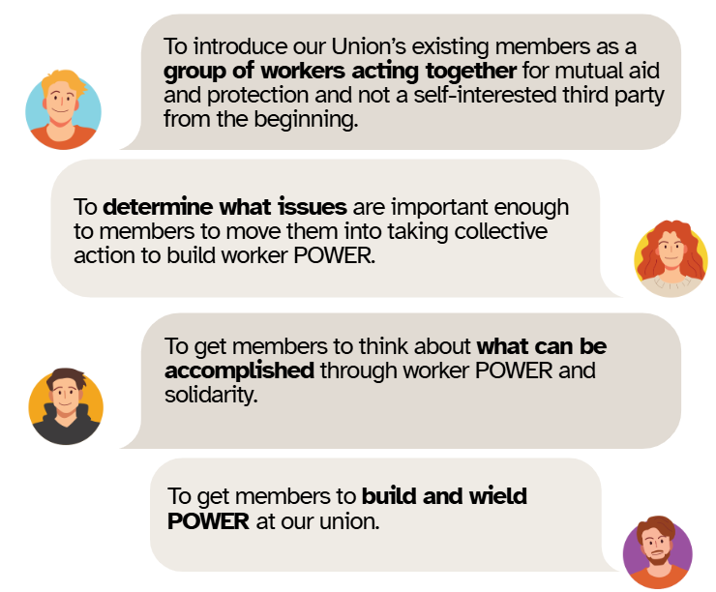
Why do we need to approach conversations with members and potential members differently?
COR 1246 Internal Organizing - Staff
Notes:
FACILITATOR NOTES:
EXPLAIN why we need to approach conversations with members and potential members differently.

Slide 29
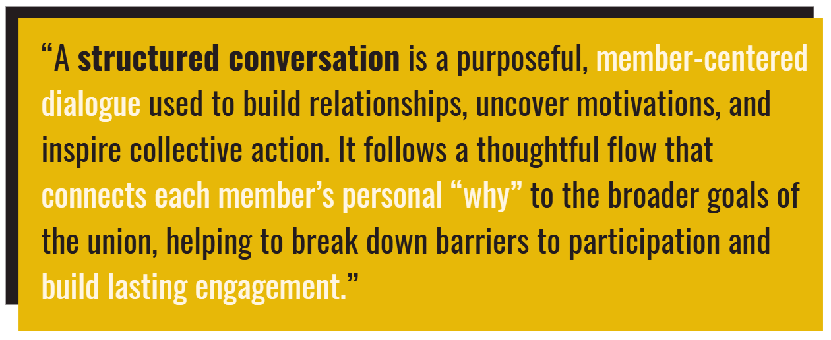
What are Structured Conversations?
COR 1246 Internal Organizing - Staff
Notes:
FACILITATOR NOTES:
ASK – What are structured conversations? Structured conversations are the backbone of any internal organizing campaign. They allow us to break down barriers to member participation by connecting collective action and power building to each member’s ‘why’. Structured conversations are hard, but having real conversations with members is the only way to create enough ownership and buy-in to truly engage members in internal organizing and, more broadly, the union as a whole. Remember that listening to members/workers gets us further than preaching to them.

Slide 30
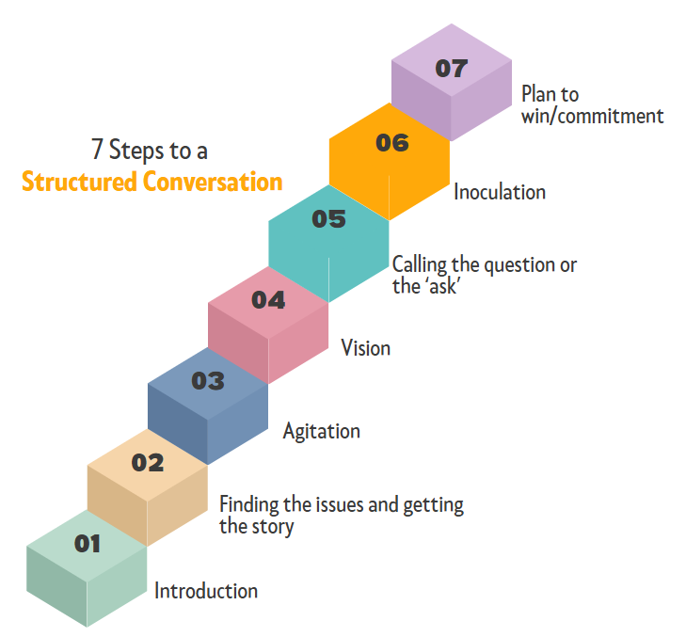
What are the 7 Steps to a Structured Conversation?
COR 1246 Internal Organizing - Staff
Notes:
FACILITATOR NOTES:
ASK – How does it help have a transformative member interaction?
INTRODUCE the 7-step conversation. A 7-Step Conversation focused on listening to and understanding membership concerns and developing solutions based on their ‘why’. A conversation that identifies individual member issues that can be connected to and addressed through member-to-member solidarity and POWER building.
A conversation that identifies Internal Organizing Issues.
DISCUSS the 7 Steps to a structured conversation.
Introduction
Finding the issues and getting the story
Agitation
Vision
Calling the question or the ‘ask’
Inoculation
Plan to win/commitment

Slide 31

Step 1: Introduction
What makes a good introduction?
Who you are & Why you are there. THAT’S IT!
Make why you are there about members taking collective action.
Sample:
“I’m Danny Vuyk with the Glaziers Union and I’m here because your co-workers at Gemtron are fighting back against the company’s proposed elimination of your pension”.
COR 1246 Internal Organizing - Staff
Notes:
FACILITATOR NOTES:
ASK – What makes a good introduction?

Slide 32
Step 2: Finding the issues and getting the story
How do we identify issues and get the story?
Start with an Icebreaker
Ask Open-Ended Questions
Go Broad, and then Go Deep
Listen, Don’t be Defensive
Get Personal, that’s where the ‘why’ is.
Follow up, don’t rush, and learn as much as you can about the member, their life, and concerns.
COR 1246 Internal Organizing - Staff
Notes:
FACILITATOR NOTES:
ASK – How do we identify issues and get the story?
Examples of open-ended questions:
How does that affect your life at home?
What did you do before you worked here?
How would you describe a typical day at work?
How have things at work changed for you over (selected timeframe, since the recession, etc.)?
What do you like/dislike about the industry?
Do conditions at work allow you to be/do your best?

Slide 33
Step 3: Agitation
How do we agitate?
Who, What, When, Where, Why, How Questions
  Who made that decision?
  What Happened?
  When were those changes made?
  Where did that happen?
  Why do they treat people that way? Why is that?
  How does that make you feel? How do they keep getting away with that?
COR 1246 Internal Organizing - Staff
Notes:
FACILITATOR NOTES:
ASK – How do we agitate?

Slide 34
Step 4: Vision
How do we lay out the Vision for our Members?
What is the Vision?
  Collective Action and Worker POWER is the Solution
Laying it out:
More open ended questions
What would it take to change things?
What would happen if we all stood together?
POWER OF ONE VS. POWER OF MANY!
COR 1246 Internal Organizing - Staff
Notes:
FACILITATOR NOTES:
ASK – How do we lay out the vision for our members?
Examples of open-ended questions:
What would you change at work if you had a chance?
What would it take/what would need to happen for you to earn more/get respect?
Can you change any of that on your own?
Do other people on your job/in your trade feel that way too?
What would happen if everyone stood together and demanded change?

Slide 35
Step 5: Calling the Question or the ‘Ask’
How do we call the Question?
The ‘Question’ is a choice between POWER and powerlessness at work and a commitment to fight for the vision- Which side are you on?
Frame the Choice
Agitation to Action, Abandon Comfort Zones
Tell your Union Story
Make the ‘Ask’
COR 1246 Internal Organizing - Staff
Notes:
FACILITATOR NOTES:
ASK – How do we call the Question?
STATE that organizers at this stage are doing four things (not necessarily in this order).
Tell Your Union Story - Go around the room. Pick 3 to 4 people and say ‘Your union story was this…’, and then ask. ‘When I introduced myself, what was my union story?’

Slide 36
Step 6: Inoculation
How and why do we inoculate our members?
Inoculation is about preparing members/workers for the long struggle and roadblocks up ahead.
We need to be real with them about how employers will inevitably react to collective action.
We need to be real about the fact the victories are hard to come by and always take a fight.
We must discuss this struggle with every member.
COR 1246 Internal Organizing - Staff
Notes:
FACILITATOR NOTES:
ASK – How and why do we inoculate our members?
ASK the following questions:
How many of you have been in a contract negotiation and it didn’t go as you wanted. How did that feel when you go the news? Were you prepared for it?
What could have prepared you for that? Did you still want to stay involved?

Slide 37
Step 7: Plan to Win/Commitment
Making a Plan to Win with a Member/Worker
Assess Members’ level of commitment to the Union as a whole and the campaign at hand.
Give Members realistic hope for the future and commit them to being involved.
Help Members understand that the first step to winning anything is to bring workers together.
Don’t do things for Members.
COR 1246 Internal Organizing - Staff
Notes:
FACILITATOR NOTES:
ASK the following questions:
How do we plan to win with a member/worker?
What does a plan to win look like?
EMPHASIZE that their involvement in the Building Union Power campaign will strengthen our union. Then encourage them to attend Phase 1 training and sign the pledge.

Slide 38
Objections from Members and Workers
Objections are usually based on fear or futility.
Time, effort, ownership, and rejection are hard.
Past experiences with the union have led to pushback.
Union Dues
COR 1246 Internal Organizing - Staff
Notes:
FACILITATOR NOTES:
Go around the room and ask what objections members have.
ASK - What are some reasons a worker might object?
Objections are understood and addressed as being based usually on senses of fear or futility.
Time, effort, ownership, and rejection are hard.
Past experiences with the union have led to pushback.
Union Dues
DISCUSS how we counter those conversations.
WRITE the answers in a flip chart, then have a conversation about how you address those conversations.

Slide 39
Overcoming Objections
Remember the issues (their Issues, not ours).
Affirm, Acknowledge, Redirect (AAR) Method
Call the question again.
Make it personal.
Don’t let members off the hook.
Get back to their ‘why’.
COR 1246 Internal Organizing - Staff
Notes:
FACILITATOR NOTES:
ASK someone for an objection.
ASK – How do we overcome objections?
Remember the Issues (Their Issues, not ours)
Affirm, Acknowledge, Redirect (AAR) Method
Call the Question Again
Make it Personal
Don’t let members off the hook.
Get back to their ‘why’.
DEMONSTRATE how the conversation should go using the steps above with the redirect to their why.

Slide 40
Talking About Dues
Dues are for building POWER, not a fee-for-service.
Shift the conversation away from ‘what do I get for my dues?’ to a question of what it takes to fight the boss (Do we have more POWER if we have money? How do we build the most POWER at the bargaining table?).
Facilitate a sense of worker ownership of the Union.
Members are more likely to fight if they understand dues as transformative rather than transactional.
COR 1246 Internal Organizing - Staff
Notes:
FACILITATOR NOTES:
DISCUSS dues.
PROVIDE an objection and have a council staff member give a redirect.

Slide 41
Internal Organizing:
Active Listening Skills
05
®
iFTI.edu
Notes:
FACILITATOR NOTES:
PRESENT the listening skills slides and DISCUSS real-world scenarios where they have been applied.
DISCUSS the importance of applying listening skills during a transformative conversation with a member.

Slide 42
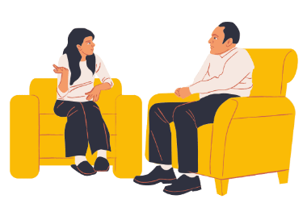
What is Active Listening?
Active Listening is an essential skill for fostering effective communication, particularly in union settings where challenging or sensitive conversations are common.
COR 1246 Internal Organizing - Staff
Notes:
FACILITATOR NOTES:
STATE that Active listening is essential for fostering effective communication, particularly in union settings where challenging or sensitive conversations are common. Active listening involves fully concentrating, understanding, responding, and remembering what the other person is saying. It requires not just hearing the words but also recognizing the speaker's emotions, body language, and underlying concerns. This approach helps to build trust, resolve conflicts, and improve relationships with union members.
STATE that on the next slides, you will review key elements of active listening and examine the top 3 questions from members. These scenarios provide an opportunity to practice active listening and dealing with difficult situations.
EXPLAIN that Listening isn’t waiting for your turn to speak. Listening is the ability to make others feel heard. One of the ways to do that is to practice using these three statements when someone is telling you something: “Tell me more.“ "Go on.” “What else?” If you try this, you will quickly learn how much effort it takes to pay attention to what the person you’re talking to is saying and resist the urge to interrupt, correct, or fix what they say. And that’s why it’s a skill. Because all skills take effort, and in this case, the effort is worth it.
Additional Resources:
Video Link - Simon Sinek on LinkedIn: Listening isn’t waiting for your turn to speak. - https://www.linkedin.com/videos/simonsinek_listening-isnt-waiting-for-your-turn-to-activity-7290821845153435649-6I3I/
Video Link - How To Actively Listen (Even During Uncomfortable Conversations) - https://www.youtube.com/embed/Lkj86o69c5c

Slide 43
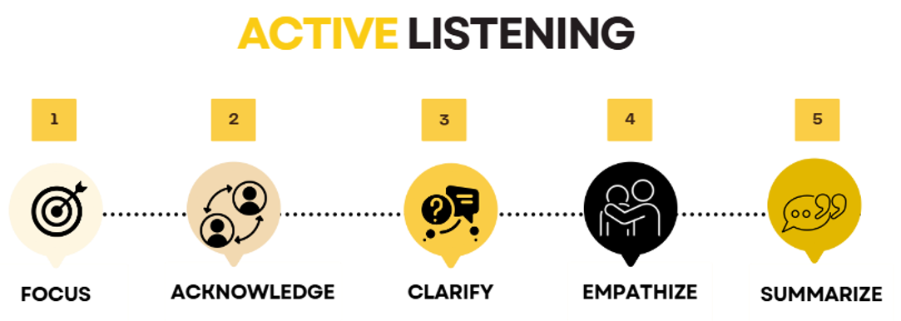
Key Elements of Active Listening
COR 1246 Internal Organizing - Staff
Notes:
FACILITATOR NOTES:
DISCUSS the key elements of active listening.
Focus – Stop talking. Pay full attention to the speaker.
Avoid Distractions - Keep phones, notebooks, etc. put away. Look members in the eye for the entire conversation.
Be Observant – Take note of your surroundings. You can learn a lot about a member through their surroundings.
Focus your attention on their words, their ideas, and feelings related to the subject. Watch their facial expressions, hand gestures, etc. Put down any papers, pens, etc. Sometimes you can learn as much from what is not being said as you can from what they say.
Slow Down - Our brains process thoughts four times faster than spoken words. It’s easy to skip ahead in conversation, using your assumptions to fill in the gaps and formulate a response. Resist this urge and focus on what is being said.
Keep an Open Mind - Never assume that you already know what is important to the member you are speaking with.
Don’t Interrupt - Take the time to listen to the member or worker’s entire story. Let the speaker express their thoughts fully before responding. Everything the member wants to tell us has value in moving a campaign forward.
Don’t Fish - Avoid asking leading questions like ‘wouldn’t you agree that…..’
Acknowledge – Show that you are engaged by nodding, maintaining eye contact, and using brief verbal acknowledgments ("I see," "Go on").
Clarify – Ask questions to clarify the message. Be careful not to ask questions that might embarrass the speaker. Get to the main points. Concentrate on the ideas and not the illustrative material, i.e., examples, statistics, etc.
Empathize – Sometimes members need to blow off steam. Let them. We’re there to listen, not to judge. Show understanding of the speaker's feelings. Recognize your prejudices. Don’t allow your feelings towards the person to influence your interpretation of what they are saying.
Don’t Dismiss a Member or Worker’s Concerns - Even if a member expresses disappointment with the Union or with you, let them know you hear them and ask what it would take to make things right.
Find common ground - You don’t have to agree on everything. Acknowledge points on which you disagree. Emphasize points on which you do. Look for areas on which you agree and ask questions around that. Workers and Members will respect your opinion if you respect theirs.
Don’t feel the need to sell something - A Union representative is not a salesperson. We are genuinely looking to learn the Member’s point of view and build something collectively around that.
Organizing vs. Gathering: Remember the Difference - Organizing is more than putting several people with the same views in one place. It’s bringing people from different viewpoints together around a common cause.
Summarize – Paraphrase what was said to confirm understanding. Avoid jumping to conclusions.
Show that you hear what the member is saying - React. Match body language. Repeat what you said as you understood it. If you don’t understand or misunderstand, ask to clarify.

Slide 44
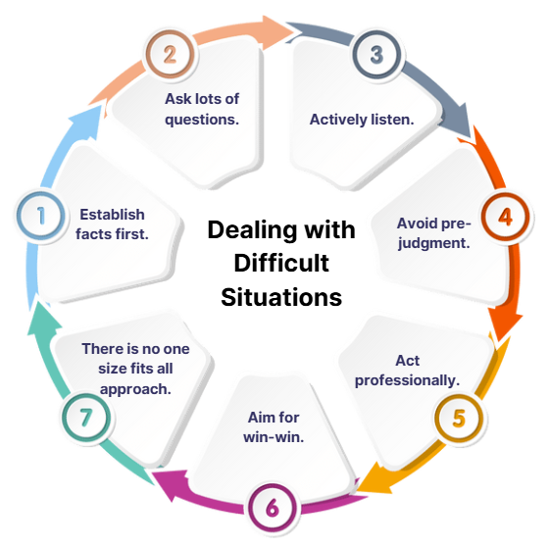
7 Key Tips for Dealing with Difficult Situations
COR 1246 Internal Organizing - Staff
Notes:
FACILITATOR NOTES:
DISCUSS the tips in dealing with difficult situations.
Establish facts first. When difficult situations arise, it is all too easy to jump to solution mode too quickly. While there may be a limited amount of time when fast action is absolutely necessary, your first step to a successful resolution is to establish the facts. Remember that facts, as opposed to hearsay or opinion, are verifiable. Be alert to being swayed by the opinion of those who are strong characters. When people make claims or assertions, ask for specific examples of what happened and when it happened. Often, you find that there isn’t a lot of substance behind what is being said.
Ask lots of questions. Questions, especially the short, powerful variety, are a great way of getting to the core issue rather than all the details that someone is trying to provide to you. Think of it like peeling an onion; each layer is getting you closer to the core. Open questions are a much better way of getting to the core of the issue. Try these questions:
When did this issue arise?
How did it impact what you were trying to achieve?
What would be an ideal outcome from your perspective?
What are the options?
How can we move forward?
Actively listen. There is little point in asking questions if you are not actively listening to what is being said. Resist the temptation to jump in before you have properly listened to the different points of view. Most of the time we listen passively or not at all, simply going on the defensive or pushing our point of view. If you can listen with intent and pay attention to what is being said and the speaker’s body language, then you will do a much better job of listening. Better listening leads to better understanding and a better response.
Avoid pre-judgment. We all, if we are honest, will form some judgments immediately. While these might be right at the end of the day, don’t let pre-judgment get in the way of establishing the real issues. Aim to stay open-minded and objective rather than assuming or guessing.
Act professionally. The challenge for you is to remain professional at all times. A good test of this is to ask yourself how would you like to be treated if you were not the manager or leader but an aggrieved party. Think about the longer-term consequences for you and your career if you deal with a difficult situation unprofessionally. People will respect you more if you try to always be professional in your dealings with them, even on a difficult issue.
Aim for a win-win. While this is not always possible, you should aim to find solutions that don’t result in a feeling from one party that they have lost while another has won. This might require some careful negotiation around what would constitute a good outcome for all those involved. Accept that there may be situations where you have to be very direct, but make these situations the exception rather than the norm.
Remember there is no one-size-fits-all approach. Each situation is different. While there might be some common ground, remember that there is unlikely to be a one-size-fits-all approach to difficult situations. Adapt your approach depending on the situation. Good planning and preparation will help make sure you can adapt while dealing with the situation or issue. Bottom line – Handling difficult situations is just part and parcel of managing and leading. Where do you need to focus your attention in terms of developing your competence?

Slide 45
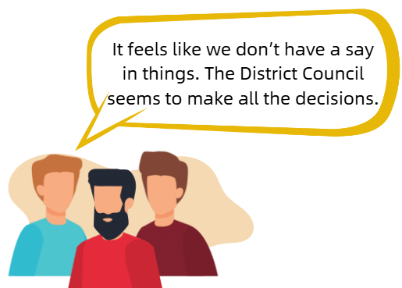
Practice Active Listening - Scenario 1: We Don’t Have A Voice.
COR 1246 Internal Organizing - Staff
Notes:
FACILITATOR NOTES:
ASK - How will you address Scenario 1?
PRACTICE Active Listening Skills:
Focus: Give the member your full attention, eliminating any distractions.
Acknowledge: Nod, maintaining eye contact.
Clarify: Ask, “Can you give me some examples of situations where you felt like you didn’t have a say or weren’t involved in the decision-making?”
Empathize: “I totally hear where you're coming from, and I understand why you’d feel that way. It’s tough when it seems like decisions are being made without input from everyone.”
Summarize: “So, what I’m hearing is that you're frustrated because you don't feel heard or that your input isn't being valued. Is that correct?”
HIGHLIGHT ONE UNION value.

Slide 46
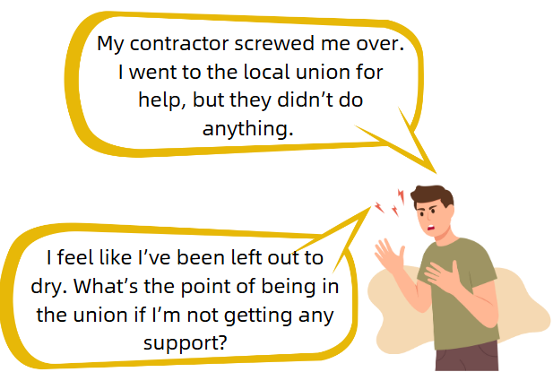
Practice Active Listening - Scenario 2: Our Union Does Not Support Me.
COR 1246 Internal Organizing - Staff
Notes:
FACILITATOR NOTES:
ASK - How will you address Scenario 2?
PRACTICE Active Listening Skills:
Focus: Give the member your full attention, eliminating any distractions.
Acknowledge: Nod, maintaining eye contact.
Clarify: Ask, “Can you walk me through exactly what happened with the contractor? What steps did you take when you reached out to the union for help? I want to make sure I understand everything clearly so we can address this properly.”
Empathize: “It sounds like you’ve been through a lot, and I’m really sorry this has happened. The union should have been there to help you sooner. We’ll get this sorted and hold the people accountable. I’m going to personally follow up to make sure this is addressed.”
Summarize: “I want to make sure you’re taken care of. We’ll work together. I’ll also help ensure that the union does what it’s supposed to do for you. You’ve got my full support.”
HIGHLIGHT ONE FAMILY value.
Possible Scenario 2a: Union Member: “The union only wants my money. Where does my money go?"

Slide 47
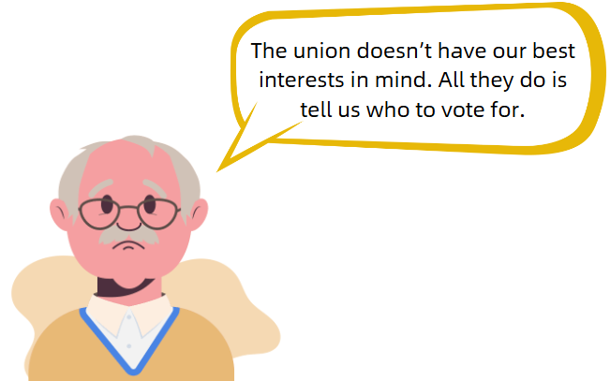
Practice Active Listening - Scenario 3: Failed To Prioritize Our Interests
COR 1246 Internal Organizing - Staff
Notes:
FACILITATOR NOTES:
ASK - How you will address Scenario 3?
PRACTICE Active Listening Skills:
Focus: Give the member your full attention, eliminating any distractions.
Acknowledge: Nod, maintaining eye contact.
Clarify: Ask, “Can you tell me more about what makes you feel like the union doesn’t care for you?”
Empathize: “I understand how frustrating it must be to feel like your concerns aren't being addressed.”
Summarize: “We take your concerns seriously and will work to ensure you're supported moving forward.”
HIGHLIGHT ONE FIGHT value.

Slide 48
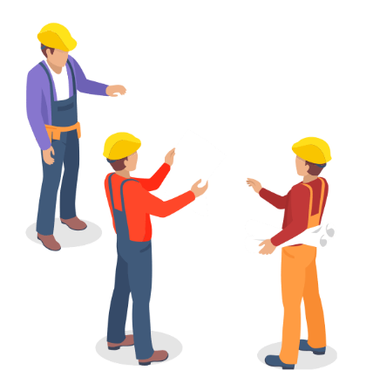
What Can YOU Do?
In your experience, what are some of the things you’ve heard as a member?
COR 1246 Internal Organizing - Staff
Notes:
FACILITATOR NOTES: Break into groups.
ASK members - What are some of the things you’ve heard as a member, in your experience?
ASK - How you will address this scenario?
PRACTICE Active Listening Skills:
Focus: Give the member your full attention, eliminating any distractions.
Acknowledge: Nod, maintaining eye contact.
Clarify: Ask, “Can you give me some examples of situations where you felt like you didn’t have a say or weren’t involved in the decision-making?”
Empathize: “I totally hear where you're coming from, and I understand why you’d feel that way. It’s tough when it seems like decisions are being made without input from everyone.”
Summarize: “So, I’m hearing that you're frustrated because you don't feel heard or that your input isn't being valued. Is that correct?”
HIGHLIGHT ONE UNION value.
TELL participants to use their listening skills to probe on the job, talk to journeymen or other mentor figures; use active listening skills on the job

Slide 49
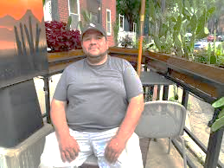
Member Conversation Roleplays
BUILD a worker profile by charting the worker's name, age, occupation, and story (5-6 personal issues, 5-6 work issues, and 2 hobbies).
DEMONSTRATE a membership transformative conversation and how to use the structured conversation.
DEBRIEF
COR 1246 Internal Organizing - Staff
Notes:
FACILITATOR NOTES:
CONDUCT a group exercise. Every participant will get the chance to do a member conversation roleplay (4-hour practice)
After each roleplay, DEBRIEF and ask for feedback from the group.
EXPLAIN how the group will build a worker profile by charting the worker's name, age, occupation, and story (5-6 personal issues, 5-6 work issues, and 2 hobbies), and write on a flipchart.
ASK who wants to play the worker first, and then call that person up and give them a marker.
STEP OUT of the room and give the group 5 minutes to come up with the worker profile. The person playing the worker turns the profile around so that it can't be seen by the facilitator when they come back into the room.
DEMONSTRATE a membership transformative conversation and how to use the structured conversation to find the workers 'why’, and their issues, and connect it to building collective power in the workplace and committing to our Union Values.
REPEAT the worker profile exercise for each participant, with the participant playing the organizer stepping out of the room and the person playing the worker filling out the profile sheet. (I've attached a worker profile sheet from one of the NLRB Trainings as an example).
ASK the group to give feedback to the person playing the organizer and then give some feedback as a facilitator. Tell them to provide their feedback citing experience in past internal organizing campaigns.

Slide 50
Internal Organizing:
Building Internal Campaigns
06
®
iFTI.edu
Notes:
FACILITATOR NOTES:
DISCUSS the different types of internal organizing campaigns and explain the basics of each.
EXPLAIN how to select the right campaign and the steps for developing each. FOCUS on how members are involved in each step and how to move a campaign forward with members.
REVIEW the steps to developing an internal organizing campaign, share real-world experience in doing so, and lead a discussion around how we might apply these principles in the District Council.

Slide 51
Getting Started
How do we identify and launch the right internal campaign for our Local or District Council?
The key lies in listening to our members. The issues that surface in our one-on-one conversations point us toward the right campaign.
  What issues can be solved through collective action and POWER Building?
  How do we leverage our Collective Bargaining Agreements (CBAs) and the bargaining process to the workplace POWER balance?
COR 1246 Internal Organizing - Staff
Notes:
FACILITATOR NOTES:
DISCUSS how we identify and launch the right internal campaigns for our Local or District Council?
EMPHASIZE that the key lies in listening to our members (through one-on-one conversations). The issues that surface in our one-on-one conversations point us toward the right campaign.

Slide 52
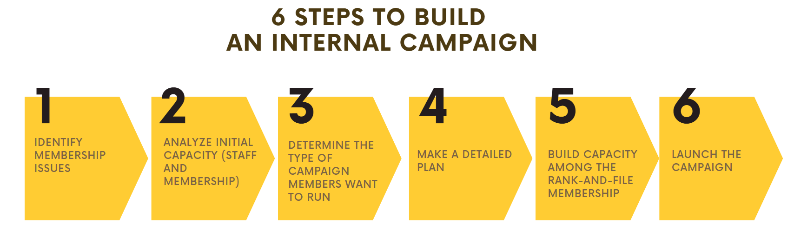
6 Steps to Build an Internal Campaign
COR 1246 Internal Organizing - Staff
Notes:
FACILITATOR NOTES:
DISCUSS the steps to build an Internal Campaign.
Identify Membership Issues
Analyze Initial Capacity (Staff and Membership)
Determine the Type of Campaign Members Want to Run
Make a Detailed Plan (Objectives, Goals, Metrics, Timeline, Charting, Tracking, Defining your Win)
Build Capacity among the Rank-and-file Membership
Launch the Campaign

Slide 53
Step 1: Identify Member Issues
4 Questions for Success - Is the issue:
Widely Felt?
Deeply Felt?
Winnable?
Does it build the Union, POWER, and Leaders?
COR 1246 Internal Organizing - Staff
Notes:
FACILITATOR NOTES:
DISCUSS the 4 questions for success.
Widely Felt? Do most members agree that the issue is a problem?
Deeply Felt? Do most members feel strongly enough about the problem to take collective action and engage in POWER building? We are looking not only for common problems or issues, but also shared hopes.
Winnable? Is there a clear path to victory if Members stick together?
Does it build the Union, POWER, and Leaders? Will winning on the issue bring more members into the union, activate and engage inactive members, set the stage for more victories in the future, and give rank and file leaders ownership of the Union?
Draw back on the member conversation role play. What issues did we identify, and what would we hope to see happen after you address those issues?
ASK the following questions.
What happens if we identify an issue that is not widely felt or winnable?
Once you identify issues, how do you test it?

Slide 54
Step 2: Analyze Initial Capacity
How do we assess capacity?
Who will lead the campaign (think members)?
What District Council staff will participate?
What does our Member base look like now?
What are our strengths and vulnerabilities as a Membership (SWOT, PEST, etc.)
COR 1246 Internal Organizing - Staff
Notes:
FACILITATOR NOTES:
ASK the following questions:
Who has done this in the past?
How did that go? What could have been thought our better?
Did we identify the right leaders within the membership?
Who would need to be involved in internal organizing campaigns form the staff? (answer everyone) Because it promotes unity with the staff and membership by setting the example.
Ask who has done and SWOT and have them tall you what it is and how it works (then have them do a SWOT as a group based on the issues they came to consensus on. (10 minutes)

Slide 55
Step 3: Determine the Campaign
What do members want to FIGHT for?
Connect Members Issues to the broader concept of collective action and building POWER.
Acting together is the solution to the Issue.
What types of action can be built around the issue?
Let Members decide what type of internal campaign they want to run.
COR 1246 Internal Organizing - Staff
Notes:
FACILITATOR NOTES:
Draw back from your conversation about identifying the right issues. Take issues and explain to participants how they relate to our organizing efforts.
PROVIDE an example - High Cost of living (member issues).
How does that connect to our organizing efforts?
What plays into us not getting the raises we want?
Are workers getting their fair share of construction profits?
PROVIDE a specific example - Denver Local 930 and 79 membership identified cost of living and improved training as their two issues. The council was working on wage theft campaigns. They explained how wage theft affected our ability to negotiate good wages to offset the cost of living. Membership got engaged, helped canvas for city council candidates, participated in job action with city council members, attended city council meetings to speak on the issue with non-members, and got a wage theft ordinance passed that made General Contractors liable for wage theft committed by the contractors they hired. Members were engaged through house calls and recruited to a larger meeting and help think of ways the council can help with organizing.

Slide 56
Step 4: Make a Detailed Plan
Why is having a campaign plan important?
So Members have a roadmap to success.
So Members can see where they are and what their role is in growing the Organization.
So Members can measure and assess our collective progress as a Union.
It creates buy-in and ownership from the rank-and-file.
MEMBERS MUST BE INVOLVED FROM START TO FINISH
COR 1246 Internal Organizing - Staff
Notes:
FACILITATOR NOTES:
HAND-OUT an example detailed internal organizing plan. Then break them into groups and talk about why it is important to write out your mission, build long-term goals, and then take actions to accomplish short-term goals. If a plan is not written, it is not real.
ASK the following questions:
How can you hold yourself and others accountable for something that is not written?
Who can tell me what a long-term goal is?
Who can tell me what a short-term goal is?
EXPLAIN that long-term goals are overarching that take a year or more to accomplish and should be measurable, while short-term goals are accomplished over months and are also measurable.

Slide 57
Step 4: Make a Detailed Plan, continued
What are the key components of a plan?
Objectives
Measurable Goals and Metrics of Attainment
Benchmarks
What are the Attainable Results?
The plan should be simple, written, accessible, and easy for members to follow
COR 1246 Internal Organizing - Staff
Notes:
FACILITATOR NOTES:
REVIEW a sample plan.
ASK the following questions:
What were the objectives?
What were the metrics?
What were the benchmarks?
Were the plan/goals attainable?
Where was the cross-department collaboration in the plan?

Slide 58
Step 5: Build Membership Capacity
How do we build enough Membership support and capacity to execute the plan?
Activate our initial base of rank-and-file activists to help us identify and organize new leaders into the campaign.
Teach leaders how to have 1-on-1 organizing conversations with their co-workers around issues.
Build a committee and membership campaign structure.
Engage in structure tests to test capacity and POWER
COR 1246 Internal Organizing - Staff
Notes:
FACILITATOR NOTES:
STATE that this is a conversation about committee building and using the one on one conversations to build that committee and drive the campaign forward
ASK the following questions:
Think about the role plays we did. Who would you identify as leader? How would you approach them about forming the committee? Are they the right person to lead it?
Who has heard of a structure test? Then give examples of structure test (members wearing union shirts to work on the same day)
Who can give me examples of structure test they have done in the past?
What happens if we don’t do a structure test? Sometimes we think we are further along then what we are and end up starting from behind if we don’t utilize structure tests.

Slide 59
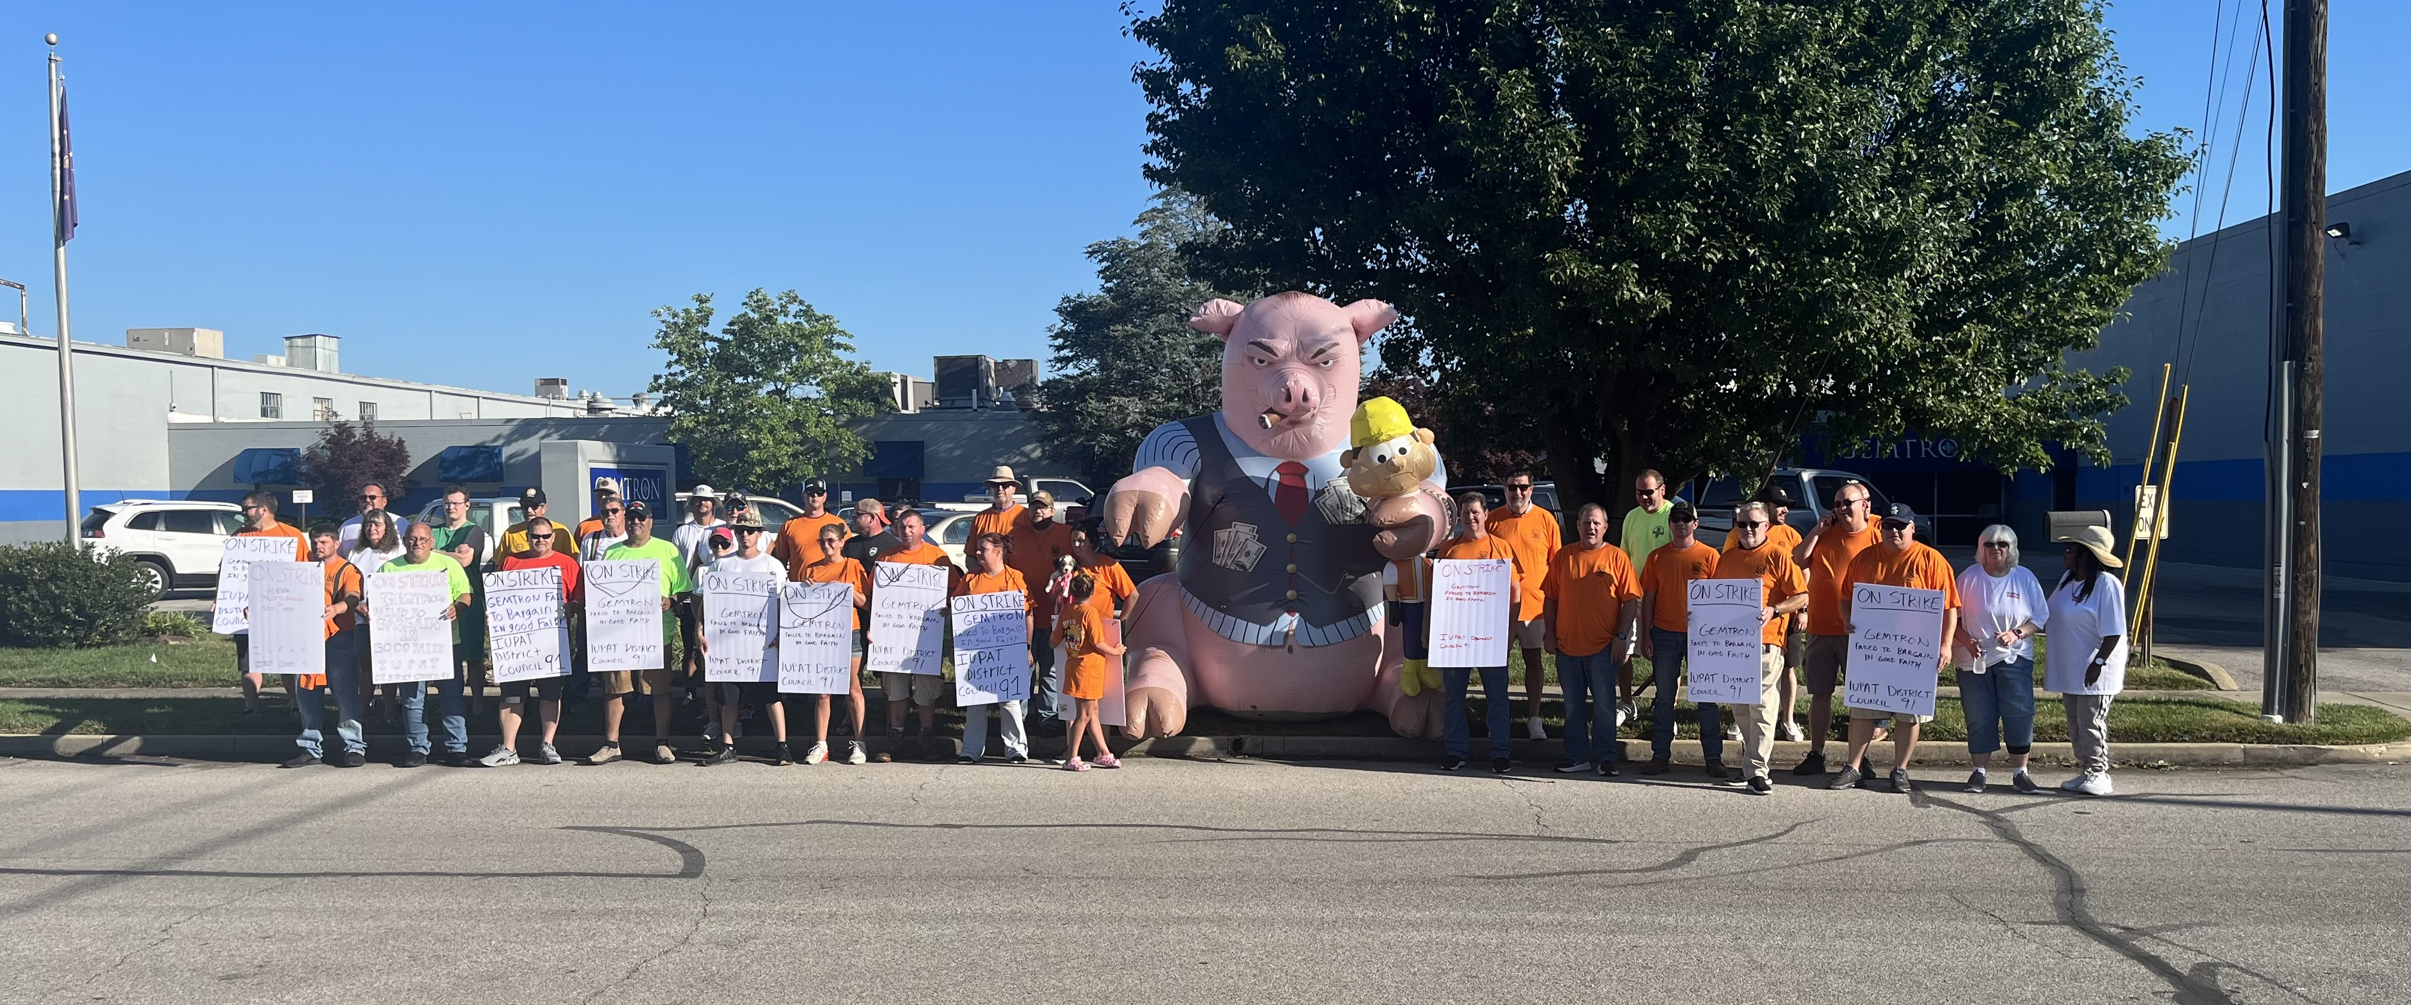
Step 6: Launch the Campaign
Are the members ready to go public with their struggles?
COR 1246 Internal Organizing - Staff
Notes:
FACILITATOR NOTES:
ASK the following questions:
Are the members ready to go public with their struggles?
Why do we need to take our campaign to the public? (contract fight, strikes, policy, etc.)
How could the public be helpful in our campaigns?
What did we identify in our SWOT, and how are we using that to decide when to go public and move things forward?

Slide 60

Connecting to a Movement
The first step in power building is connection—linking members active in internal organizing to external campaigns, and connecting external campaign workers to our members’ struggles within the larger labor movement.
COR 1246 Internal Organizing - Staff
Notes:
FACILITATOR NOTES:
STATE the following points:
At the beginning of the training, we talked about how members view the Union and how members experience the Union.
We agreed that if members view the Union as part of a movement and experience the Union in an inspirational sense, they are more likely to engage in building the Organization.
EMPHASIZE that connecting members involved in Internal Organizing to External Campaigns and connecting workers involved in External Campaigns to our Members’ fights is the first and simplest step to plugging Members and Workers into the larger POWER building Labor Movement.
DISCUSS how we connect internal and external campaigns, work across departments, and how members can inspire non-union workers organizing and vice-versa.
EXPLAIN the broader labor movement and tie it back to the Union Culture discussion from the beginning of the training.

Slide 61
Making House Calls
07
®
iFTI.edu
Notes:
FACILITATOR NOTES:
WRAP UP the training by getting out in the field and house-calling our members. APPLY the skills learned in the training to identify what the membership issues are and then discuss in a debrief how some of those issues might lead to a good internal organizing campaign moving into the future.
NOTE: Servicing Director of the Council wraps everything up with a call to action.
ENSURE that the council has a list of 3 to 5 members for every 2 participants to a house call. The house calls should be done on members who are not active in the union.

Slide 62
House Calls
Apply the skills learned in the training.
Identify the membership issues.
Let’s get in the trenches and talk to our members.
SOLIDARITY FOREVER
COR 1246 Internal Organizing - Staff
Notes:
FACILITATOR NOTES:
DISCUSS the reminders when making house calls.
DEBRIEF on how some of those issues might lead to a good internal organizing campaign moving into the future.

Slide 63
Individual Workplans
08
®
iFTI.edu
Notes:
FACILITATOR NOTES:
WRAP UP the training by getting out in the field and house-calling our members.
EMPHASIZE to apply the skills learned in the training and identify what the membership issues are, and then discuss in a debrief how some of those issues might lead to a good internal organizing campaign moving into the future.
NOTE: Servicing Director of the Council wraps everything up with a call to action.
Based on the debrief from the member’s house call, the instructor will ask each representative to build out a work plan for the following week to follow up on those house calls and the issues they identified

Slide 64
Bringing it all Together through Individual Internal Organizing
Workplans
Individual Internal Organizing Workplans for Union Representatives:
Time Management and Working Internal Organizing into Our Day-to-day Work
Internal Organizing Workplan Sample, Discussion, and Exercise (simplified example)
COR 1246 Internal Organizing - Staff
Notes:
FACILITATOR NOTES:
EXPLAIN time management and working internal organizing into a representative’s day-to-day plan.
DISTRIBUTE handout – Sample Internal Organizing Campaign in Local 77.
PRESENT a sample Individual work plan for internal organizing is presented, reviewed, and discussed with the group.
The group wraps up with an Individual work plan exercise and presents to the rest of the group.
Make sure you are open and honest about how your house calls went to ask for feedback from your peers and director. Use this feedback to improve your one-on-ones.

Slide 65

Summary
Stronger together, unstoppable as one!
Build union power, grow membership, and ignite solidarity.
Speak up, stand firm, and organize for a future where every worker’s voice is heard!
iFTI.edu
Notes:
FACILITATOR NOTES:
ASK participants to share their key takeaways.

Slide 66

Questions or Comments?
Contact Information
Daniel Vuyk
dvuyk@iupat.org
International Union of Painters and Allied Trades
7234 Parkway Drive
Hanover, MD 21076
http://www.iupat.org
ONE UNION. ONE FAMILY. ONE FIGHT!
iFTI.edu
Notes:
FACILITATOR NOTES:
ASK questions or comments from participants.
STATE contact information.

