Slide 1




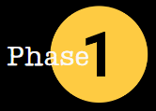
DC 77
COR 1057 Building Union Power - Stewards
One Union One Family One Fight
Education and Engagement
Notes:
FACILITATOR NOTES:
PREPARE the course materials and equipment to present this course effectively.
Course Materials and Equipment: PowerPoint Presentation - Instructor Computer, Internet Connection, TV/Projector, Handouts – Value Statement and Case Studies/Simulations, Flip Chart(s) / Markers (at least three colors) for brainstorming or group activities, and Name Tents/Tags
MAKE the necessary modifications when appropriate.
CHECK room setup. Is the room arranged in a way that is comfortable to the participants and conducive to learning? If possible, a U-shaped table and chair set-up should be used. A U-shape allows participants to interact with one another and the instructor.
REVIEW Presentation Tips: There are three types of audience members:
The Givers – They’re locked in, nodding, leaning forward, feeding you energy.
The Takers – Arms crossed, scrolling their phone, radiating resistance.
The Neutrals – Present, but not yet engaged—waiting to be swayed.
Here’s where inexperienced speakers (and leaders, and creators) go wrong:
They focus on the wrong people. It’s human nature to fixate on the grumpy guy in the third row. The one who looks like he’d rather be anywhere else. But that’s a trap. A dangerous one. Because the moment you give your energy to a taker, you play their game. Your confidence wavers. Your momentum stalls. The room follows. Not good.
But if you anchor yourself in the givers? Your energy surges. Your presence expands. The neutrals lean in. And suddenly, the entire room shifts. It's actually extraordinary the difference this small shift in focus can make.

Slide 2

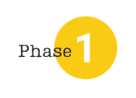


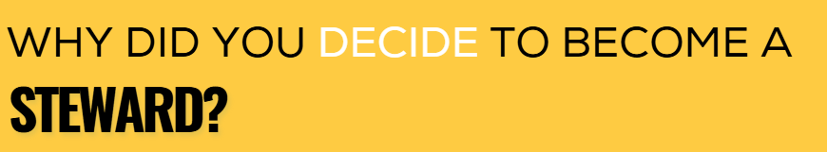
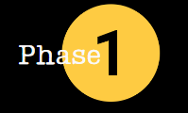
Introduction
COR 1057 Building Union Power - Stewards
Notes:
FACILITATOR NOTES:
For Instructor Introduction:
Describe your experience with the IUPAT, noting if you have ever worked without union representation and focusing on how you became a member of the union apprenticeship, organizing, etc.
Explain your role as a union organizer (or union rep., leader, etc.), emphasizing your responsibilities as an educator/trainer.
Introduce Representatives and Officers of the District Council/Local Union (if applicable)
CONDUCT the following activity for participants:
SAY ‘Before we go further, I want to pull you all into the conversation. In just a moment, I will ask you all to pair off (give the option to do groups of three if necessary, based on the room setup). And I want you to take turns answering these three questions for each other. Please share your answers to the questions. I’m going to give you five minutes to talk in your groups. Go ahead.
DO: *** use a timer to give them 4-5 minutes to discuss ***
SAY ‘Ok, it sounds like most everyone has had a chance to share. Let’s bring it back to the main group.
ASK – ‘Who wants to share, either your answers or your partner’s answers?
DO the following:
Take 5-10 answers, depending on the size of the group.
Use flip chart paper to record the answers.
Pull out common themes (a majority of people joined because someone recruited them – family or friends)
FOCUS on how most people are looking to get something out of the union – higher wages, benefits, retirement. Very few people will say that they joined because they wanted to join for selfless reasons.

Slide 3
Course Description
COR 1057 Building Union Power - Steward
Centered around IUPAT’s value statement "One Union, One Family, One Fight," the course emphasizes the importance of commitment, mutual support, and solidarity in driving meaningful change within our union.
This training module is designed to empower our members by fostering a shared understanding and commitment to our core values.
Participants will gain insight into their personal role in strengthening union power, understand the value of working together toward common goals, and leave with a deeper sense of how individual actions contribute to our union’s success.
COR 1057 Building Union Power - Stewards
Notes:
FACILITATOR NOTES:
ASK - What is union power? It is shared decision-making, accountability, and member-led action.
EXPLAIN the course description.
STATE that this course is about Building Union Power. Our strength and power as a union are derived from our members. This course will help us better understand what it means to live our union values of One Union, One Family, One Fight.
EMPHASIZE that true union power is when members are informed, engaged, and organized, not just represented.

Slide 4
Learning Outcomes
Explain the importance of your role as a Steward to promote IUPAT’s mission and value statement.
Identify key events and milestones in our union’s history.
Explain IUPAT’s Mission and Values Statement —One Union, One Family, One Fight.
Recognize and describe the decline in union power and its key factors.
Discuss ways members can take an active role in building power within our union.
COR 1057 Building Union Power - Stewards
Notes:
FACILITATOR NOTES:
STATE the learning outcomes.

Slide 5
Course Topics
1
2
3
4
5
Introduction
Market Share Past and Present
IUPAT History
Our Mission and Value Statement
Member Empowerment
COR 1057 Building Union Power - Stewards
Notes:
FACILITATOR NOTES:
STATE that there are four topics in the course.

Slide 6
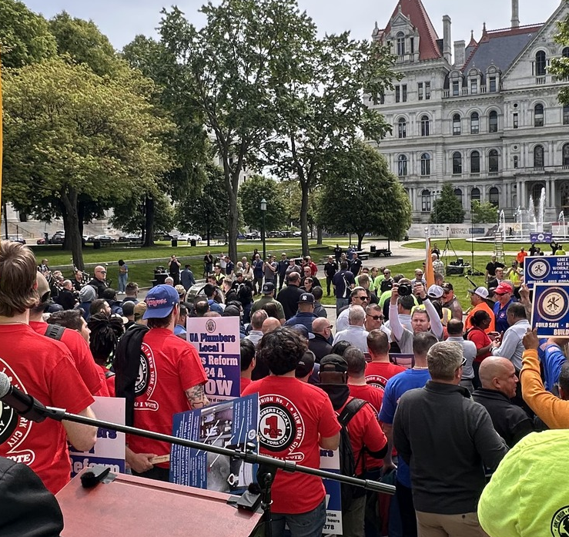
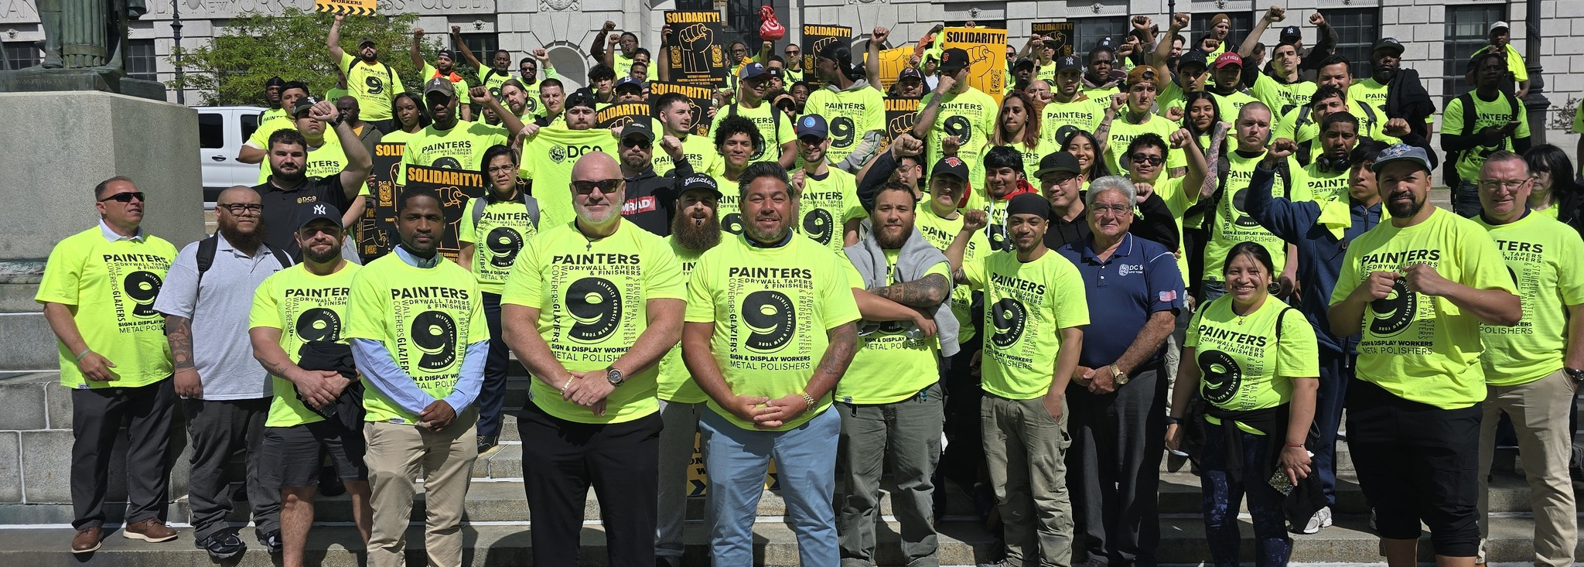

IUPAT Steward
Introduction and Role
01
®
iFTI.edu
Notes:
FACILITATOR NOTES:
ASK – What is your role as a union steward?

Slide 7
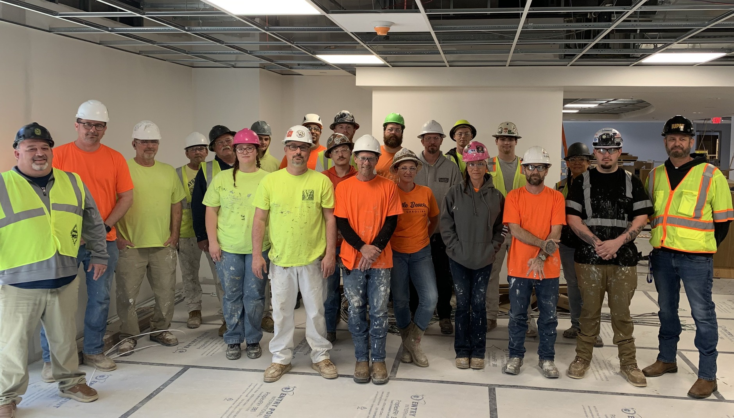
Role as Steward
Who is a Steward?
Representative for fellow union members in the workplace
First Point of contact for members
Leader and Messenger of the IUPAT’s mission and value statement
COR 1057 Building Union Power - Stewards
Notes:
FACILITATOR NOTES:
EMPHASIZE the role of a steward in the Building Union Power Critical to the program’s success.
Representative for fellow union members in the workplace, ensuring their rights and contract provisions are upheld.
Stewards serve as the first point of contact for members, addressing workplace issues, communicating union information, and advocating for their needs. This makes stewards crucial for building trust and engagement within the union.
Leader and messenger of the IUPAT’s mission and value statement

Slide 8
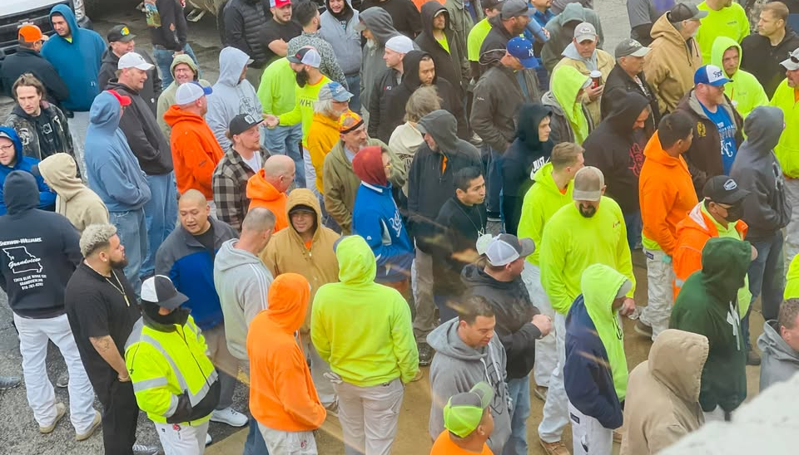
Key Responsibilities
Representing Members
Enforcing the Contract
Resolving Workplace Issues
Communicating Information
Educating Members
Building a
Strong Union
COR 1057 Building Union Power - Stewards
Notes:
FACILITATOR NOTES:
DISCUSS the Key Responsibilities of a Steward.
Representing Members: Stewards act as the primary link between members and the union leadership, advocating for their concerns and rights in the workplace.
Enforcing the Contract: They ensure that all members are aware of and adhere to the collective bargaining agreement (CBA) and that their rights under the contract are protected.
Resolving Workplace Issues: Stewards investigate and help resolve workplace problems, grievances, and disputes between members and employers.
Communicating Information: They disseminate information about union meetings, events, workplace actions, and political issues to members.
Educating Members: Stewards inform members about their rights, responsibilities, available resources, and benefits of union membership.
Building a Strong Union: By effectively representing members and fostering communication, stewards contribute to a stronger and more engaged union. Effective stewards are essential for building a strong and vibrant union by empowering members and advocating for their interests.

Slide 9


Construction Unions:
Market Share Past and Present
02
®
iFTI.edu
Notes:
FACILITATOR NOTES:
ASK - What is Market Share? In the context of the union, it represents the portion of workers in a specific industry or sector who are union members.
SAY ‘Let’s start by diving into our market share as a union throughout our history.’
ASK - Can anyone define what market share is? (Take a few answers.) Our market share is simply how many workers who do our crafts belong to a union. So if there are 100 glaziers in this state, and 40 of them are in our union, then our market share is 40%.
ASK - Does anyone have an idea of why that matters? (Take a few answers.) That’s right, the higher our market share, the more powerful our union is.

Slide 10
Market Share - 1947
Question 1
What percentage of construction workers belonged to labor unions in the U.S. in the 1940s?
A. 12%
B. 40%
C. 73%
D. 87%
COR 1057 Building Union Power - Stewards
Notes:
FACILITATOR NOTES:
SAY ‘Here is my question for you. What percentage of construction workers do you think belonged to labor unions in the US in the 1940s?’
By a show of hands, how many think it is A, 12%?
And how many think it was B, 40%?
How many think it’s C, 73%?
And how many think its D, 87%?
DO: Click to reveal the answer on the next slide.

Slide 11

Market Share - 1947
Question 1
What percentage of construction workers belonged to labor unions in the U.S. in the 1940s?
Answer
D. 87%
D. 87%
COR 1057 Building Union Power - Stewards
Notes:
FACILITATOR NOTES:
SAY ‘That’s right, in the late 1940s, 87% of construction workers in the United States belonged to a union. I’ll give you a spoiler: that number is higher than it is today.
ASK - Why does that matter? Like we said before, the higher our market share, the more power we have to negotiate better contracts. I want you to keep this number in mind while we go through some history that has impacted our union.’
ASK - What do you think this meant for our power and influence?

Slide 12
Market Share - 2024
Question 2
What percentage of construction workers belonged to labor unions in the U.S. in 2024?
A. 10.3%
B. 40.5%
C. 73.2%
D. 25%
COR 1057 Building Union Power - Stewards
Notes:
FACILITATOR NOTES:
ASK Question 2: What percentage of construction workers belonged to labor unions in the U.S. in 2024?
ASK participants to raise their hands if they believe the answer is A. ASK them to raise their hands if they believe it’s B, C, and D.

Slide 13
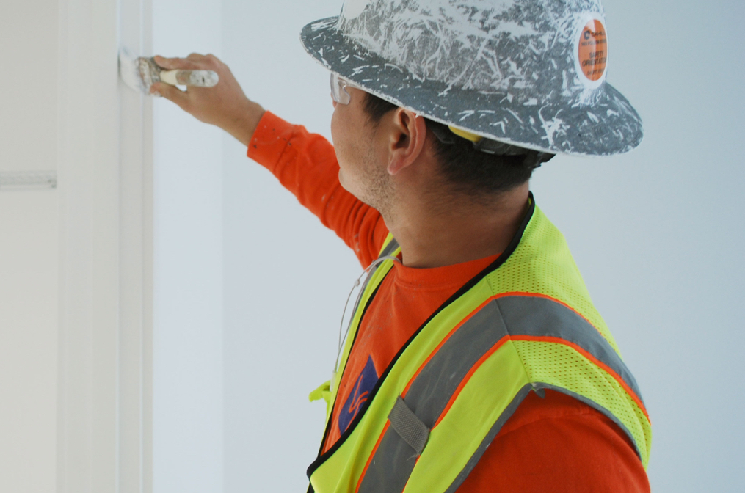
Market Share - 2024
Question 2
What percentage of construction workers belonged to labor unions in the U.S. in 2024?
Answer
A. 10.3%
COR 1057 Building Union Power - Stewards
Notes:
FACILITATOR NOTES:
STATE that the answer is A. According to the Associated Builders and Contractors (ABC), as of 2024, only 10.3% of construction workers in the U.S. belong to a labor union, marking a record low percentage. This figure represents the lowest percentage of unionized construction workers on record. If we continue to do the same thing for the next 20 years, what percentage of all construction workers in the US will belong to unions in 2030? A class participant may want to do the calculation. In DC 91, a glazier calculated 9.5%
EMPHASIZE that this means today, just 1 in 10 construction workers in the US is union.
REMIND participants that this decline is why we are all here today!
EXPLAIN the following:
These are not just numbers on a graph.
These numbers represent our ability to raise industry standards.
These numbers represent our power to win industry-leading contracts.
These numbers represent our strength to protect our pensions, to fight for better safety standards, and to enshrine our right to organize.

Slide 14
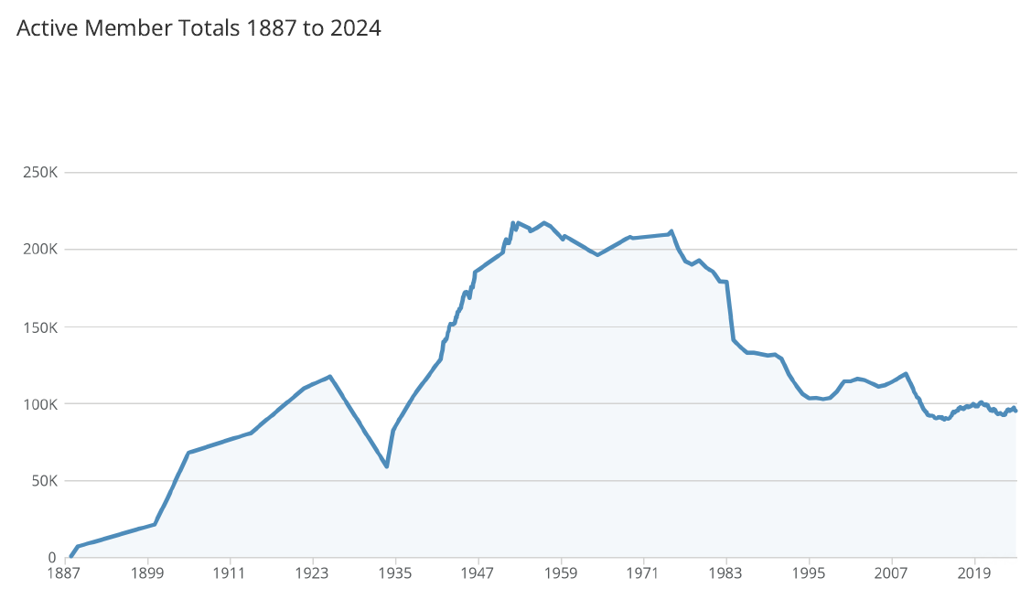
Trend of Total Membership
COR 1057 Building Union Power - Stewards
Notes:
FACILITATOR NOTES:
STATE that the previous slide was about the construction industry as a whole. So, let’s take a look at the IUPAT’s membership specifically.
DISCUSS the chart for active member totals from 1887 to 2024.
The Brotherhood of Painters and Decorators of America was organized formally in 1887. Within a year, the union boasted a membership of over 7,000 tradesmen and more than 100 Local Unions.
The first 35 years of our union’s history saw steady growth.
ASK – What happened in 1923? - The great depression caused a steep decline in not just our union, but all unions, as work dried up across the country.
ASK – What happened in 1935? [Wagner Act or National Labor Relations Act]
This landmark piece of US labor law guaranteed private sector employees the right to organize, form unions, and engage in collective bargaining. It also prohibits employers from engaging in unfair labor practices, such as interfering with union organization or discriminating against employees for union activity.
Almost immediately, labor organizing takes off (including for the IUPAT). In just 12 years from 1935 to 1947, we tripled the size of our union from approximately 60k to 220,000.
ASK - What does this chart tell us? Even though IUPAT has gained members, its market share has declined.
Offer these general conclusions:
The demand for construction has steadily risen and will continue to rise.
With this decline in the percentage of the total construction workforce that is organized has come a decline in the unions’ market share, as reflected in the declining real incomes of construction workers.
One reason for the decline is the loss of union values.

Slide 15

Percentage of Construction Workers Belonging to Unions in the U.S.
87%
Taft-Hartley
Organized Capital
Professional Air Traffic Controllers’ Organization (PATCO).
NAFTA
Recession
Pandemic and Rising Union Approval
10%
COR 1057 Building Union Power - Stewards
Notes:
FACILITATOR NOTES:
DISCUSS the highlights per decade.
Taft-Hartley Act (1940s) - The Taft-Hartley Act (https://www.nlrb.gov/about-nlrb/who-we-are/our-history/1947-taft-hartley-substantive-provisions) was passed, which amended the NLRA, and set labor back on several fronts:
Section 8(b) added unfair labor practices for labor unions.
Section 8(b)(7), “secondary boycott provision,” -- A group's refusal to work for, purchase from, or handle the products of a business with which the group has no dispute.
Section 14(b), “right to work provision,” gave state legislatures the authority to outlaw the union shop (i.e. contract provisions stating that new hires must join the union after a certain length of service with the company). No close shops.
McCarthyism (1950s) - Republican Senator Joseph McCarthy of Wisconsin exploited Cold War frustrations charging the highest reaches of government and labor unions in the name of anti-communism. After the militant strikes of 1945–1956, capitalists and congressional investigators were happy to “Red Bait” union officials during strikes and elections. At that time Communists and other radicals led several important trade unions. In 1949, the CIO expelled about 900,000 workers, for refusing to purge themselves of Communists leaders. These expelled unions reflected the diversity of the American working class to a greater degree than those unions that remained in the CIO. Contributed to a change in the perception of the union by the public.
Corporate Attacks (1960s) - Big corporations (construction users -- get names of companies to refer to here i.e. Dow Chemical in Midland, MI. Also Upjohn Pharmaceutical in Portage, MI.) conspired to break the Building Trades unions by promoting non-union contractors, and in some cases, denying bids to unionized employers. Their strategy was to “divide and conquer.” Perception of union as thugs.
Construction Recession (1970s) – A severe downturn in the construction industry fueled by high inflation, high interest rates, and high unemployment heightened the competitive pressures from young non-union contractors and undermined the vitality of the union sector.
Political Backlash (1980s) - An anti-labor climate emerged that resisted supported legislation (like common situs picketing) and undermined the enforcement of existing prevailing wage laws and OSHA standards and regulations.
Professional Air Traffic Controllers’ Organization (PATCO). These well-educated, well paid workers, many of them US Air Force veterans, complained of the crushing mental and physical strains of air traffic control work. Mental burnout forced the average controller to retire at age thirty-five. When the FAA did little to resolve these problems, PATCO struck in August 1981. President Reagan quickly fired more than ten thousand (10,000) striking air traffic controllers and filled their jobs with supervisors and inadequately trained replacements. Ironically, PATCO had been one of the few unions to support the Republican presidential candidate in 1980.
NAFTA/Competing Unionism (1990s) - The North American Free Trade Agreement or NAFTA is an agreement signed by the governments of the United States, Canada, and Mexico creating a trilateral trade bloc in North America. The agreement came into force on January 1, 1994. It superseded the Canada-United States Free Trade Agreement between the U.S. and Canada. In terms of combined purchasing power parity GDP of its members, as of 2007 the trade block is the largest in the world and second largest by nominal GDP comparison. GDP - The gross domestic product (GDP) or gross domestic income (GDI) is the amount of goods and services produced in a year, in a country.
Undocumented workers, underground economy, 1099 workers
Break-up of AFL-CIO / Lack of Union Solidarity
Mention that President Clinton a Democrat signed NAFTA into law.
911 & Great Recession (2000s)
The 9/11 Attacks and Union Responses: The September 11 attacks in 2001 had a profound effect on the U.S. and the labor movement. Many unions responded by stepping up their advocacy for workers in the affected industries, such as emergency responders, construction workers, and transportation employees. Workplace Safety: Labor unions played a significant role in pushing for better workplace safety regulations following the attacks. For instance, unions in construction and emergency services were involved in demanding better protection for workers at Ground Zero.
The George W. Bush era (2001–2009) had significant effects on labor unions and the labor industry in the United States. While the period did not see a huge surge in union membership, several key policies and events impacted the labor movement, particularly regarding workers' rights, collective bargaining, and union influence.
Citizens United & the Rise of Social Media (2010s)
Trump’s Pro-Business, Anti-Union Policies: The Trump administration enacted policies that were seen as undermining unions and workers' rights, including support for right-to-work laws and NLRB appointments favoring businesses.
Rise of Social Media: Social media became a critical tool for organizing, especially in non-unionized sectors like gig work, retail, and fast food, leading to campaigns like Fight for $15 and organizing efforts at companies like Amazon.
Pandemic (2020s)
Key Impacts of COVID-19 on Labor:
Essential Workers and Increased Union Demands: The pandemic brought essential workers, including healthcare workers, grocery store employees, delivery drivers, and warehouse workers, into the spotlight. These workers faced high-risk conditions, long hours, and low pay. As a result, there was a surge in calls for higher wages, better working conditions, and stronger workplace protections.
Strikes and Protests: There were widespread protests and work stoppages among frontline workers demanding better safety protocols, hazard pay, and sick leave. Some healthcare and warehouse workers organized strikes or joined unions to demand better treatment during the pandemic.
Shift to Remote Work and Job Insecurity: The pandemic accelerated the trend of remote work, particularly in industries like tech, education, and finance. While many white-collar workers transitioned to home offices, blue-collar workers, gig workers, and service workers faced mass layoffs or had to continue working in unsafe conditions. Many workers in sectors like hospitality, restaurants, and retail experienced job losses or furloughs, exacerbating existing economic inequalities.
Support for Unions and the PRO Act: Biden has expressed strong support for unions and workers’ rights. One of his key labor policy initiatives was backing the Protecting the Right to Organize (PRO) Act, a comprehensive labor law reform designed to make it easier for workers to organize unions, address issues like misclassification of workers, and strengthen penalties for employers engaging in anti-union activities.
Despite the Biden administration’s push to support workers, former President Trump’s influence remained strong in U.S. politics, especially among conservative-leaning labor sectors. Trump’s political presence continued to shape labor policy and worker sentiment, particularly as he began campaigning for the 2024 election.
EMPHASIZE that all nine factors were EXTERNAL – that is, they were going to happen regardless of what unions did, they were beyond the control of the construction unions. While they no doubt had a negative impact on construction unions, they still don’t fully explain the steep decline and loss of power that took place between 1947 to present.
SUGGEST that we need to look at INTERNAL factors that contributed to the decline in construction union power.

Slide 16
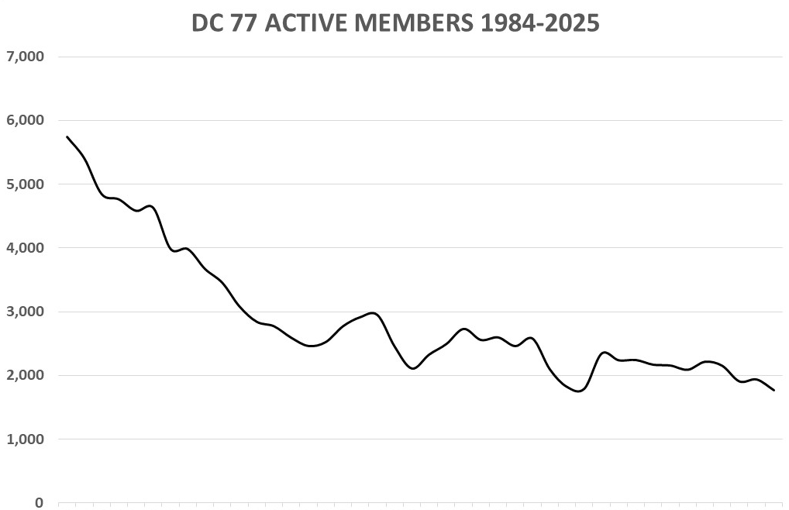

District Council 77 Membership Trend
COR 1057 Building Union Power - Stewards
Notes:
FACILITATOR NOTES:
STATE that we talked about what was happening to the construction industry. We talked about the IUPAT membership over this time. Now, let’s look at our District Council. Unfortunately, those same trends we saw at the national level also affected us here.
PRESENT DC 77’s membership trend.
NOTE: This slide is a template for the District Council membership trend. District Councils should add their data to the slide.

Slide 17
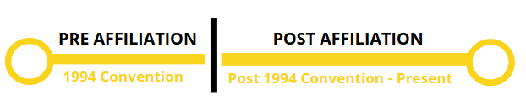
History of Our Union
03
®
iFTI.edu
Notes:
FACILITATOR NOTES:
DISCUSS our history – pre and post affiliation.
SAY ‘Now, we’ve explored the history of everything that was happening outside in the world that impacted our union. But now I want to spend a few minutes talking about our internal history.
While the world was changing around us, our union was changing too. And the key moment that divides our history is everything that happened before full affiliation, and everything that came after full affiliation.’
ASK - Does anyone here have an idea of what I mean when I say pre- and post-affiliation? (Take a few answers.) Let’s dive in.

Slide 18
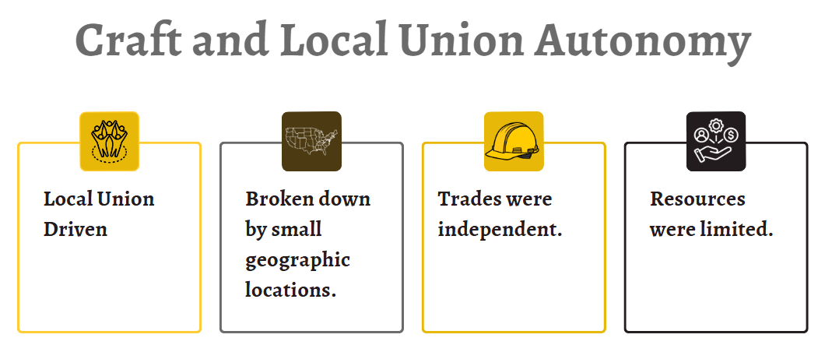
Pre 1994 Convention
COR 1057 Building Union Power - Stewards
Notes:
FACILITATOR NOTES:
SAY the following statements:
Before the 1994 convention, we did not have District Councils like we know them today.
Before 1994, we had hundreds of local unions around the country, all decentralized.
Our membership was isolated in small geographic locations.
And our trades were independent. Painters didn’t talk to Glaziers. Tapers didn’t talk to Trade Show Workers. Floor Coverers and our Public Sector workers operated by themselves.
And that means that we didn’t have the strength that comes with solidarity.
As the world was shifting around us, as corporate America was trying to break the backs of unions, our local unions were weaker because they were not coordinating.

Slide 19
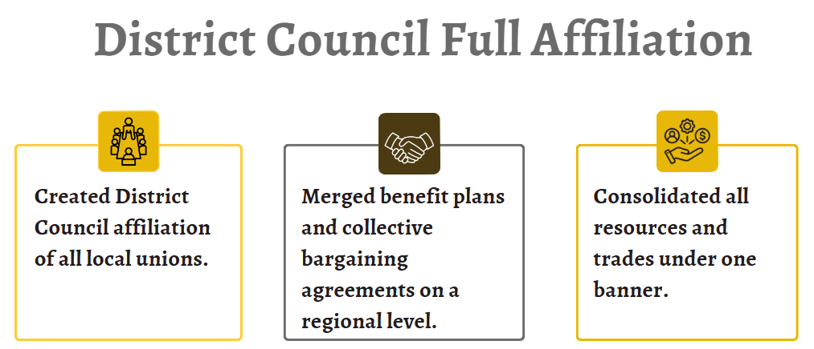
1994 Convention
COR 1057 Building Union Power - Stewards
Notes:
FACILITATOR NOTES:
SAY ‘Affiliation provided access to broader resources, support, and networks to enhance your bargaining power, advocacy efforts, and professional development opportunities. For example, affiliation gives you more negotiation leverage and offers training or educational resources tailored to your needs.’
DISCUSS the highlights of the 1994 Convention:
Created DC affiliation of all Local Unions (LUs). – All LUs were mandated, regardless of craft, to affiliate with DC. This monumental change in our union’s structure was met with resistance. No change is easy; the visionary moment was critical to our survival. The change was adaptive to meet the needs of a declining unionized construction workforce and laid the foundation of what the union is today.
Merged benefit plans and collective bargaining agreements on a regional level. The merger helped create larger and stronger funds. Affiliated LUs paid full capita tax and participated in the DC’s organizing drives. In return, all affiliated locals enjoyed full voting rights and were entitled to DC assistance. The resources of all locals were used to strengthen collective bargaining agreements, protect jurisdiction, and organize the industry.
Consolidated all resources and trades under one banner.
ASK - What is the role of Collective Bargaining Agreements (CBAs)? They are the living documents of our power and establish a foundation for fair wages, safe working conditions, benefits, and job dignity.
REFLECT on what we win at the table, because of what we build in the field.
SAY ‘This moment was key because it was a moment when our leaders decided we had to change to survive. While organized capital was coming for us and trying to break unions, we made the hard choice to change so that we would have the resources to fight back.’

Slide 20
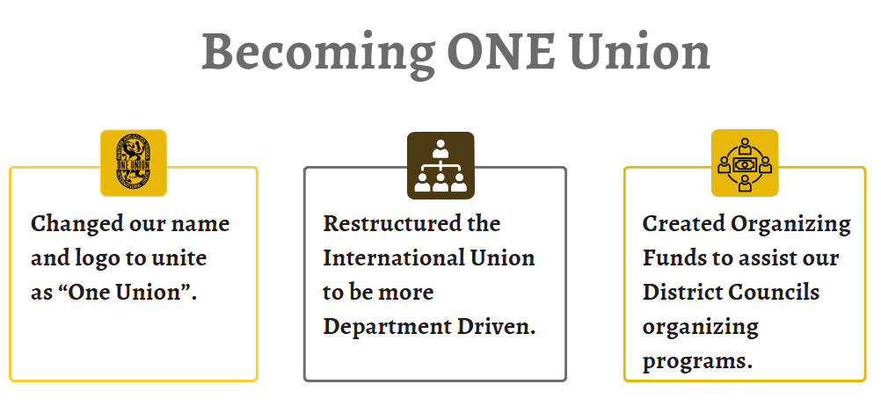
1999-2009
COR 1057 Building Union Power - Stewards
Notes:
FACILITATOR NOTES:
SAY the following statements:
The spirit of change and growth continued. In our next conventions, we made other key updates to our union. And these updates have a direct impact on you and your job, and your paycheck.
We changed our name – before, our union was the International Brotherhood. But we are more than that. We are proud to have many women in our ranks. And so we changed our name to reflect that.
We changed our logo to unite as “One Union.” Symbols matter. Before, if you walked into a union hall, you might see a seal that only named Painters – how do you think that made our glaziers or our drywall finishers feel as members of the union?
Being One Union means that we stand shoulder to shoulder with each other, regardless of our craft and regardless of our gender.
And finally, we created organizing funds to help our councils organize new members.
Think back to the market share we had in the 1940s. More market share means more power.
Sometimes members will say they don’t understand why we spend so many resources on organizing. But this is what we know: more organizing leads to more power leads to better contracts.

Slide 21
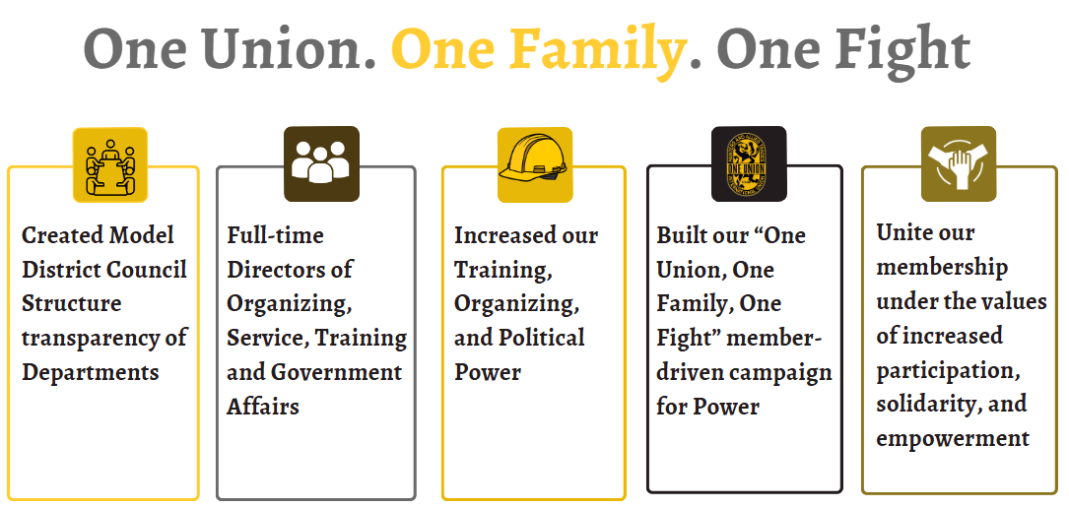
2010-Present
COR 1057 Building Union Power - Stewards
Notes:
FACILITATOR NOTES:
SAY the following statements:
And we moved to a department structure. No more fiefdoms where people were operating as independent agents. We created full-time directors of Organizing, Service, Training, and Government Affairs. These four pillars are all necessary for us to have a strong, growing union.
We leveraged these changes to strengthen our training programs at the iFTI, we used them to invest more and more resources in organizing new workers, and we used them to flex our political power to get city councils and state legislatures, and congress to pass laws that benefit us, not the wealthiest.
And that brings us to today, where in our last convention, we adopted our One Union, One Family, One Fight Campaign to Build Union Power.

Slide 22

Obstacles
Ignoring Segments of Work and Geographic Locations
Lack of Organizing Resources
Internal Politics
Member Apathy
COR 1057 Building Union Power - Stewards
Notes:
FACILITATOR NOTES:
Say ‘Think back to the chart I showed you before, the one that showed our membership declining slowly and steadily.’
ASK - Can anyone shout out some of the factors that contributed to the decline of unions, including ours? (Take a few answers.)
SAY the following statements:
Our union was facing a lot of obstacles, both outside and inside. But this is a story of endurance and strength.
We used our internal changes to challenge head-on the internal politics that often ripped us apart. Gone are the days when a painter’s local and a glazier’s local that share the same city won’t even speak to each other. Our union is stronger because of our councils. Our experiment has worked. We have BMSTs who were painters, we have BMSTs who were glaziers, and we have united together.
We’ve refocused our efforts on organizing. In 1947, when we were at our strongest, an average of 50% of union dues went into organizing new members.
Today, nationwide and in all unions, an average of 3% of union dues go to organizing. But our union decided to buck that trend and continue to focus on organizing and growing.
In the past, huge segments of work and geographic locations were ignored.
As the world was changing around us, we gave up too much ground.
ASK the following questions:
Can anyone here guess where our largest glazing local was in the 1980s? (Take a few answers.) It was in Houston, Texas, where we had XXXX members.
And can you guess where our largest painting local was at the same time? (Take a few answers.) Also in Texas.
SAY the following statements:
And then in the span of a few years, organized capital and the state helped break those unions; they went from thousands of members to a few hundred.
You can drive from Washington, DC, to Miami, Florida, and only drive past ____ signatory contracts to our union. You can drive from Miami to Phoenix and only pass ____ signatory contractors.
We gave up HUGE parts of the country and HUGE parts of our crafts, like residential, because we were under so many attacks.
Now I am proud to say our union is fighting back and organizing in those places. Some of our biggest growth has happened in DC 10 and in DC 77, the home of the deep south and some of the strongest anti-union laws.
So that leads us to the last piece of the puzzle. Member apathy.
ASK - What is member apathy? What do you think I mean when I say that? (Take a few answers.)
SAY the following statements:
It is the lack of interest, engagement, or participation from the members, often manifesting lack of enthusiasm, unwillingness to contribute, and general indifference towards union activities or goals.
There is apathy and a lack of connection between our union and our membership.
ASK – So, how do we address member apathy? Focus on actively engaging members by providing opportunities for meaningful participation, clear communication about the group's goals, recognizing achievements, fostering a positive and inclusive environment, and tailoring activities to cater to diverse interests, while also addressing any underlying issues that might be causing the apathy in the first place.

Slide 23


Our Value Statement –
One Union. One Family. One Fight!
04
®
iFTI.edu
Notes:
FACILITATOR NOTES:
SAY ‘So far, we have talked about attacks from organized capital that have led to the decline of the entire labor movement in the United States. And we talked about the internal changes our union has made to stand up in the face of that adversity. The changes we have made to be stronger as a union. Let’s turn now to talk about our mission and our values as a union.
ASK - Can anyone share what they think our Mission is? People will often say things that are close, but not exactly it, like “produce the best workers.” Producing the best-trained workforce in our crafts is something we do, but it is not our mission. Being a strong union is something we do, but it is not our mission.
DO: Move to the next slide.

Slide 24

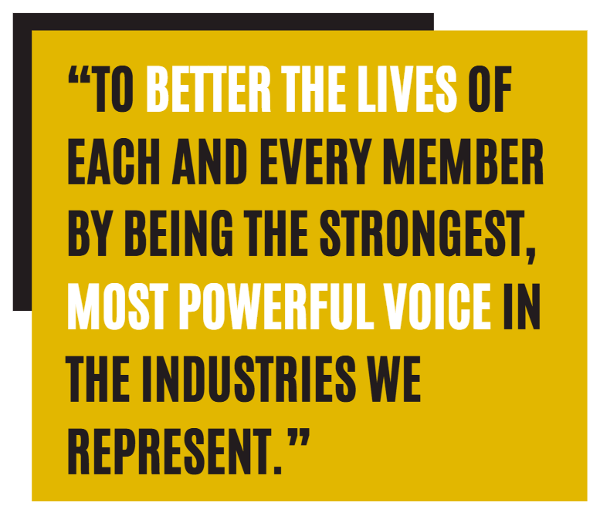
Our Mission
COR 1057 Building Union Power - Stewards
Notes:
FACILITATOR NOTES:
SAY ‘This is our mission. To better the lives of each and every member by being the strongest, most powerful voice in the industries we represent. This is our mission. This is the key to our growth as a union.’

Slide 25
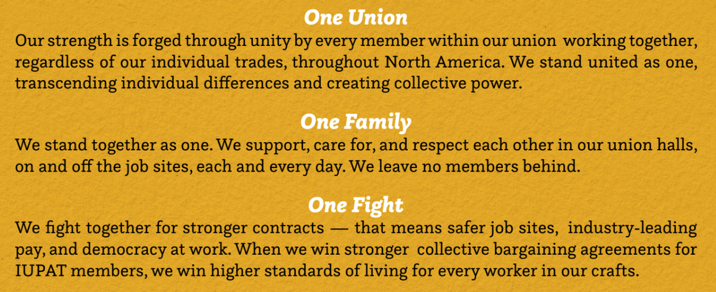
IUPAT Value Statement
COR 1057 Building Union Power - Stewards
Notes:
FACILITATOR NOTES:
SAY ‘This value statement is how we achieve our mission.’
ASK - How many people have seen this phrase – “One Union, One Family, One Fight” in the last year or so?
SAY ‘This is more than a slogan. This is more than a phrase we used at our convention in 2024. These are the values that hold us together as a union, and they’re the values that help us meet the moment we are in now.’
DO: Read each value/or have three audience members take turns reading the values.
SAY ‘These values are incredibly important to the work that we are doing. So I want to spend some time on this.’
SAY ‘We are going to break up into groups and assign one of these values to each group. You have ten minutes to elect a group spokesperson to share out at the end. I want you to discuss what you can do tomorrow and every day moving forward to better advance these values in our union. What can you do at the job sites? What can you do in your local union?’
CONDUCT the following activity (10 mins):
Break the participants into groups. If the room is <30 people, do three groups. If the room is >30 people, break into six groups.
Assign more than one group to each value.
Bring everyone together and have each group share out (after 10 mins).
A co-facilitator should write some of the key ideas for each value on the flipchart.
SAY ‘Thank you for sharing all of that – these are amazing ideas, and we are going to take them and share them in other places. These values are so core to our ability to grow our union and be our strongest force.’

Slide 26



Member Empowerment
Ways Members Can Build Power within the Union
05
®
iFTI.edu
Notes:
FACILITATOR NOTES:
SAY the following statements:
That brings us to the final section of this training.
Let’s talk about member empowerment. Let’s talk about this campaign that we are launching.
Our goal here is to ensure that every member of the IUPAT recognizes the power of their voice in our union. I am not the union, your BMST is not the union, all of us together are the union.
We are doing these trainings to ensure that every member has the confidence, the skills, and the tools to take initiative and lead on our job sites and in our union.

Slide 27
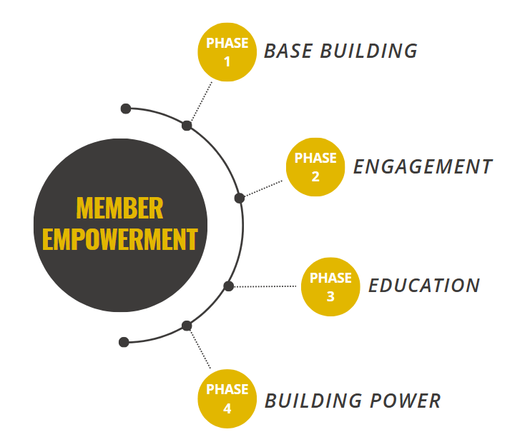
Member Empowerment: 4 Phases
COR 1057 Building Union Power - Stewards
Notes:
FACILITATOR NOTES:
SAY the following statements:
This training fits into a bigger, broader campaign that is happening within our whole international union.
This is just the first step. And I want to preview for you what the rest of the campaign looks like.
This is about running a full organizing campaign within our union to make sure we live up to that mission and our values.
This is step one – base building.
But this is just the first step. We will be back here over and over again to talk to members at the jobsites and work through those values. We will be hitting jobsites and finding people at local meetings, and if we have to, we will go door to door.
And only then, after we’ve met our members exactly where they are, can we begin doing more education about some of the history we showed you before and some of the challenges we face.
And that is how we build power as a union. That’s how we negotiate better contracts. How do we pass better laws through city councils and the state legislature? We provide better training for anyone who wants it.
And I just want to emphasize that this is about all of us – every single one of us in this room – pulling our fair share.

Slide 28


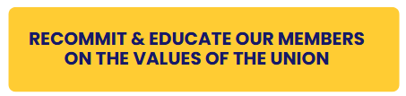
Phase 1: Base Building
COR 1057 Building Union Power - Stewards
Notes:
FACILITATOR NOTES:
PHASE 1 - BASE BUILDING – It is recommitting our base and educating them on the values of the union.
ASK - Who is our base?
Elected Officers
Stewards
Apprentices
Activists
Delegates
ASK - How does each member contribute to the union’s success? Every member contributes by advocating for union rights, supporting fellow members, etc.

Slide 29





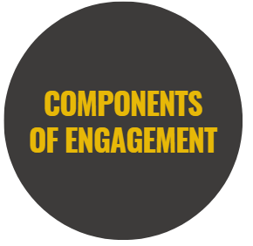

Phase 2: Engagement
COR 1057 Building Union Power - Stewards
Notes:
FACILITATOR NOTES:
SAY ’And this is what we mean by engagement. There are three key things here.’
ASK - How do you engage members? DISCUSS the key components of engagement.
SAY the following statements about Two-way Communication:
It means that I am not just here to lecture at you, that I am listening to what you have to say.
It means that when you talk to your coworker at a jobsite next week, you are listening to what they have to say.
We are past the days when union leaders only tell our members what they have to do; we have to, as a union, do this together.
ASK - What does Inclusive Leadership mean? It means that when we share power, we multiply that power. It means that there is a spot for every person in this room at the table. Whether you are a first-year apprentice or you’ve been on your executive board for years, there is a role for you to play in leading this union.
SAY the following statements about Regular Interaction:
It means that the interaction between members and the union happens regularly.
It’s not about showing up at jobsites just when we need something.
It means that as a union, we are taking the initiative to get in front of members over and over again, and to truly listen and to truly engage with each other, care about.

Slide 30


Phase 2: Engagement - Membership Participation Check List
Commit to the values.
Live the values.
Share the values.
Be a leader on the job site.
Be a leader in your local union.
Participate in the union activities.
COR 1057 Building Union Power - Stewards
Notes:
FACILITATOR NOTES:
DISCUSS commitment to values, living and sharing the values.
HIGHLIGHT commitment – Commitment is not just about showing up—it's about belief in the cause, dedication to the union's mission, and willingness to act when needed.
IDENTIFY the factors that drive commitment: Shared purpose, strong leadership, trust, and sense of belonging.
ASK- How can you be a leader on the jobsite? In your local union?
EXPLAIN the difference between activism and engagement: Activism is a more intense, action-oriented form of engagement.
Activism involves taking action—rallies, strikes, petitions, and other activities that push the union's agenda and bring about positive change.
DEVELOP an action plan: Each participant will write down 2-3 ACTIONS they will take in the next month to help activate more members and build power within the union. Participants will share their plans in small groups and offer suggestions for improvement. Possible answers: Attend your union meetings. Show up and participate. Make house calls to workers/union and non–union. Participate in rallies, demonstrations, and mass meetings. Attend a school board and/or city council meeting. Become a Mentor to a member.

Slide 31
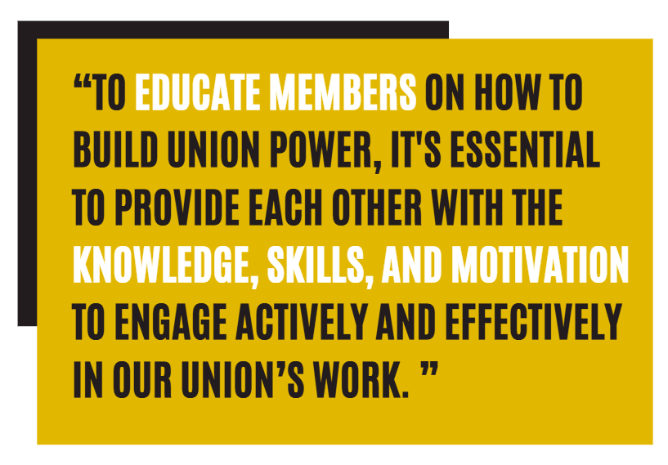
Phase 3: Education
COR 1057 Building Union Power - Stewards
Notes:
FACILITATOR NOTES:
HIGHLIGHT the importance of training, and having the right knowledge and skillset. EMPHASIZE that we empower members with skills and tools.
ASK - What are the different ways to educate members?
DISCUSS the two important skills of a union leader – Active Listening and Dealing with Difficult Conversations.
STATE that the following slides will briefly cover key skills and strategies for improvement.

Slide 32

What is Active Listening?
Active Listening is an essential skill for fostering effective communication, particularly in union settings where challenging or sensitive conversations are common.
COR 1057 Building Union Power - Stewards
Notes:
FACILITATOR NOTES:
STATE that Active listening is essential for fostering effective communication, particularly in union settings where challenging or sensitive conversations are common. Active listening involves fully concentrating, understanding, responding, and remembering what the other person is saying. It requires not just hearing the words but also recognizing the speaker's emotions, body language, and underlying concerns. This approach helps to build trust, resolve conflicts, and improve relationships with union members.
STATE that on the next slides, you will review key elements of active listening and examine the top 3 questions from members. These scenarios provide an opportunity to practice active listening and dealing with difficult situations.
EXPLAIN that Listening isn’t waiting for your turn to speak. Listening is the ability to make others feel heard. One of the ways to do that is to practice using these three statements when someone is telling you something: “Tell me more.“ "Go on.” “What else?” If you try this, you will quickly learn how much effort it takes to pay attention to what the person you’re talking to is saying and resist the urge to interrupt, correct, or fix what they say. And that’s why it’s a skill. Because all skills take effort, and in this case, the effort is worth it.
Additional Resources:
Video Link - Simon Sinek on LinkedIn: Listening isn’t waiting for your turn to speak. - https://www.linkedin.com/videos/simonsinek_listening-isnt-waiting-for-your-turn-to-activity-7290821845153435649-6I3I/
Video Link - How To Actively Listen (Even During Uncomfortable Conversations) - https://www.youtube.com/embed/Lkj86o69c5c

Slide 33
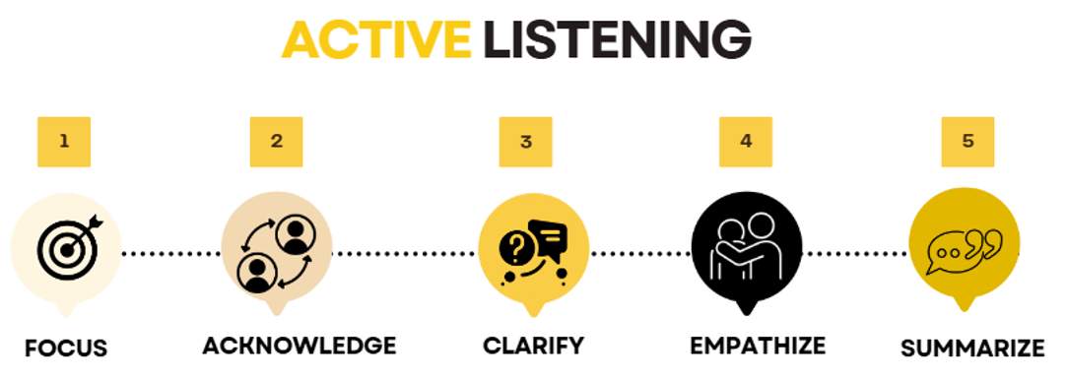
Key Elements of Active Listening
COR 1057 Building Union Power - Stewards
Notes:
FACILITATOR NOTES:
DISCUSS the key elements of active listening.
Focus – Stop talking. Pay full attention to the speaker.
Avoid Distractions - Keep phones, notebooks, etc. put away. Look members in the eye for the entire conversation.
Be Observant – Take note of your surroundings. You can learn a lot about a member through their surroundings.
Focus your attention on their words, their ideas, and feelings related to the subject. Watch their facial expressions, hand gestures, etc. Put down any papers, pens, etc. Sometimes you can learn as much from what is not being said as you can from what they say.
Slow Down - Our brains process thoughts four times faster than spoken words. It’s easy to skip ahead in conversation, using your assumptions to fill in the gaps and formulate a response. Resist this urge and focus on what is being said.
Keep an Open Mind - Never assume that you already know what is important to the member you are speaking with.
Don’t Interrupt - Take the time to listen to the member or worker’s entire story. Let the speaker express their thoughts fully before responding. Everything the member wants to tell us has value in moving a campaign forward.
Don’t Fish - Avoid asking leading questions like ‘wouldn’t you agree that…..’
Acknowledge – Show that you are engaged by nodding, maintaining eye contact, and using brief verbal acknowledgments ("I see," "Go on").
Clarify – Ask questions to clarify the message. Be careful not to ask questions that might embarrass the speaker. Get to the main points. Concentrate on the ideas and not the illustrative material, i.e., examples, statistics, etc.
Empathize – Sometimes members need to blow off steam. Let them. We’re there to listen, not to judge. Show understanding of the speaker's feelings. Recognize your prejudices. Don’t allow your feelings towards the person to influence your interpretation of what they are saying.
Don’t Dismiss a Member or Worker’s Concerns - Even if a member expresses disappointment with the Union or with you, let them know you hear them and ask what it would take to make things right.
Find common ground - You don’t have to agree on everything. Acknowledge points on which you disagree. Emphasize points on which you do. Look for areas on which you agree and ask questions around that. Workers and Members will respect your opinion if you respect theirs.
Don’t feel the need to sell something - A Union representative is not a salesperson. We are genuinely looking to learn the Member’s point of view and build something collectively around that.
Organizing vs. Gathering: Remember the Difference - Organizing is more than putting several people with the same views in one place. It’s bringing people from different viewpoints together around a common cause.
Summarize – Paraphrase what was said to confirm understanding. Avoid jumping to conclusions.
Show that you hear what the member is saying - React. Match body language. Repeat what you said as you understood it. If you don’t understand or misunderstand, ask to clarify.

Slide 34
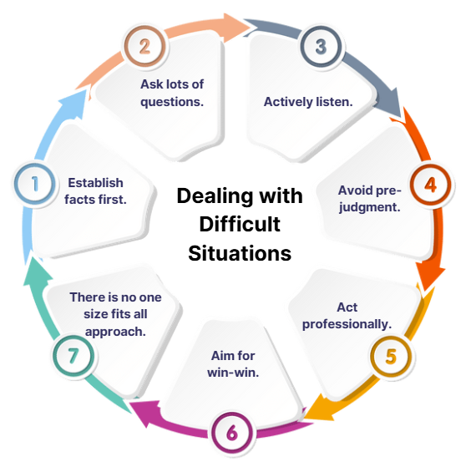
7 Key Tips for Dealing with Difficult Situations
COR 1057 Building Union Power - Stewards
Notes:
FACILITATOR NOTES:
DISCUSS the tips in dealing with difficult situations.
Establish facts first. When difficult situations arise, it is all too easy to jump to solution mode too quickly. While there may be a limited amount of time when fast action is absolutely necessary, your first step to a successful resolution is to establish the facts. Remember that facts, as opposed to hearsay, or opinion, are verifiable. Be alert to being swayed by the opinion of those who are strong characters. When people make claims or assertions, ask for specific examples of what happened and when it happened. Often you find that there isn’t a lot of substance behind what is being said.
Ask lots of questions. Questions, especially the short powerful variety, are a great way of getting to the core issue rather than all the detail that someone is trying to provide to you. Think of it like peeling an onion, each layer is getting you closer to the core. Open questions are a much better way of getting to the core of the issue. Try these questions:
When did this issue arise?
How did it impact what you were trying to achieve?
What would be an ideal outcome from your perspective?
What are the options?
How can we move forward?
Actively listen. There is little point in asking questions if you are not actively listening to what is being said. Resist the temptation to jump in before you have properly listened to the different points of view. Most of the time we listen passively or not at all, simply going on the defensive or pushing our point of view. If you can listen with intent and pay attention to what is being said and the speaker’s body language, then you will do a much better job of listening. Better listening leads to better understanding and a better response.
Avoid pre-judgment. We all, if we are honest, will form some judgments immediately. While these might be right at the end of the day, don’t let pre-judgment get in the way of establishing the real issues. Aim to stay open-minded and objective rather than assuming or guessing.
Act professionally. The challenge for you is to remain professional at all times. A good test of this is to ask yourself how would you like to be treated if you were not the manager or leader but an aggrieved party. Think about the longer-term consequences for you and your career if you deal with a difficult situation unprofessionally. People will respect you more if you try to always be professional in your dealing with them, even on a difficult issue.
Aim for a win-win. While this is not always possible, you should aim to find solutions that don’t result in a feeling from one party that they had lost while another has won. This might require some careful negotiation around what would constitute a good outcome for all those involved. Accept that there may be situations where you have to be very direct, but make these situations the exception rather than the norm.
Remember there is no one-size-fits-all approach. Each situation is different. While there might be some common ground, remember there is unlikely to be a one-size-fits-all approach to difficult situations. Adapt your approach depending on the situation. Good planning and preparation will help make sure you can adapt while dealing with the situation or issue. Bottom line – Handling difficult situations is just part and parcel of managing and leading. Where do you need to focus your attention in terms of developing your competence?

Slide 35

Practice Active Listening
COR 1057 Building Union Power - Stewards
Notes:
FACILITATOR NOTES:
CONDUCT the following group activity:
DIVIDE the participants into small groups, e.g., 3-5.
STATE the question - 'What are you hearing at jobsites?’ Participants will share their answers within their groups.
ENSURE that there is a group leader who will summarize the discussion.
DEBRIEF and call the leader by group.

Slide 36

Phase 4: Building Power
Union Power comes from the strength of engaged and committed members who unite and speak with one voice.
The more involved, informed, and unified we are, the stronger our union becomes, giving us the power to drive meaningful change.
Strength is found in the solidarity of our union’s members.
COR 1057 Building Union Power - Stewards
Notes:
FACILITATOR NOTES:
ASK - What does building power look like? Power is Strength in numbers: Especially during strikes, ratification votes, and contract enforcement.
ASK - Why is power important for the union? How does a strong, united union make a difference in contract negotiations, workplace safety, and member well-being?
SHARE history and examples of union victories where collective action played a key role. How solidarity ensures better negotiation power, fair treatment, and job security.
EMPHASIZE the Power of One Union: Strength lies in collective action—engaged and committed members who actively participate are the union’s power.
The goal of this training is to help union members recognize their individual power, the importance of collective strength, and how to work together toward common goals.
GROUP ACTIVITY: Action Planning for Building Power (10 minutes): Participants will create an action plan that incorporates:
1. How they will engage with fellow members to build unity.
2. How they will commit to advancing union efforts.
3. One specific activism action they will take to support the union’s mission.
Participants pair up to share their action plans and provide feedback.
REINFORCE that power isn’t about telling members what to do, but about building strength from the top down and bottom up.

Slide 37

Summary
iFTI.edu
The future of OUR Union is in OUR hands.
Membership participation is CRITICAL.
The value statement of One Union, One Family, One Fight is the foundation for building a united and powerful union.
OUR Union is only as Strong as OUR Members.
Notes:
FACILITATOR NOTES:
ASK participants to share their learnings from the course. What specific way can you contribute to strengthening the union and fostering solidarity?
STATE your personal commitments to the union.
REFLECT on how each member can embody the values of “One Union, One Family, One Fight” in their daily actions.
EMPHASIZE that building the power within begins with the understanding that we are stronger together. Our value statement "One Union, One Family, One Fight" serves as a reminder that our strength, rooted in trust, respect, and shared purpose, is the key to achieving lasting change and improving the lives of all members. Each member’s contribution matters—when we work as one, we can achieve great things.

Slide 38

Questions or Comments?
Contact Information
Support@iupat.org
International Union of Painters and Allied Trades
7234 Parkway Drive
Hanover, MD 21076
http://www.iupat.org
ONE UNION. ONE FAMILY. ONE FIGHT
iFTI.edu
Notes:
FACILITATOR NOTES:
ASK for any remaining questions or comments.
PROVIDE participants with a list of upcoming union events, meetings, trainings, and opportunities.
THANK participants for their time and commitment to strengthening the union. Encourage them to stay active, engage with their fellow members, and continue fighting for a better future for all workers.

