Slide 1





DC 78
COR 1056 Building Union Power - Apprentices
One Union One Family One Fight!
Education and Engagement
Notes:
FACILITATOR NOTES:
PREPARE the course materials and equipment to present this course effectively.
Course Materials and Equipment: PowerPoint Presentation - Instructor Computer, Internet Connection, TV/Projector, Handouts – Value Statement and Case Studies/Simulations, Flip Chart(s) / Markers (at least three colors) for brainstorming or group activities, and Name Tents/Tags
MAKE the necessary modifications when appropriate.
CHECK room setup. Is the room arranged in a way that is comfortable to the participants and conducive to learning? If possible, a U-shaped table and chair set-up should be used. A U-shape allows participants to interact with one another and the instructor.
REVIEW Presentation Tips: There are three types of audience members:
The Givers – They’re locked in, nodding, leaning forward, feeding you energy.
The Takers – Arms crossed, scrolling their phone, radiating resistance.
The Neutrals – Present, but not yet engaged—waiting to be swayed.
Here’s where inexperienced speakers (and leaders, and creators) go wrong:
They focus on the wrong people. It’s human nature to fixate on the grumpy guy in the third row. The one who looks like he’d rather be anywhere else. But that’s a trap. A dangerous one. Because the moment you give your energy to a taker, you play their game. Your confidence wavers. Your momentum stalls. The room follows. Not good.
But if you anchor yourself in the givers? Your energy surges. Your presence expands. The neutrals lean in. And suddenly, the entire room shifts. It's actually extraordinary the difference this small shift in focus can make.

Slide 2
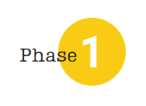

Introduction
YOU
GETTING
KNOW
Answer the Questions:
How did you become a member?
What are you expecting from becoming an IUPAT member?
TO
Name
Title/Position
Title/Position
Trade
COR 1056 Building Union Power - Apprentices
Notes:
FACILITATOR NOTES:
For Instructor Introduction:
Describe your experience with the IUPAT, noting if you have ever worked without union representation and focusing on how you became a member of the union apprenticeship, organizing, etc.
Explain your role as a union organizer (or union rep., leader, etc.), emphasizing your responsibilities as an educator/trainer.
Introduce Representatives and Officers of the District Council/Local Union (if applicable)
CONDUCT the following activity for participants:
For the ‘Getting to Know’:
SAY ‘ State your Name, Title/Position, and Trade’
For the ‘Answer the Questions’:
SAY ‘Before we go further, I want to pull you all into the conversation. In just a moment, I will ask you all to pair off (give the option to do groups of three if necessary, based on the room setup). And I want you to take turns answering these two questions for each other. Please share how you became a member of this union, and share what you expected to get out of it. I’m going to give you five minutes to talk in your groups. Go ahead.
DO: *** use a timer to give them 4-5 minutes to discuss ***
SAY ‘Ok, it sounds like most everyone has had a chance to share. Let’s bring it back to the main group.
ASK – ‘Who wants to share, either your answers or your partner’s answers? How did you become a member? What did you expect to get out of it?
DO the following:
Take 5-10 answers, depending on the size of the group.
Use flip chart paper to record the answers.
Pull out common themes (a majority of people joined because someone recruited them – family or friends)
FOCUS on how most people are looking to get something out of the union – higher wages, benefits, retirement. Very few people will say that they joined because they wanted to join for selfless reasons.

Slide 3
Course Description
COR 1028 Building Union Power
Centered around IUPAT’s value statement "One Union, One Family, One Fight," the course emphasizes the importance of commitment, mutual support, and solidarity in driving meaningful change within our union.
This training module is designed to empower our members by fostering a shared understanding and commitment to our core values.
Participants will gain insight into their personal role in strengthening union power, understand the value of working together toward common goals, and leave with a deeper sense of how individual actions contribute to our union’s success.
COR 1056 Building Union Power - Apprentices
Notes:
FACILITATOR NOTES:
ASK - What is union power? It is shared decision-making, accountability, and member-led action.
EXPLAIN the course description.
STATE that this course is about Building Union Power. Our strength and power as a union are derived from our members. This course will help us better understand what it means to live our union values of One Union, One Family, One Fight.
EMPHASIZE that true union power is when members are informed, engaged, and organized, not just represented.

Slide 4
Learning Outcomes
Identify key events and milestones in our union’s history.
Explain IUPAT’s Mission and Values Statement —One Union, One Family, One Fight.
Recognize and describe the decline in union power and its key factors.
Discuss ways members can take an active role in building power within our union.
COR 1056 Building Union Power - Apprentices
Notes:
FACILITATOR NOTES:
STATE the learning outcomes.

Slide 5
Course Topics
1
2
3
4
Market Share Past and Present
IUPAT History
Our Mission and Value Statement
Member Empowerment
COR 1056 Building Union Power - Apprentices
Notes:
FACILITATOR NOTES:
STATE that there are four topics in the course.

Slide 6



Construction Unions:
Market Share Past and Present
01
®
iFTI.edu
Notes:
FACILITATOR NOTES:
ASK - What is Market Share? In the context of the union, it represents the portion of workers in a specific industry or sector who are union members.
SAY ‘Let’s start by diving into our market share as a union throughout our history.’
ASK - Can anyone define what market share is? (Take a few answers.) Our market share is simply how many workers who do our crafts belong to a union. So if there are 100 glaziers in this state, and 40 of them are in our union, then our market share is 40%.
ASK - Does anyone have an idea of why that matters? (Take a few answers.) That’s right, the higher our market share, the more powerful our union is.

Slide 7
Market Share - 1947
Question 1
What percentage of construction workers belonged to labor unions in the U.S. in the 1940s?
A. 12%
B. 40%
C. 73%
D. 87%
COR 1056 Building Union Power - Apprentices
Notes:
FACILITATOR NOTES:
SAY ‘Here is my question for you. What percentage of construction workers do you think belonged to labor unions in the US in the 1940s?’
By a show of hands, how many think it is A, 12%?
And how many think it was B, 40%?
How many think it’s C, 73%?
And how many think its D, 87%?
DO: Click to reveal the answer on the next slide.

Slide 8

Market Share - 1947
Question 1
What percentage of construction workers belonged to labor unions in the U.S. in the 1940s?
Answer
D. 87%
D. 87%
COR 1056 Building Union Power - Apprentices
Notes:
FACILITATOR NOTES:
SAY ‘That’s right, in the late 1940s, 87% of construction workers in the United States belonged to a union. I’ll give you a spoiler: that number is higher than it is today.
ASK - Why does that matter? Like we said before, the higher our market share, the more power we have to negotiate better contracts. I want you to keep this number in mind while we go through some history that has impacted our union.’
ASK - What do you think this meant for our power and influence?

Slide 9
Market Share - 2024
Question 2
What percentage of construction workers belonged to labor unions in the U.S. in 2024?
A. 10.3%
B. 40.5%
C. 73.2%
D. 25%
COR 1056 Building Union Power - Apprentices
Notes:
FACILITATOR NOTES:
ASK Question 2: What percentage of construction workers belonged to labor unions in the U.S. in 2024?
ASK participants to raise their hands if they believe the answer is A. ASK them to raise their hands if they believe it’s B, C, and D.

Slide 10

Market Share - 2024
Question 2
What percentage of construction workers belonged to labor unions in the U.S. in 2024?
Answer
A. 10.3%
COR 1056 Building Union Power - Apprentices
Notes:
FACILITATOR NOTES:
STATE that the answer is A. According to the Associated Builders and Contractors (ABC), as of 2024, only 10.3% of construction workers in the U.S. belong to a labor union, marking a record low percentage. This figure represents the lowest percentage of unionized construction workers on record. If we continue to do the same thing for the next 20 years, what percentage of all construction workers in the US will belong to unions in 2030? A class participant may want to do the calculation. In DC 91, a glazier calculated 9.5%
EMPHASIZE that this means today, just 1 in 10 construction workers in the US is union.
REMIND participants that this decline is why we are all here today!
EXPLAIN the following:
These are not just numbers on a graph.
These numbers represent our ability to raise industry standards.
These numbers represent our power to win industry-leading contracts.
These numbers represent our strength to protect our pensions, to fight for better safety standards, and to enshrine our right to organize.

Slide 11
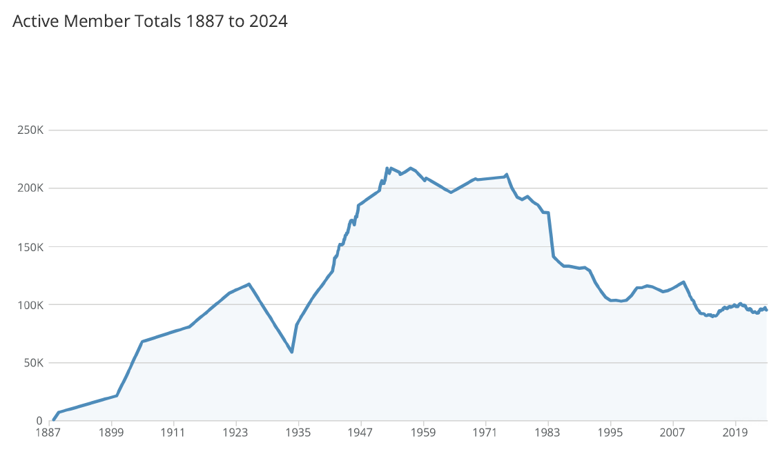
Trend of Total Membership
COR 1056 Building Union Power - Apprentices
Notes:
FACILITATOR NOTES:
STATE that the previous slide was about the construction industry as a whole. So, let’s take a look at the IUPAT’s membership specifically.
DISCUSS the chart for active member totals from 1887 to 2024.
The Brotherhood of Painters and Decorators of America was organized formally in 1887. Within a year, the union boasted a membership of over 7,000 tradesmen and more than 100 Local Unions.
The first 35 years of our union’s history saw steady growth.
ASK – What happened in 1923? - The great depression caused a steep decline in not just our union, but all unions, as work dried up across the country.
ASK – What happened in 1935? [Wagner Act or National Labor Relations Act]
This landmark piece of US labor law guaranteed private sector employees the right to organize, form unions, and engage in collective bargaining. It also prohibits employers from engaging in unfair labor practices, such as interfering with union organization or discriminating against employees for union activity.
Almost immediately, labor organizing takes off (including for the IUPAT). In just 12 years from 1935 to 1947, we tripled the size of our union from approximately 60k to 220,000.
ASK - What does this chart tell us? Even though IUPAT has gained members, its market share has declined.
Offer these general conclusions:
The demand for construction has steadily risen and will continue to rise.
With this decline in the percentage of the total construction workforce that is organized has come a decline in the unions’ market share, as reflected in the declining real incomes of construction workers.
One reason for the decline is the loss of union values.

Slide 12

Percentage of Construction Workers Belonging to Unions in the U.S.
87%
Taft-Hartley
Organized Capital
Professional Air Traffic Controllers’ Organization (PATCO).
NAFTA
Recession
Pandemic and Rising Union Approval
10%
COR 1056 Building Union Power - Apprentices
Notes:
FACILITATOR NOTES:
DISCUSS the highlights per decade.
Taft-Hartley Act (1940s) - The Taft-Hartley Act (https://www.nlrb.gov/about-nlrb/who-we-are/our-history/1947-taft-hartley-substantive-provisions) was passed, which amended the NLRA, and set labor back on several fronts:
Section 8(b) added unfair labor practices for labor unions.
Section 8(b)(7), “secondary boycott provision,” -- A group's refusal to work for, purchase from, or handle the products of a business with which the group has no dispute.
Section 14(b), “right to work provision,” gave state legislatures the authority to outlaw the union shop (i.e. contract provisions stating that new hires must join the union after a certain length of service with the company). No close shops.
McCarthyism (1950s) - Republican Senator Joseph McCarthy of Wisconsin exploited Cold War frustrations charging the highest reaches of government and labor unions in the name of anti-communism. After the militant strikes of 1945–1956, capitalists and congressional investigators were happy to “Red Bait” union officials during strikes and elections. At that time Communists and other radicals led several important trade unions. In 1949, the CIO expelled about 900,000 workers, for refusing to purge themselves of Communists leaders. These expelled unions reflected the diversity of the American working class to a greater degree than those unions that remained in the CIO. Contributed to a change in the perception of the union by the public.
Corporate Attacks (1960s) - Big corporations (construction users -- get names of companies to refer to here i.e. Dow Chemical in Midland, MI. Also Upjohn Pharmaceutical in Portage, MI.) conspired to break the Building Trades unions by promoting non-union contractors, and in some cases, denying bids to unionized employers. Their strategy was to “divide and conquer.” Perception of union as thugs.
Construction Recession (1970s) – A severe downturn in the construction industry fueled by high inflation, high interest rates, and high unemployment heightened the competitive pressures from young non-union contractors and undermined the vitality of the union sector.
Political Backlash (1980s) - An anti-labor climate emerged that resisted supported legislation (like common situs picketing) and undermined the enforcement of existing prevailing wage laws and OSHA standards and regulations.
Professional Air Traffic Controllers’ Organization (PATCO). These well-educated, well paid workers, many of them US Air Force veterans, complained of the crushing mental and physical strains of air traffic control work. Mental burnout forced the average controller to retire at age thirty-five. When the FAA did little to resolve these problems, PATCO struck in August 1981. President Reagan quickly fired more than ten thousand (10,000) striking air traffic controllers and filled their jobs with supervisors and inadequately trained replacements. Ironically, PATCO had been one of the few unions to support the Republican presidential candidate in 1980.
NAFTA/Competing Unionism (1990s) - The North American Free Trade Agreement or NAFTA is an agreement signed by the governments of the United States, Canada, and Mexico creating a trilateral trade bloc in North America. The agreement came into force on January 1, 1994. It superseded the Canada-United States Free Trade Agreement between the U.S. and Canada. In terms of combined purchasing power parity GDP of its members, as of 2007 the trade block is the largest in the world and second largest by nominal GDP comparison. GDP - The gross domestic product (GDP) or gross domestic income (GDI) is the amount of goods and services produced in a year, in a country.
Undocumented workers, underground economy, 1099 workers
Break-up of AFL-CIO / Lack of Union Solidarity
Mention that President Clinton a Democrat signed NAFTA into law.
911 & Great Recession (2000s)
The 9/11 Attacks and Union Responses: The September 11 attacks in 2001 had a profound effect on the U.S. and the labor movement. Many unions responded by stepping up their advocacy for workers in the affected industries, such as emergency responders, construction workers, and transportation employees. Workplace Safety: Labor unions played a significant role in pushing for better workplace safety regulations following the attacks. For instance, unions in construction and emergency services were involved in demanding better protection for workers at Ground Zero.
The George W. Bush era (2001–2009) had significant effects on labor unions and the labor industry in the United States. While the period did not see a huge surge in union membership, several key policies and events impacted the labor movement, particularly regarding workers' rights, collective bargaining, and union influence.
Citizens United & the Rise of Social Media (2010s)
Trump’s Pro-Business, Anti-Union Policies: The Trump administration enacted policies that were seen as undermining unions and workers' rights, including support for right-to-work laws and NLRB appointments favoring businesses.
Rise of Social Media: Social media became a critical tool for organizing, especially in non-unionized sectors like gig work, retail, and fast food, leading to campaigns like Fight for $15 and organizing efforts at companies like Amazon.
Pandemic (2020s)
Key Impacts of COVID-19 on Labor:
Essential Workers and Increased Union Demands: The pandemic brought essential workers, including healthcare workers, grocery store employees, delivery drivers, and warehouse workers, into the spotlight. These workers faced high-risk conditions, long hours, and low pay. As a result, there was a surge in calls for higher wages, better working conditions, and stronger workplace protections.
Strikes and Protests: There were widespread protests and work stoppages among frontline workers demanding better safety protocols, hazard pay, and sick leave. Some healthcare and warehouse workers organized strikes or joined unions to demand better treatment during the pandemic.
Shift to Remote Work and Job Insecurity: The pandemic accelerated the trend of remote work, particularly in industries like tech, education, and finance. While many white-collar workers transitioned to home offices, blue-collar workers, gig workers, and service workers faced mass layoffs or had to continue working in unsafe conditions. Many workers in sectors like hospitality, restaurants, and retail experienced job losses or furloughs, exacerbating existing economic inequalities.
Support for Unions and the PRO Act: Biden has expressed strong support for unions and workers’ rights. One of his key labor policy initiatives was backing the Protecting the Right to Organize (PRO) Act, a comprehensive labor law reform designed to make it easier for workers to organize unions, address issues like misclassification of workers, and strengthen penalties for employers engaging in anti-union activities.
Despite the Biden administration’s push to support workers, former President Trump’s influence remained strong in U.S. politics, especially among conservative-leaning labor sectors. Trump’s political presence continued to shape labor policy and worker sentiment, particularly as he began campaigning for the 2024 election.
EMPHASIZE that all nine factors were EXTERNAL – that is, they were going to happen regardless of what unions did, they were beyond the control of the construction unions. While they no doubt had a negative impact on construction unions, they still don’t fully explain the steep decline and loss of power that took place between 1947 to present.
SUGGEST that we need to look at INTERNAL factors that contributed to the decline in construction union power.

Slide 13
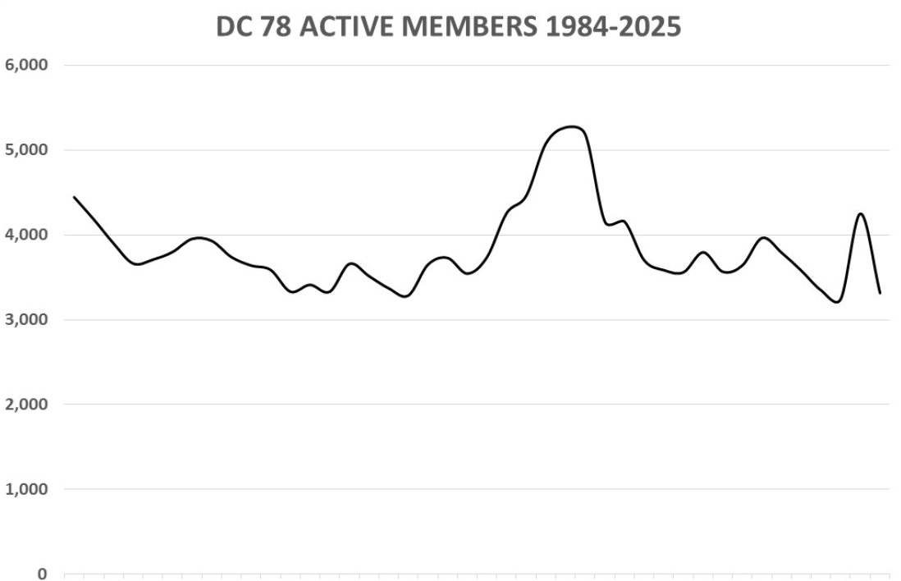

District Council 78 Membership Trend
COR 1056 Building Union Power - Apprentices
Notes:
FACILITATOR NOTES:
STATE that we talked about what was happening to the construction industry. We talked about the IUPAT membership over this time. Now, let’s look at our District Council. Unfortunately, those same trends we saw at the national level also affected us here.
PRESENT DC 78’s membership trend.
NOTE: This slide is a template for the District Council membership trend. District Councils should add their data to the slide.

Slide 14
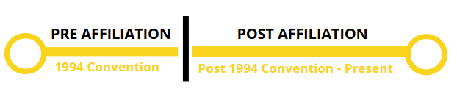
History of Our Union
02
®
iFTI.edu
Notes:
FACILITATOR NOTES:
DISCUSS our history – pre and post affiliation.
SAY ‘Now, we’ve explored the history of everything that was happening outside in the world that impacted our union. But now I want to spend a few minutes talking about our internal history.
While the world was changing around us, our union was changing too. And the key moment that divides our history is everything that happened before full affiliation, and everything that came after full affiliation.’
ASK - Does anyone here have an idea of what I mean when I say pre- and post-affiliation? (Take a few answers.) Let’s dive in.

Slide 15
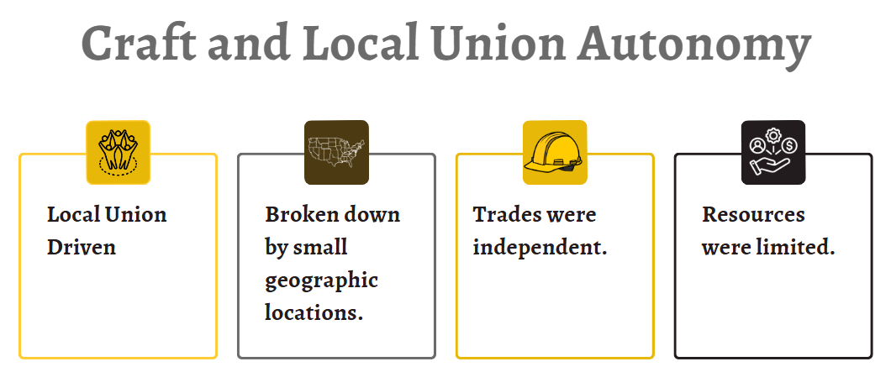
Pre 1994 Convention
COR 1056 Building Union Power - Apprentices
Notes:
FACILITATOR NOTES:
SAY the following statements:
Before the 1994 convention, we did not have District Councils like we know them today.
Before 1994, we had hundreds of local unions around the country, all decentralized.
Our membership was isolated in small geographic locations.
And our trades were independent. Painters didn’t talk to Glaziers. Tapers didn’t talk to Trade Show Workers. Floor Coverers and our Public Sector workers operated by themselves.
And that means that we didn’t have the strength that comes with solidarity.
As the world was shifting around us, as corporate America was trying to break the backs of unions, our local unions were weaker because they were not coordinating.

Slide 16
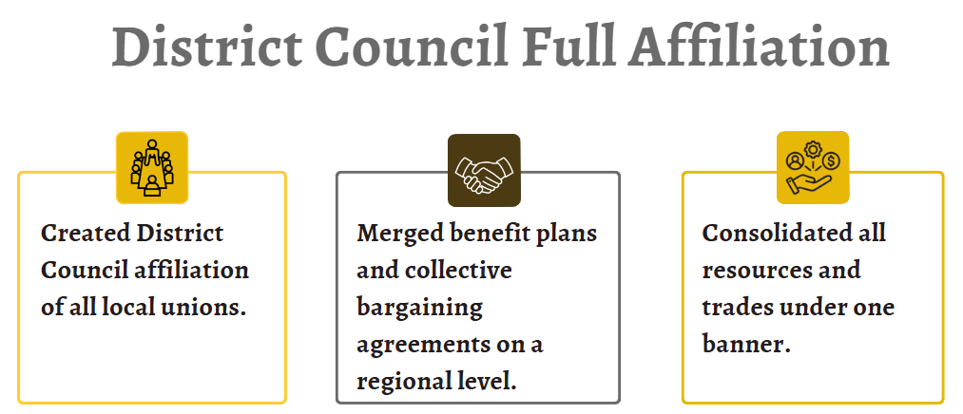
1994 Convention
COR 1056 Building Union Power - Apprentices
Notes:
FACILITATOR NOTES:
SAY ‘Affiliation provided access to broader resources, support, and networks to enhance your bargaining power, advocacy efforts, and professional development opportunities. For example, affiliation gives you more negotiation leverage and offers training or educational resources tailored to your needs.’
DISCUSS the highlights of the 1994 Convention:
Created DC affiliation of all Local Unions (LUs). – All LUs were mandated, regardless of craft, to affiliate with DC. This monumental change in our union’s structure was met with resistance. No change is easy; the visionary moment was critical to our survival. The change was adaptive to meet the needs of a declining unionized construction workforce and laid the foundation of what the union is today.
Merged benefit plans and collective bargaining agreements on a regional level. The merger helped create larger and stronger funds. Affiliated LUs paid full capita tax and participated in the DC’s organizing drives. In return, all affiliated locals enjoyed full voting rights and were entitled to DC assistance. The resources of all locals were used to strengthen collective bargaining agreements, protect jurisdiction, and organize the industry.
Consolidated all resources and trades under one banner.
ASK - What is the role of Collective Bargaining Agreements (CBAs)? They are the living documents of our power and establish a foundation for fair wages, safe working conditions, benefits, and job dignity.
REFLECT on what we win at the table, because of what we build in the field.
SAY ‘This moment was key because it was a moment when our leaders decided we had to change to survive. While organized capital was coming for us and trying to break unions, we made the hard choice to change so that we would have the resources to fight back.’

Slide 17
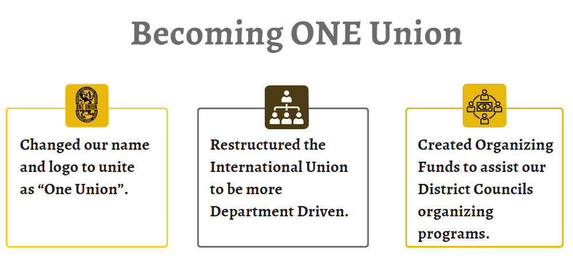
1999-2009
COR 1056 Building Union Power - Apprentices
Notes:
FACILITATOR NOTES:
SAY the following statements:
The spirit of change and growth continued. In our next conventions, we made other key updates to our union. And these updates have a direct impact on you and your job, and your paycheck.
We changed our name – before, our union was the International Brotherhood. But we are more than that. We are proud to have many women in our ranks. And so we changed our name to reflect that.
We changed our logo to unite as “One Union.” Symbols matter. Before, if you walked into a union hall, you might see a seal that only named Painters – how do you think that made our glaziers or our drywall finishers feel as members of the union?
Being One Union means that we stand shoulder to shoulder with each other, regardless of our craft and regardless of our gender.
And finally, we created organizing funds to help our councils organize new members.
Think back to the market share we had in the 1940s. More market share means more power.
Sometimes members will say they don’t understand why we spend so many resources on organizing. But this is what we know: more organizing leads to more power leads to better contracts.

Slide 18
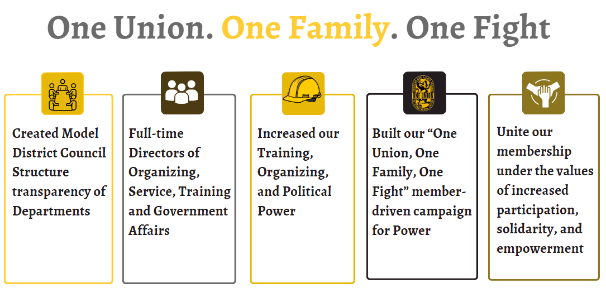
2010-Present
COR 1056 Building Union Power - Apprentices
Notes:
FACILITATOR NOTES:
SAY the following statements:
And we moved to a department structure. No more fiefdoms where people were operating as independent agents. We created full-time directors of Organizing, Service, Training, and Government Affairs. These four pillars are all necessary for us to have a strong, growing union.
We leveraged these changes to strengthen our training programs at the iFTI, we used them to invest more and more resources in organizing new workers, and we used them to flex our political power to get city councils and state legislatures, and congress to pass laws that benefit us, not the wealthiest.
And that brings us to today, where in our last convention, we adopted our One Union, One Family, One Fight Campaign to Build Union Power.

Slide 19

Obstacles
Ignoring Segments of Work and Geographic Locations
Lack of Organizing Resources
Internal Politics
Member Apathy
COR 1056 Building Union Power - Apprentices
Notes:
FACILITATOR NOTES:
Say ‘Think back to the chart I showed you before, the one that showed our membership declining slowly and steadily.’
ASK - Can anyone shout out some of the factors that contributed to the decline of unions, including ours? (Take a few answers.)
SAY the following statements:
Our union was facing many obstacles, both outside and inside. But this is a story of endurance and strength.
We used our internal changes to challenge head-on the internal politics that often ripped us apart. Gone are the days when a painter’s local and a glazier’s local that share the same city won’t even speak to each other. Our union is stronger because of our councils. Our experiment has worked. We have BMSTs who were painters, we have BMSTs who were glaziers, and we have united together.
We’ve refocused our efforts on organizing. In 1947, when the union was at its strongest, an average of 50% of union dues went toward organizing new members.
Today, nationwide and in all unions, an average of 3% of union dues go to organizing. But our union decided to buck that trend and continue to focus on organizing and growing.
In the past, huge segments of work and geographic locations were ignored.
As the world was changing around us, we gave up too much ground.
ASK the following questions:
Can anyone here guess where our largest glazing local was in the 1980s? (Take a few answers.) It was in Houston, Texas.
And can you guess where our largest painting local was at the same time? (Take a few answers.) Also in Texas.
SAY the following statements:
And then in the span of a few years, organized capital and the state helped break those unions; they went from thousands of members to a few hundred.
You can drive from Washington, DC, to Miami, Florida, and only drive past ____ signatory contracts to our union. You can drive from Miami to Phoenix and only pass ____ signatory contractors (Provide samples specific to your District Council).
We gave up HUGE parts of the country and HUGE parts of our crafts, like residential, because we were under so many attacks.
Now I am proud to say our union is fighting back and organizing in those places. Some of our biggest growth has occurred in DC 10 and DC 77, the home of the deep South and some of the strongest anti-union laws.
So that leads us to the last piece of the puzzle. Member apathy.
ASK - What is member apathy? What do you think I mean when I say that? (Take a few answers.)
SAY the following statements:
It is the lack of interest, engagement, or participation from the members, often manifesting lack of enthusiasm, unwillingness to contribute, and general indifference towards union activities or goals.
There is apathy and a lack of connection between our union and our membership.
ASK – So, how do we address member apathy? Focus on actively engaging members by providing opportunities for meaningful participation, clear communication about the group's goals, recognizing achievements, fostering a positive and inclusive environment, and tailoring activities to cater to diverse interests, while also addressing any underlying issues that might be causing the apathy in the first place.

Slide 20


Our Value Statement –
One Union. One Family. One Fight!
03
®
iFTI.edu
Notes:
FACILITATOR NOTES:
SAY ‘So far, we have talked about attacks from organized capital that have led to the decline of the entire labor movement in the United States. And we talked about the internal changes our union has made to stand up in the face of that adversity. The changes we have made to be stronger as a union. Let’s turn now to talk about our mission and our values as a union.
ASK - Can anyone share what they think our Mission is? People will often say things that are close, but not exactly it, like “produce the best workers.” Producing the best-trained workforce in our crafts is something we do, but it is not our mission. Being a strong union is something we do, but it is not our mission.
DO: Move to the next slide.

Slide 21

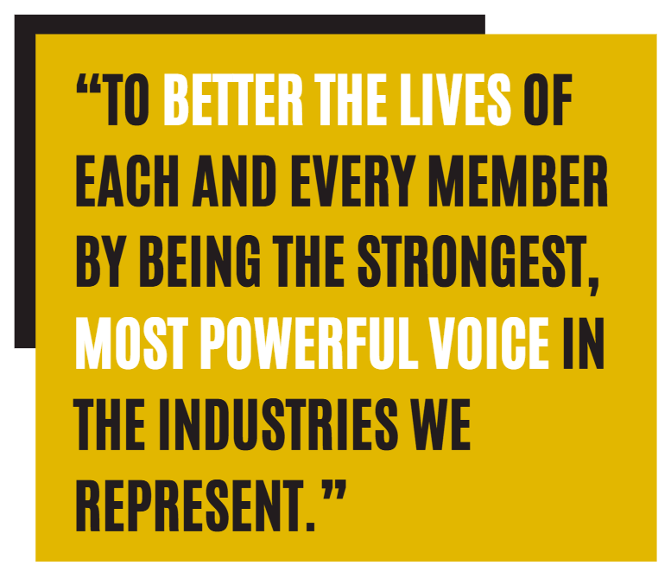
Our Mission
COR 1056 Building Union Power - Apprentices
Notes:
FACILITATOR NOTES:
SAY ‘This is our mission. To better the lives of each and every member by being the strongest, most powerful voice in the industries we represent. This is our mission. This is the key to our growth as a union.’

Slide 22
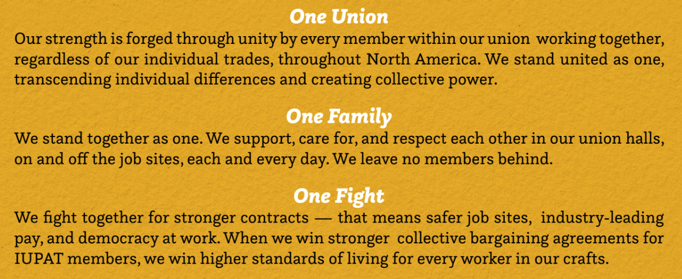
IUPAT Value Statement
COR 1056 Building Union Power - Apprentices
Notes:
FACILITATOR NOTES:
SAY ‘This value statement is how we achieve our mission.’
ASK - How many people have seen this phrase – “One Union, One Family, One Fight” in the last year or so?
SAY ‘This is more than a slogan. This is more than a phrase we used at our convention in 2024. These are the values that hold us together as a union, and they’re the values that help us meet the moment we are in now.’
DO: Read each value/or have three audience members take turns reading the values.
SAY ‘These values are incredibly important to the work that we are doing. So I want to spend some time on this.’
SAY ‘We are going to break up into groups and assign one of these values to each group. You have ten minutes to elect a group spokesperson to share out at the end. I want you to discuss what you can do tomorrow and every day moving forward to better advance these values in our union. What can you do at the job sites? What can you do in your local union?’
CONDUCT the following activity (10 mins):
Break the participants into groups. If the room is <30 people, do three groups. If the room is >30 people, break into six groups.
Assign more than one group to each value.
Bring everyone together and have each group share out (after 10 mins).
A co-facilitator should write some of the key ideas for each value on the flipchart.
SAY ‘Thank you for sharing all of that – these are amazing ideas, and we are going to take them and share them in other places. These values are so core to our ability to grow our union and be our strongest force.’

Slide 23



Member Empowerment
Ways Members Can Build Power within the Union
04
®
iFTI.edu
Notes:
FACILITATOR NOTES:
SAY the following statements:
That brings us to the final section of this training.
Let’s talk about member empowerment. Let’s talk about this campaign that we are launching.
Our goal here is to ensure that every member of the IUPAT recognizes the power of their voice in our union. I am not the union, your BMST is not the union, all of us together are the union.
We are doing these trainings to ensure that every member has the confidence, the skills, and the tools to take initiative and lead on our job sites and in our union.

Slide 24
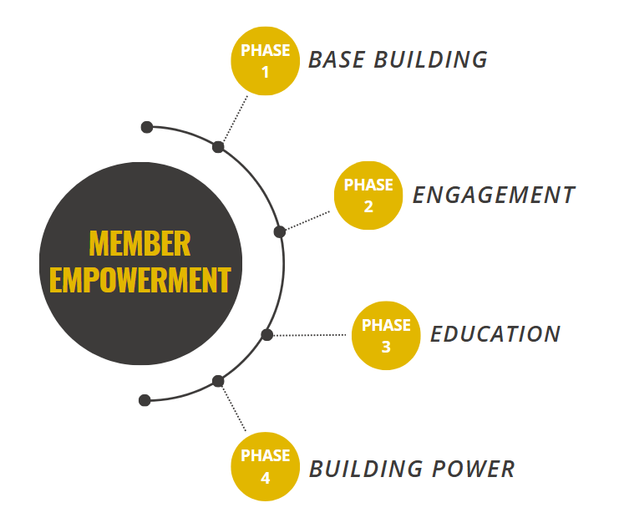
Member Empowerment: 4 Phases
COR 1056 Building Union Power - Apprentices
Notes:
FACILITATOR NOTES:
SAY the following statements:
This training fits into a bigger, broader campaign that is happening within our whole international union.
This is just the first step. And I want to preview for you what the rest of the campaign looks like.
This is about running a full organizing campaign within our union to make sure we live up to that mission and our values.
This is step one – base building.
But this is just the first step. We will be back here over and over again to talk to members at the jobsites and work through those values. We will be hitting jobsites and finding people at local meetings, and if we have to, we will go door to door.
And only then, after we’ve met our members exactly where they are, can we begin doing more education about some of the history we showed you before and some of the challenges we face.
And that is how we build power as a union. That’s how we negotiate better contracts. How do we pass better laws through city councils and the state legislature? We provide better training for anyone who wants it.
And I just want to emphasize that this is about all of us – every single one of us in this room – pulling our fair share.

Slide 25


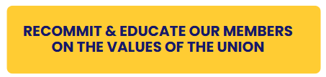
Phase 1: Base Building
COR 1056 Building Union Power - Apprentices
Notes:
FACILITATOR NOTES:
PHASE 1 - BASE BUILDING – It is recommitting our base and educating them on the values of the union.
ASK - Who is our base?
Elected Officers
Stewards
Apprentices
Activists
Delegates
ASK - How does each member contribute to the union’s success? Every member contributes by advocating for union rights, supporting fellow members, etc.

Slide 26





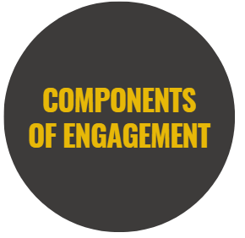

Phase 2: Engagement
COR 1056 Building Union Power - Apprentices
Notes:
FACILITATOR NOTES:
SAY ’And this is what we mean by engagement. There are three key things here.’
ASK - How do you engage members? DISCUSS the key components of engagement.
SAY the following statements about Two-way Communication:
It means that I am not just here to lecture at you, that I am listening to what you have to say.
It means that when you talk to your coworker at a jobsite next week, you are listening to what they have to say.
We are past the days when union leaders only tell our members what they have to do; we have to, as a union, do this together.
ASK - What does Inclusive Leadership mean? It means that when we share power, we multiply that power. It means that there is a spot for every person in this room at the table. Whether you are a first-year apprentice or you’ve been on your executive board for years, there is a role for you to play in leading this union.
SAY the following statements about Regular Interaction:
It means that the interaction between members and the union happens regularly.
It’s not about showing up at jobsites just when we need something.
It means that as a union, we are taking the initiative to get in front of members over and over again, and show we care by truly listening and engaging with each other.

Slide 27


Phase 2: Engagement - Membership Participation Check List
Commit to the values.
Live the values.
Share the values.
Be a leader on the job site.
Be a leader in your local union.
Participate in the union activities.
COR 1056 Building Union Power - Apprentices
Notes:
FACILITATOR NOTES:
DISCUSS commitment to values, living and sharing the values.
HIGHLIGHT commitment – Commitment is not just about showing up—it's about belief in the cause, dedication to the union's mission, and willingness to act when needed.
IDENTIFY the factors that drive commitment: Shared purpose, strong leadership, trust, and sense of belonging.
ASK- How can you be a leader on the jobsite? In your local union?
EXPLAIN the difference between activism and engagement: Activism is a more intense, action-oriented form of engagement.
Activism involves taking action—rallies, strikes, petitions, and other activities that push the union's agenda and bring about positive change.
DEVELOP an action plan: Each participant will write down 2-3 ACTIONS they will take in the next month to help activate more members and build power within the union. Participants will share their plans in small groups and offer suggestions for improvement. Possible answers: Attend your union meetings. Show up and participate. Make house calls to workers/union and non–union. Participate in rallies, demonstrations, and mass meetings. Attend a school board and/or city council meeting. Become a Mentor to a member.

Slide 28
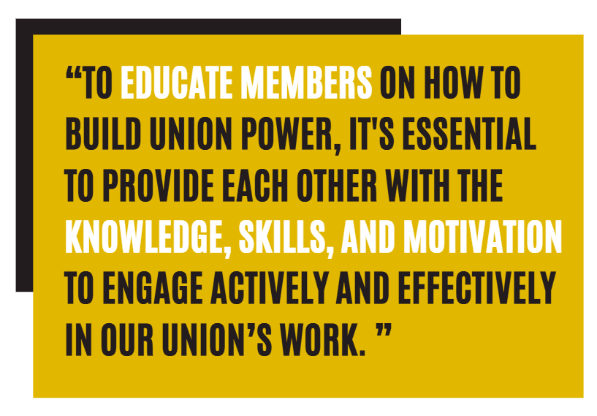
Phase 3: Education
COR 1056 Building Union Power - Apprentices
Notes:
FACILITATOR NOTES:
HIGHLIGHT the importance of training, and having the right knowledge and skillset. EMPHASIZE that we empower members with skills and tools.
ASK - What are the different ways to educate members?
DISCUSS the two important skills of a union leader – Active Listening and Dealing with Difficult Conversations.
STATE that the following slides will briefly cover key skills and strategies for improvement.

Slide 29
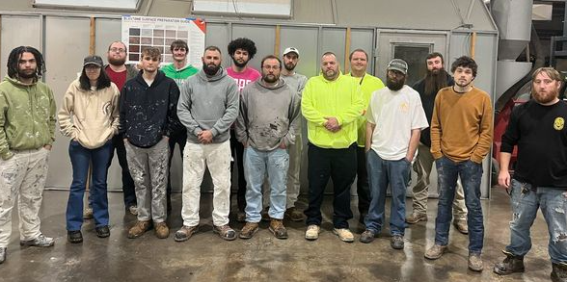
Why Apprentices Matter
You are the FUTURE of our Union.
You REPRESENT our Union at the jobsite.
You bring a FRESH PERSPECTIVE.
COR 1056 Building Union Power - Apprentices
Notes:
FACILITATOR NOTES:
EMPOWER our apprentices. Honor their role in our union. Feel free to add a personal message to make apprentices feel they are part of our union.
UPLIFT our apprentices by recognizing their vital role in shaping the future of our union. The following messages are key to making them feel seen, heard, and inspired to take part:
You are the future of our Union. As emerging leaders and forward-thinking workers, your energy, voice, and engagement are crucial to our survival and the growth of our market share. You’re not just part of the future—you’re essential to the present.
You represent our Union at the jobsites. Every time you show up for work, you carry the pride and responsibility of representing not only yourself but the entire Union family.
You bring a fresh perspective. Your tech-savviness and unique perspective challenge our old ideas and strategies. This helps our union grow with the changing times. By sharing your ideas and reimagining traditions, you also help leaders to evolve and adapt.
DISCUSS the potential for personal growth as well. Maybe yesterday and today, you were just taping baseboards or laying vinyl. But tomorrow? You’ll be running the job, leading crews, and mentoring the next generation. Every task you do now is building the skills you’ll need to lead later. Mentors/mentees, focus on the importance of 2-way mutual learning, and how productive and cohesive job sites can be if journeyworkers and apprentices learn from each other.

Slide 30
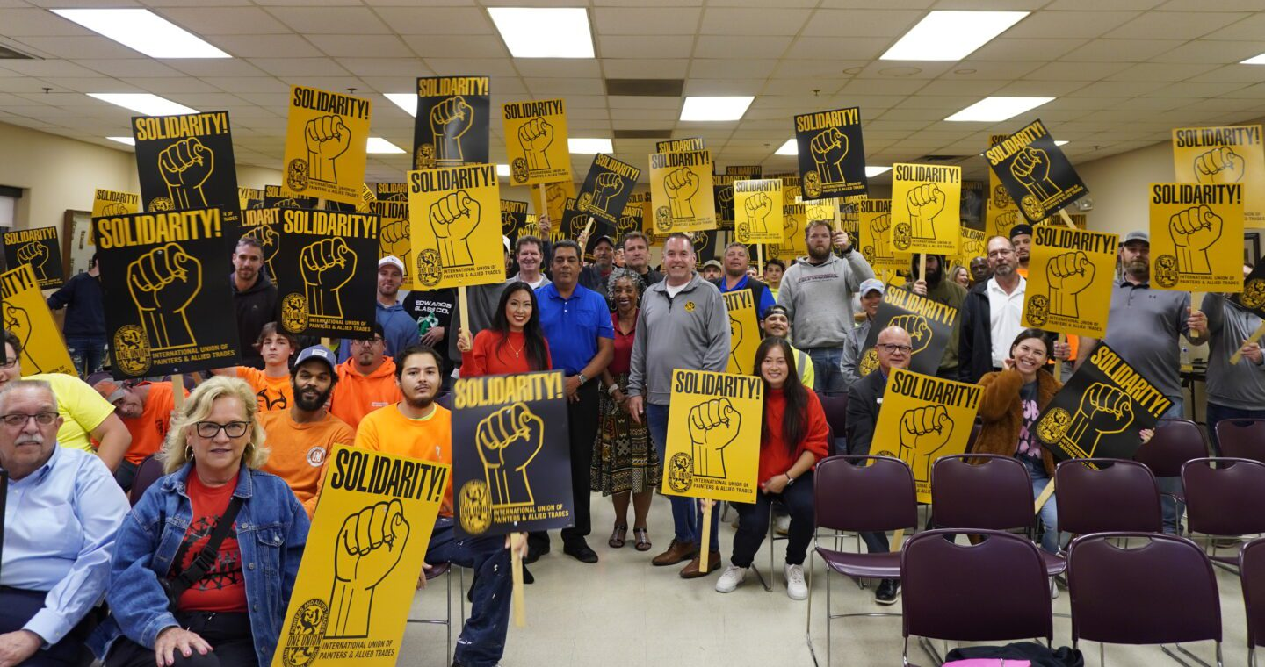
What Does it Mean to be in a Union?
Showing up, working safely, and bringing skill to every job.
Having each other’s backs—taking care of your brothers & sisters.
Looking out for one another, because we’re stronger together.
COR 1056 Building Union Power - Apprentices
Notes:
FACILITATOR NOTES:
ASK- What does it mean to be in a Union? It means showing up, working safely, and bringing skill to every job. It means having each other’s backs—taking care of your brothers and sisters on and off the job. It means looking out for one another, because we’re stronger together.
PROVIDE examples of basic solidarity on the jobsite or how Union members take care of each other.
Example 1: Overtime is offered, but not available for all workers on the job. I’ve personally seen members turn it down, to make sure workers who needed it a little bit more (buying a home, just had a child) have the opportunity. Being unselfish, feel free to give your example.
Example 2: Behavioral health issues, confiding in a coworker, giving direction, and proper resources.
Example 3: Standing up for someone, no matter their race, gender, or religion, for what is right.
ASK participants what they’ve been seeing/hearing, positive or negative.

Slide 31

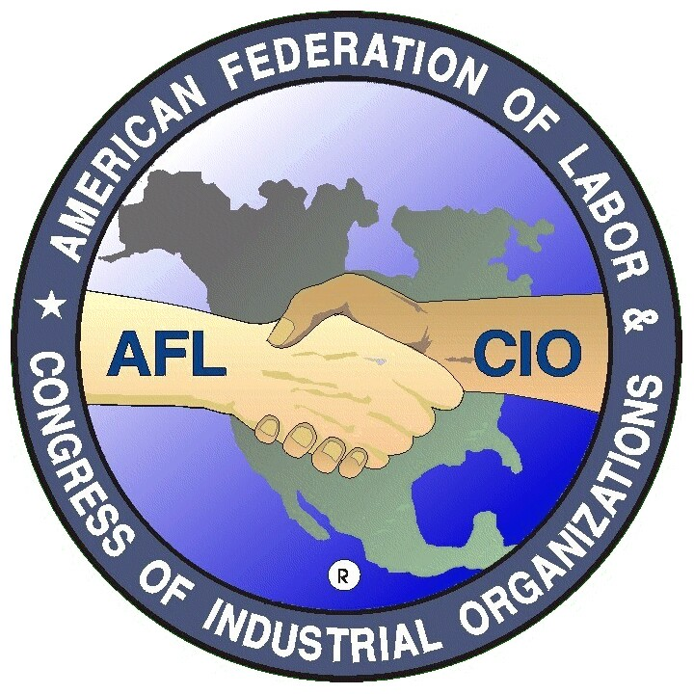

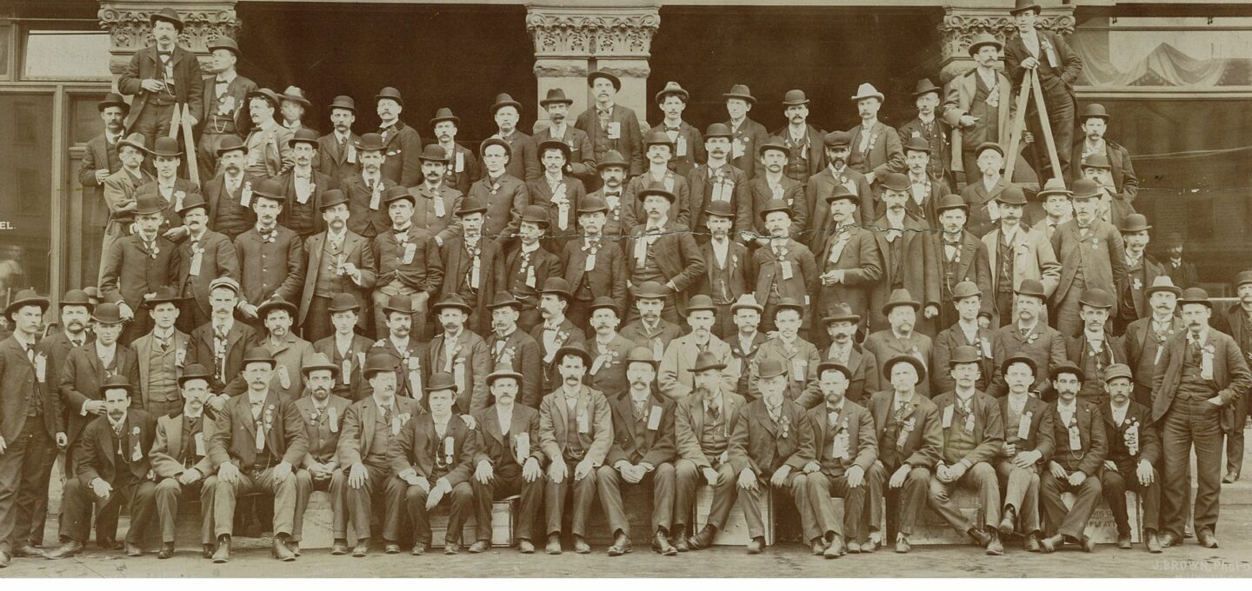
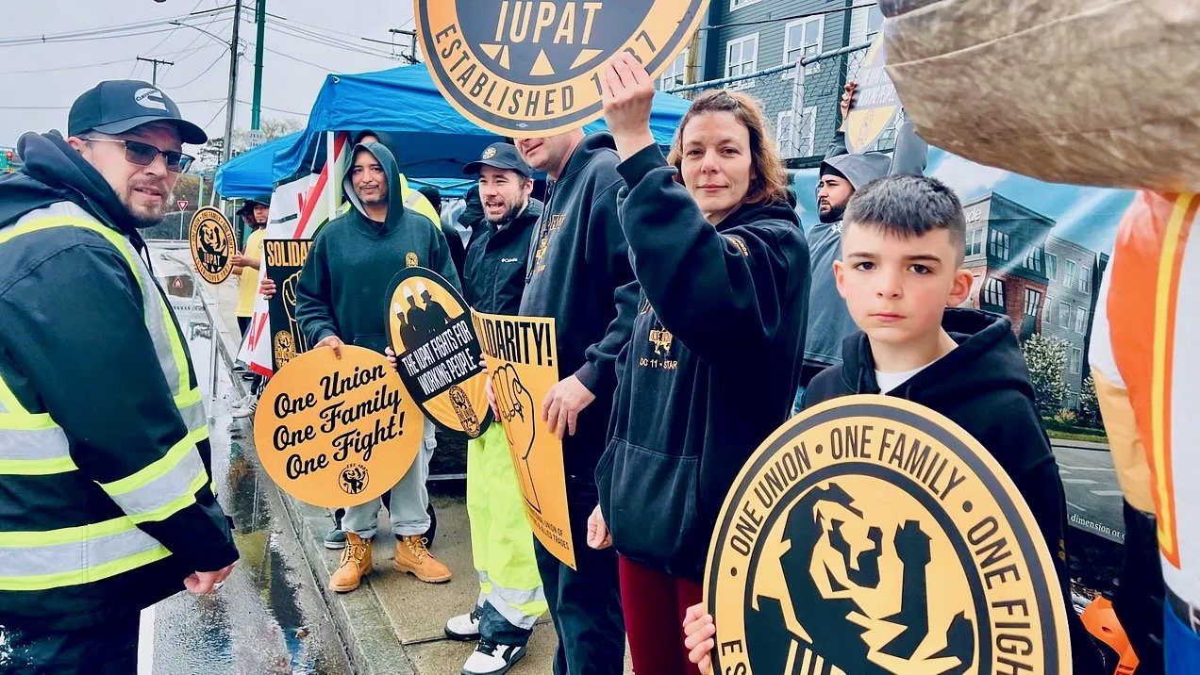
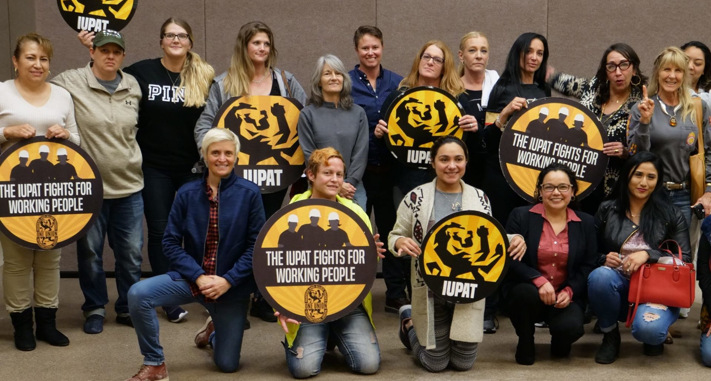
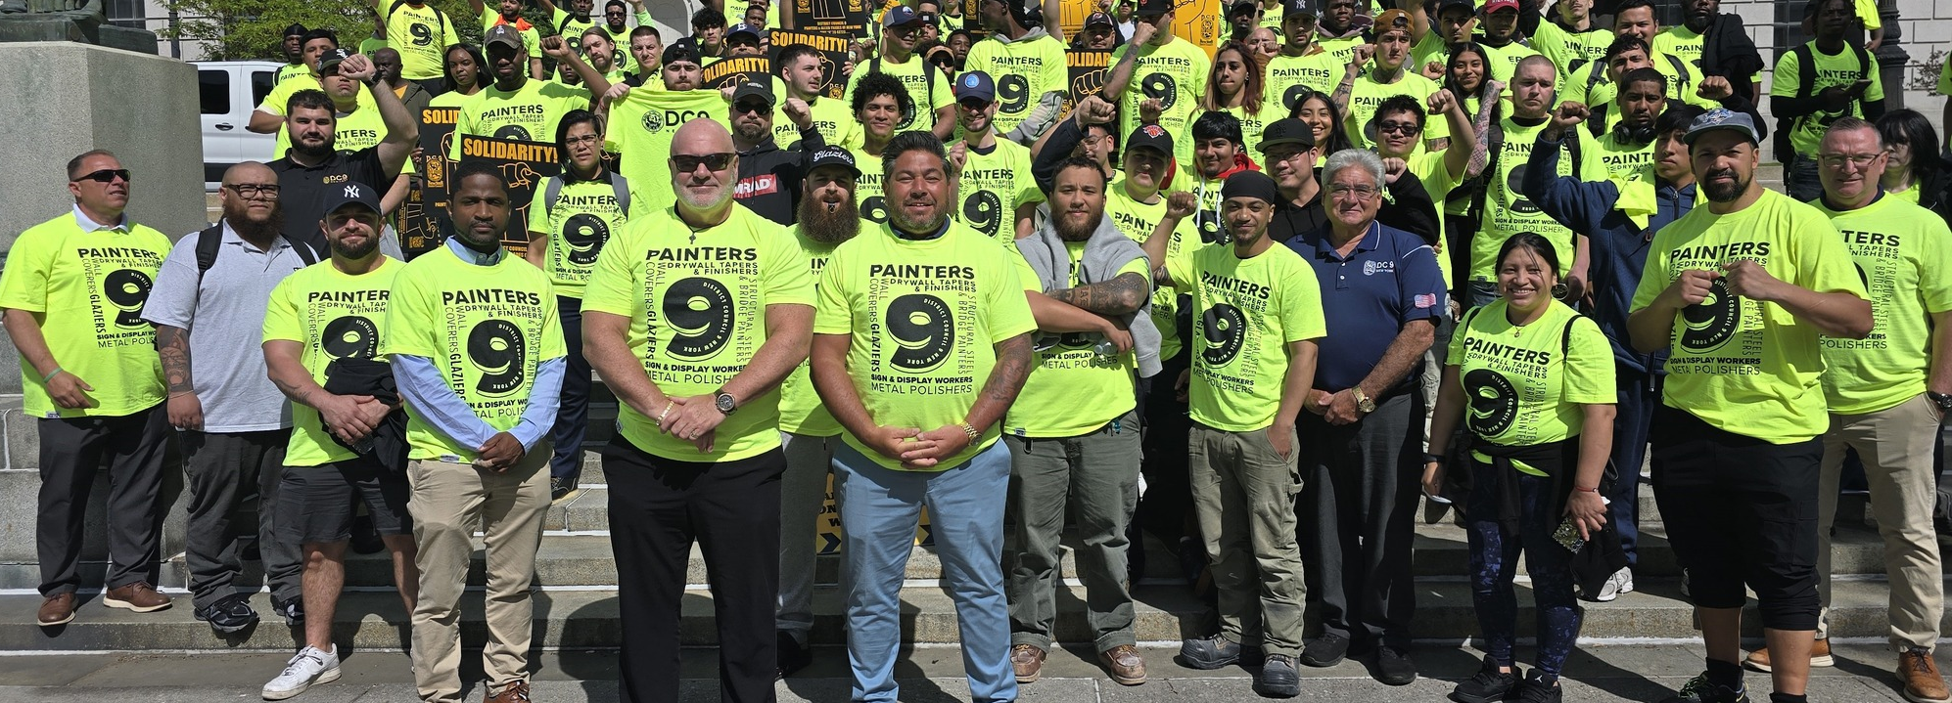
Labor Movement
You’re part of a powerful movement-the Labor Movement!
COR 1056 Building Union Power - Apprentices
Notes:
FACILITATOR NOTES:
Get Apprentices Fired Up-They’re Not Just Here for a Job
STATE the following messages:
Even if the work feels repetitive or routine right now, you’re part of something much bigger than just today’s task, and that’s something to be proud of.
You are part of your Local Union, your DC, the IUPAT, NABTU, and AFL-CIO, which represents 13 million union members across the country who are building hospitals, bridges, growing communities, all while raising the standard of living for workers!
The labor movement is bigger than just a jobsite; it’s about solidarity, progress, and power, and you play a huge role in that movement.
You’re building a future, not just for yourself, but for the next generation. You have the chance to make a difference, create real opportunities, and leave your mark. This is more than a job. This is your movement.

Slide 32
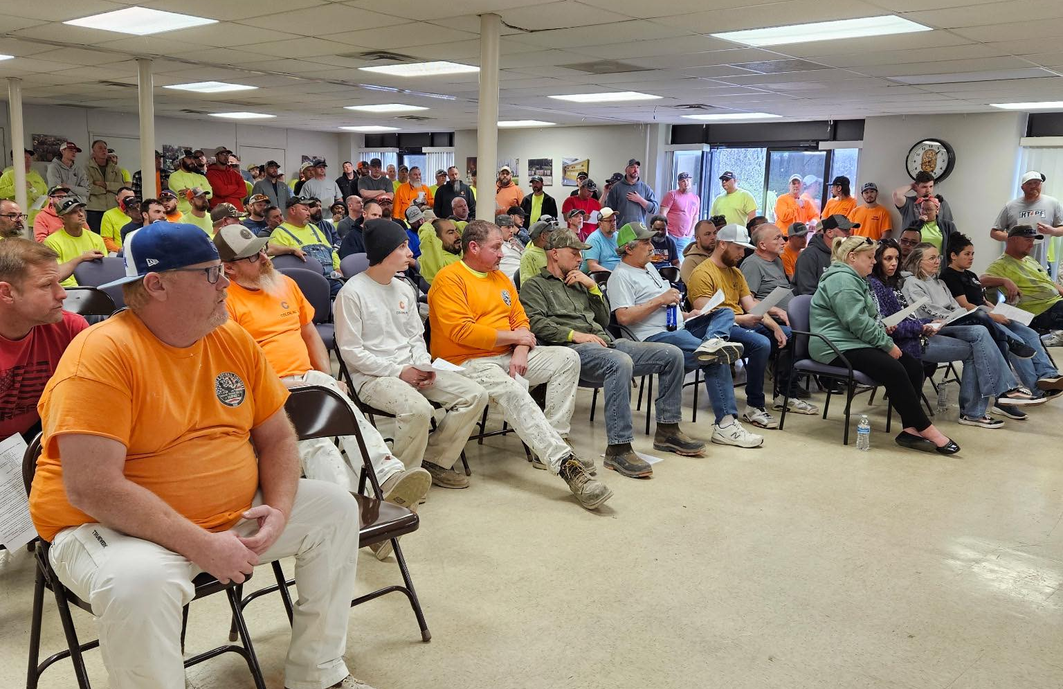
Union Rights
What is a Collective Bargaining Agreement (CBA)?
It is our power in writing.
Nothing is handed to us—everything we have comes from bargaining.
Our CBA reflects generations of struggle.
Members of LU2012 on the ratification of their historic Collective Bargaining Agreement between the Members and Contractors of Kansas City
COR 1056 Building Union Power - Apprentices
Notes:
FACILITATOR NOTES:
ASK – What is a Collective Bargaining Agreement (CBA)? It is a legal agreement that locks in our wages, benefits, rights, and working conditions.
Without it, employers can change the rules whenever they want. The contract is the only thing that protects and enforces these rights.
EXPLAIN the following points:
The CBA is our power in writing. The union contract is our foundation–without it, we’re just workers. With it, we’re a collective force.
If it’s not in the contract, it’s not protected.
Nothing is handed to us—everything we have comes from bargaining. Our wages, benefits, and pensions aren’t gifts from employers—they exist because we fought for them together. That’s the power of the union.
Our CBA reflects generations of struggle. It was fought for, negotiated, and won by Union members throughout history, sometimes with strikes. We’re benefiting from those who came before us, and fought for strong contracts, and we’re a part of the present and future contracts. It’s up to us, it’s our responsibility, as active union members. SITE examples by using notable strikes, locally if possible, or if not, include Auto Workers in the 30s, Sanitation in Tennessee, MLK, etc. Tie in our Union Values.
CREATE a parking lot to capture and address outstanding needs after the PowerPoint presentation.​

Slide 33
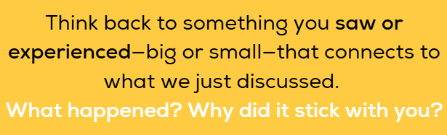
Apprentice Workshop
COR 1056 Building Union Power - Apprentices
Notes:
FACILITATOR NOTES:
STATE that we want to hear from apprentices.
ASK - Have you seen anything—good or bad—that connects to what we just talked about? What stood out to you, and why? Share your thoughts.
CONDUCT a group activity (5–7 minutes):
In small groups of 3–4, have apprentices share their examples.
Discuss: How does it connect to the training? How it impacted them or others. What could be learned from it?
Encourage respectful listening and letting each person speak.
Invite volunteers to share some of the more powerful or eye-opening examples with the whole group.
Capture a few key themes or takeaways on the board or flip chart.

Slide 34

Phase 4: Building Power
Union Power comes from the strength of engaged and committed members who unite and speak with one voice.
The more involved, informed, and unified we are, the stronger our union becomes, giving us the power to drive meaningful change.
Strength is found in the solidarity of our union’s members.
COR 1056 Building Union Power - Apprentices
Notes:
FACILITATOR NOTES:
ASK - What does building power look like? Power is Strength in numbers: Especially during strikes, ratification votes, and contract enforcement.
ASK - Why is power important for the union? How does a strong, united union make a difference in contract negotiations, workplace safety, and member well-being?
SHARE history and examples of union victories where collective action played a key role. How solidarity ensures better negotiation power, fair treatment, and job security.
EMPHASIZE the Power of One Union: Strength lies in collective action—engaged and committed members who actively participate are the union’s power.
The goal of this training is to help union members recognize their individual power, the importance of collective strength, and how to work together toward common goals.
GROUP ACTIVITY: Action Planning for Building Power (10 minutes): Participants will create an action plan that incorporates:
1. How they will engage with fellow members to build unity.
2. How they will commit to advancing union efforts.
3. One specific activism action they will take to support the union’s mission.
Participants pair up to share their action plans and provide feedback.
REINFORCE that power isn’t about telling members what to do, but about building strength from the top down and bottom up.

Slide 35

Summary
iFTI.edu
The future of OUR Union is in OUR hands.
Membership participation is CRITICAL.
The value statement of One Union, One Family, One Fight is the foundation for building a united and powerful union.
OUR Union is only as Strong as OUR Members.
Notes:
FACILITATOR NOTES:
ASK participants to share their learnings from the course. What specific way can you contribute to strengthening the union and fostering solidarity?
STATE your personal commitments to the union.
REFLECT on how each member can embody the values of “One Union, One Family, One Fight” in their daily actions.
EMPHASIZE that building the power within begins with the understanding that we are stronger together. Our value statement "One Union, One Family, One Fight" serves as a reminder that our strength, rooted in trust, respect, and shared purpose, is the key to achieving lasting change and improving the lives of all members. Each member’s contribution matters—when we work as one, we can achieve great things.

Slide 36
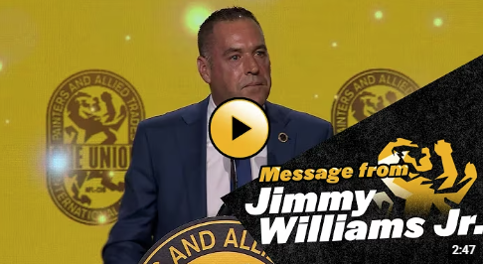
GP’s Message
COR 1056 Building Union Power - Apprentices
Notes:
FACILITATOR NOTES:
PLAY GP’s video - https://www.youtube.com/embed/fsyFzognFm0​ (linked on slide and will launch a new page)
​CREATE a parking lot to capture and address outstanding needs after the PowerPoint presentation.​

Slide 37

Questions or Comments?
Contact Information
Support@iupat.org
International Union of Painters and Allied Trades
7234 Parkway Drive
Hanover, MD 21076
http://www.iupat.org
ONE UNION. ONE FAMILY. ONE FIGHT!
iFTI.edu
Notes:
FACILITATOR NOTES:
ASK for any remaining questions or comments.
PROVIDE participants with a list of upcoming union events, meetings, trainings, and opportunities.
THANK participants for their time and commitment to strengthening the union. Encourage them to stay active, engage with their fellow members, and continue fighting for a better future for all workers.

